Slide 1
Subsea Controls
Kimberlite Report 2025 Results
Key Highlights, Market Outlook, Performance, Customer Quotes​
Marketing & Communications May 2025

Slide 2
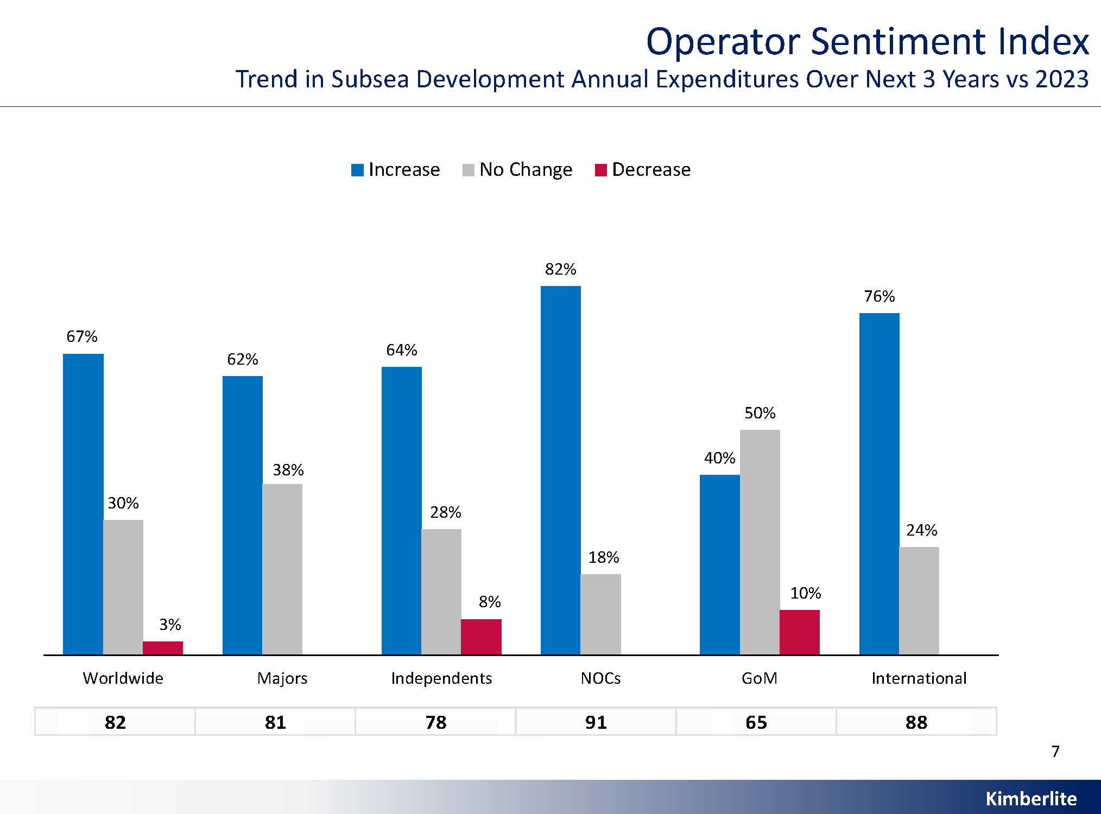
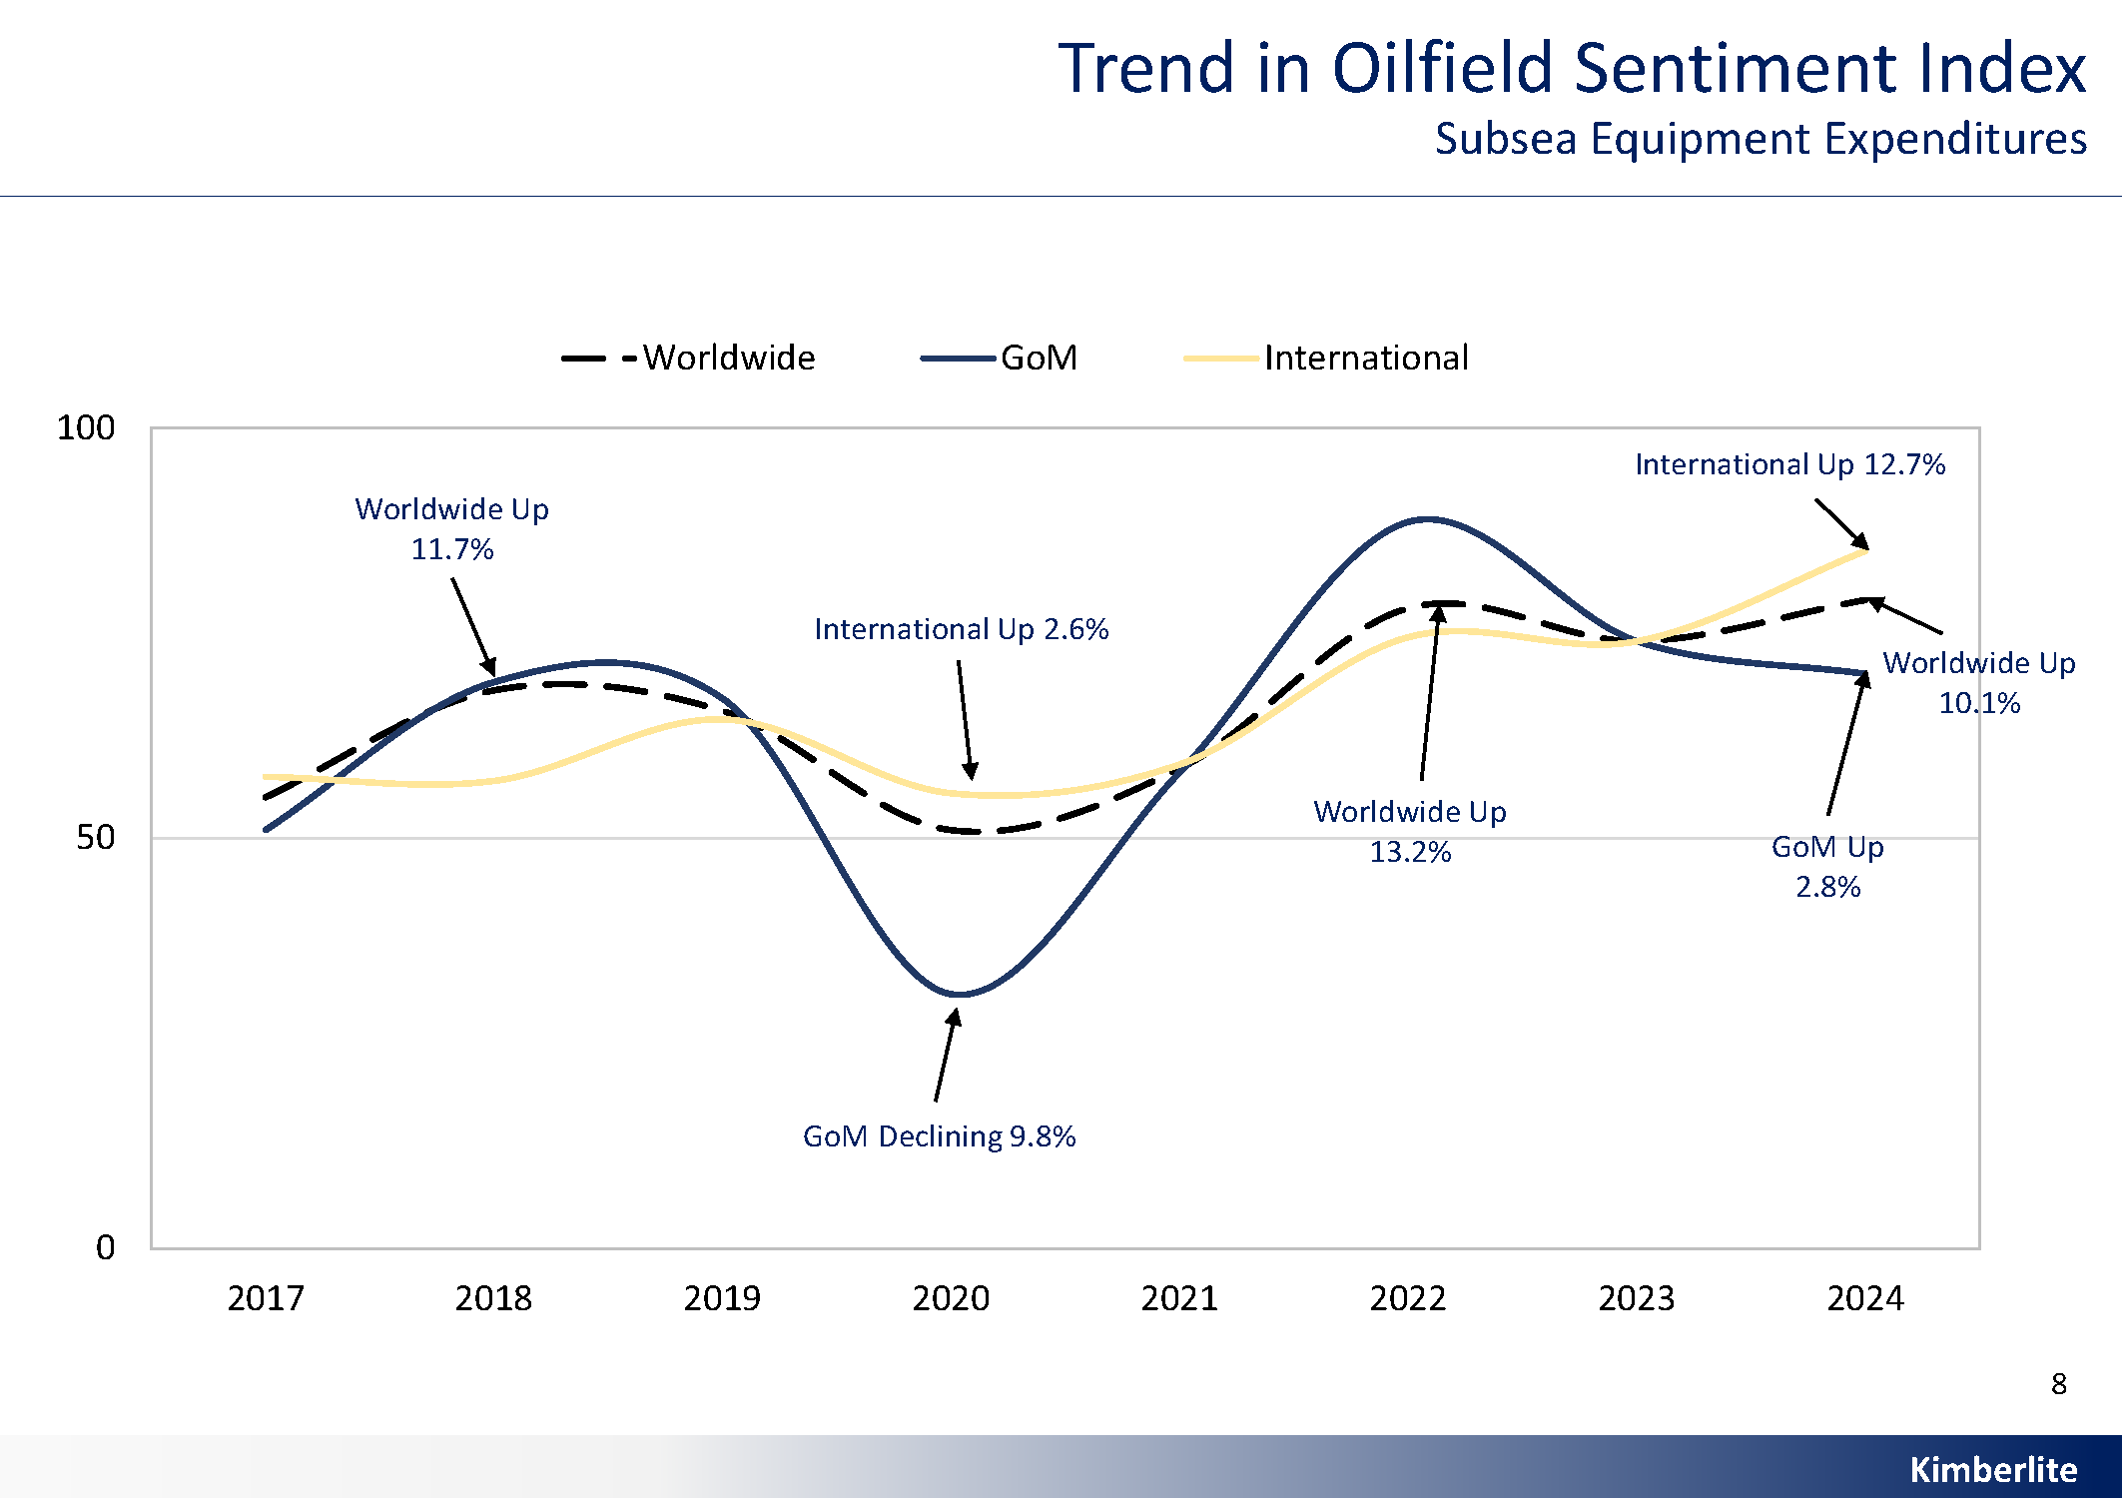
Market Growth Outlook
Market Sentiment
67% of respondents expect global subsea equipment spending to increase
Projected global market growth: +10.1% YoY over the next 3 years
International markets lead with +12.7% YoY growth, while Gulf of Mexico sees modest +2.8% growth

Slide 3
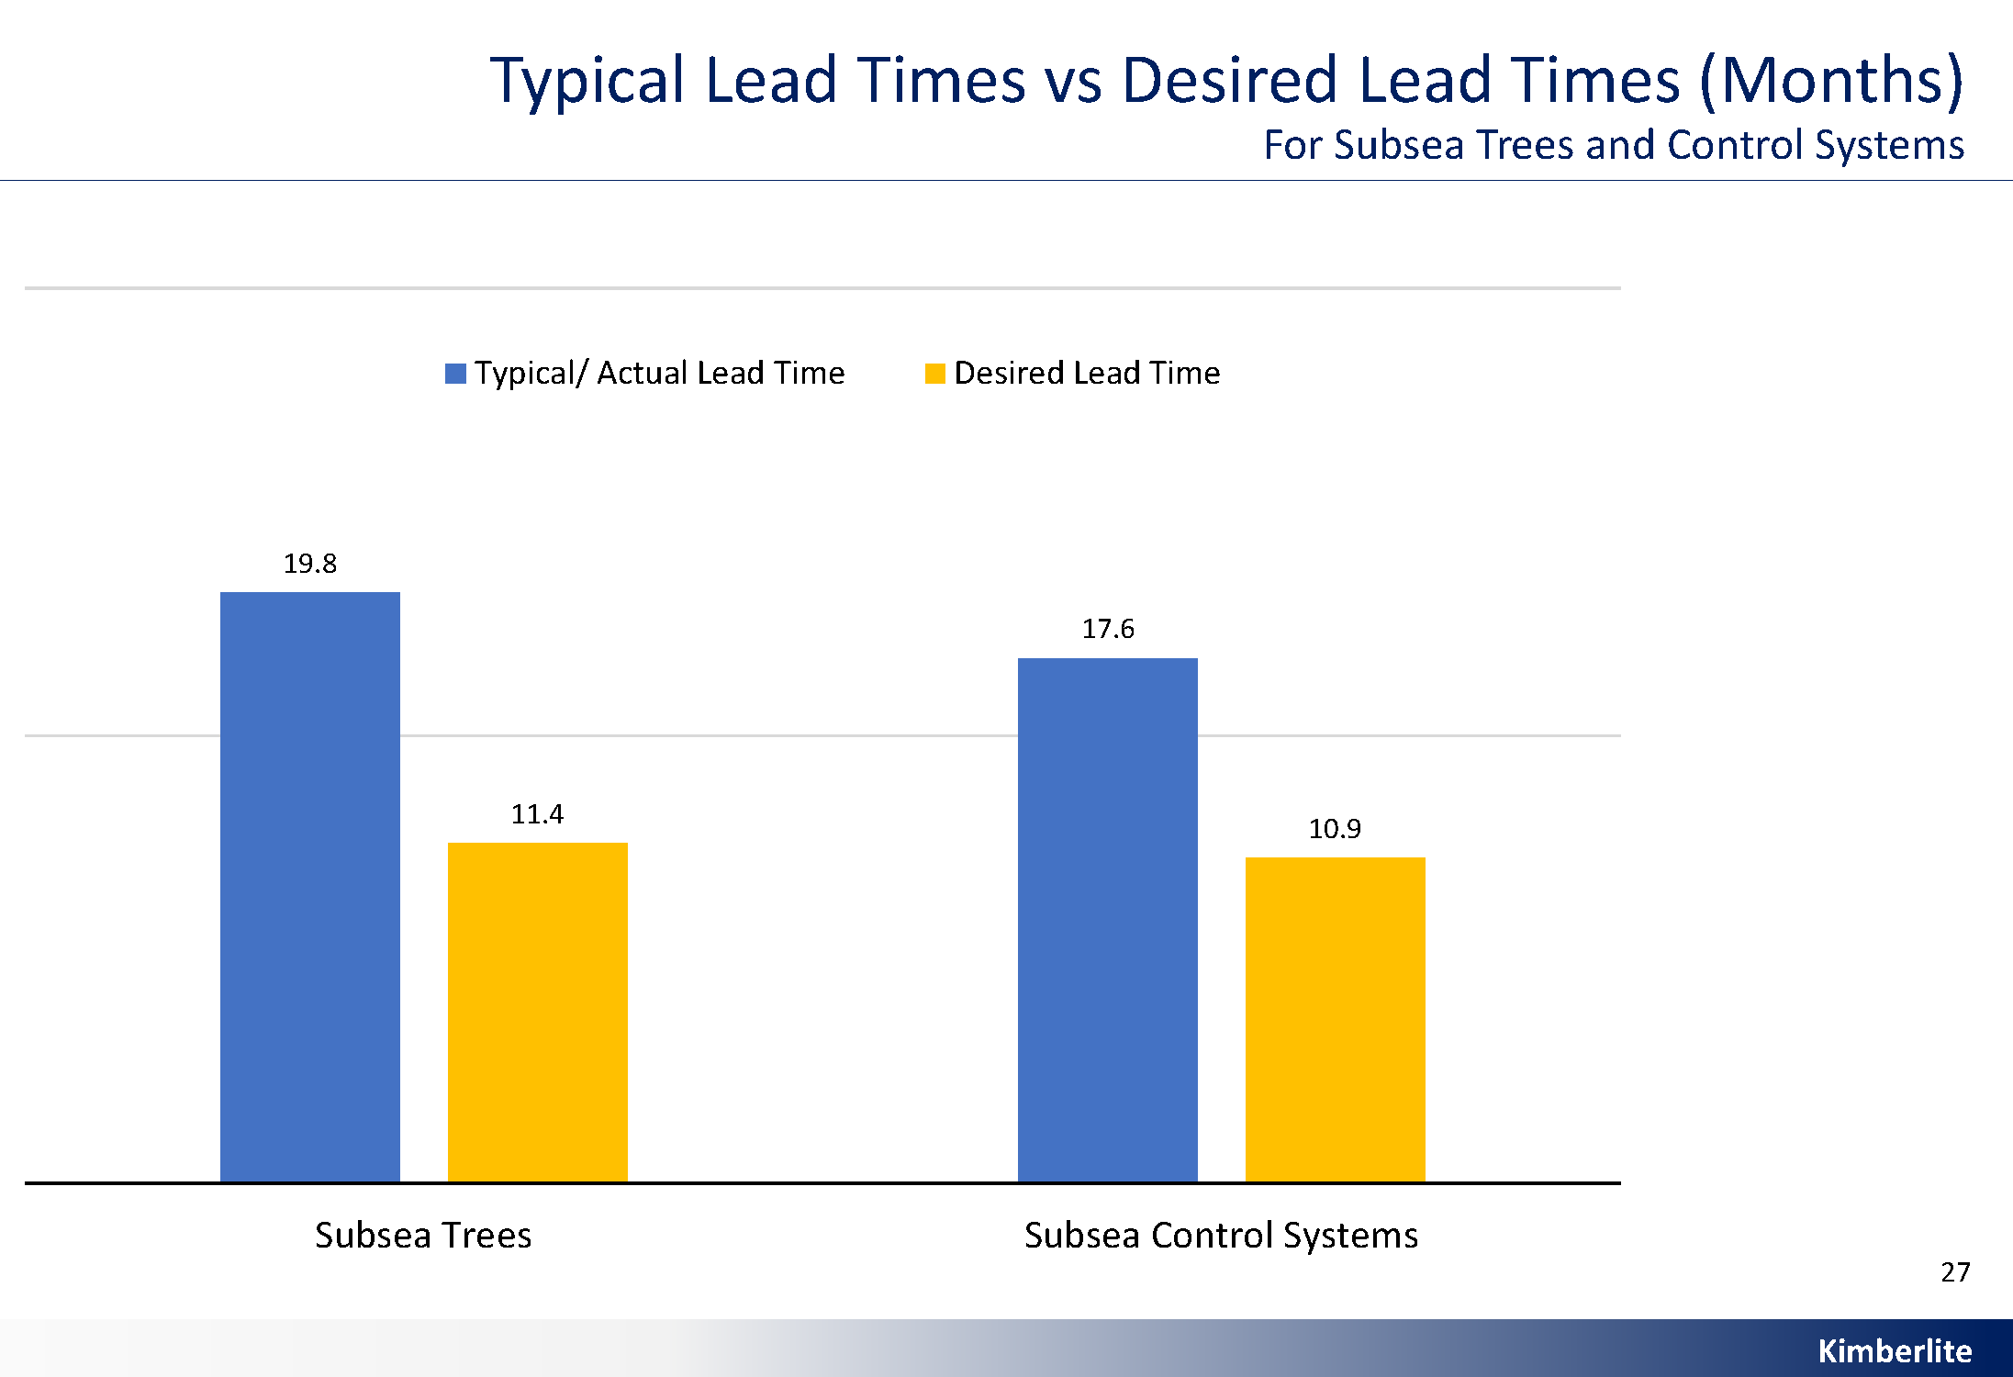
Lead Time Advantage – Proserv’s Differentiator
Market Sentiment
Industry Challenge:
Current global lead times: Subsea trees ~20 months, control systems ~18 months
Desired industry lead times: ~11 months
Proserv’s Advantage:
Proserv delivers subsea control systems in just 10.9 months, meeting industry expectations.
Proserv’s agility and delivery speed position it as a responsive and reliable partner amid tightening supply chain dynamics

Slide 4
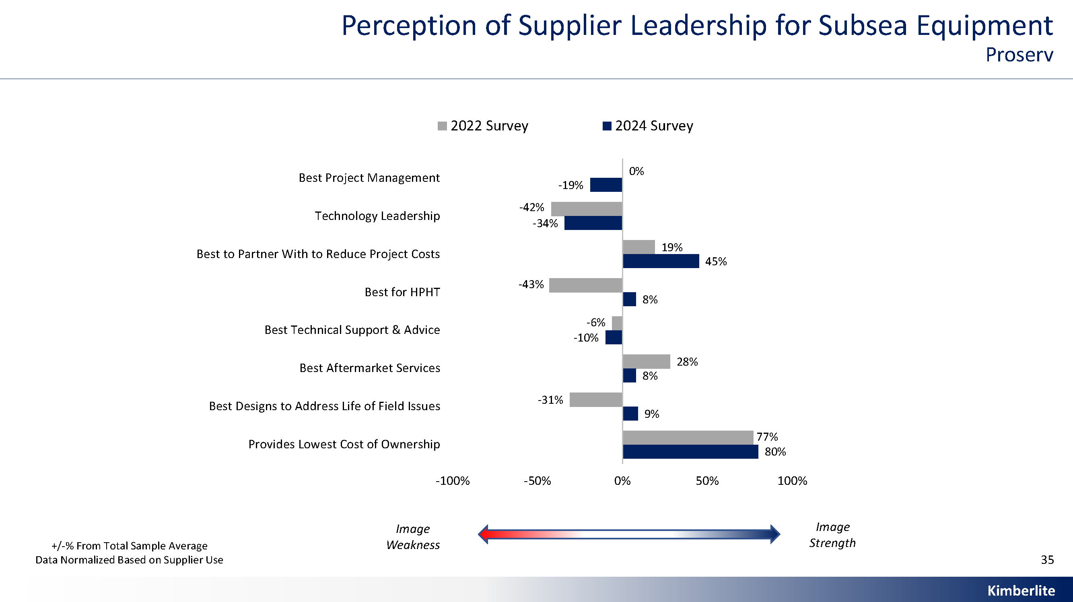
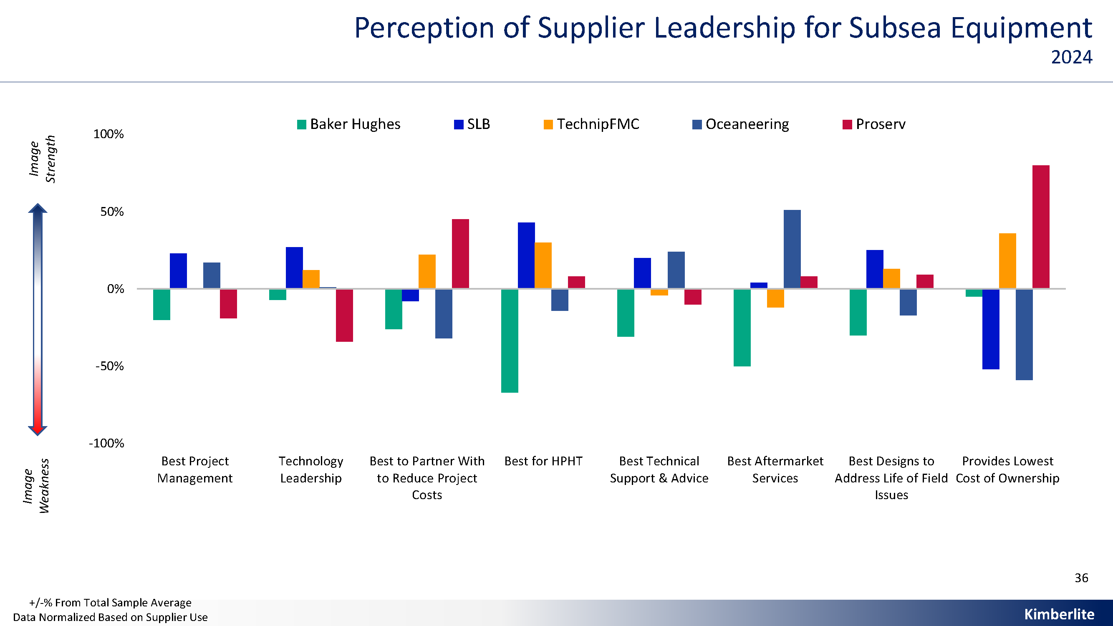
Perception of Supplier Leadership for Subsea Equipment
Market Sentiment
The subsea sector is shifting toward more integrated and technology-driven solutions
Larger competitors lead in project management and technology leadership, whilst Proserv is gaining recognition as a key player in subsea control systems
These trends signal an industry that increasingly values specialised expertise, responsiveness, and technologically advanced solutions – areas where Proserv is gaining traction

Slide 5
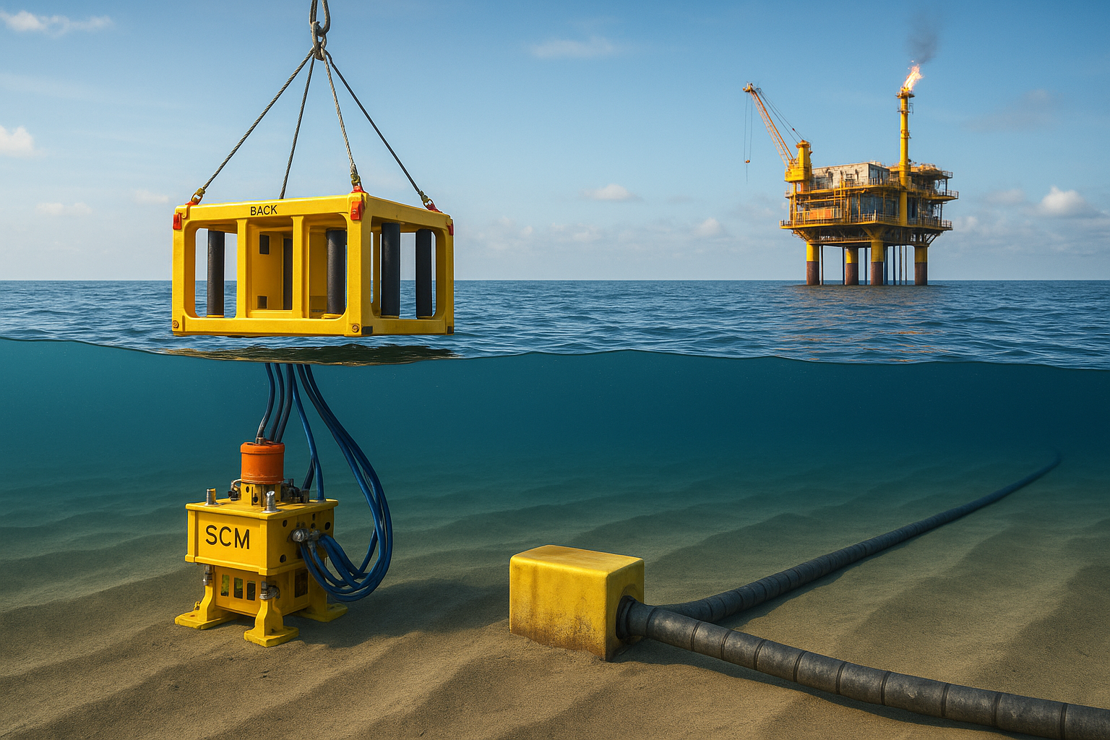
Key Performance Drivers
Subsea Tree Market
Customer Priorities
Aftermarket services, technical support and quick responsiveness are top factors influencing customer loyalty and satisfaction
Market Trends
Suppliers that align well with customer expectations in performance and support are rewarded with stronger market positioning
Premium offerings often come at a higher cost but are valued for quality and reliability
Emerging competitors are gaining traction by improving availability and offering cost-effective alternatives
There is an increasing focus on enhancing customer satisfaction, especially in international markets

Slide 6
What do Operators want
Market Sentiment
“
“More automated and remote operations. The trees having the computational capability to function through the use of AI and machine learning.”
Major, GOM / Guyana-Suriname
“More use of electric control systems, smart solutions and advanced processing systems.”
National Oil Co, West Africa
“We need to incorporate software with advanced AI engineering technologies and ML algorithms to estimate the mean time between failure.”
Major, SE Asia
“Local availability and capability for repairs and refurbishments to reduce downtime.”
Major, West Africa
“

Slide 7
Proserv’s Rating in the Market

Slide 8
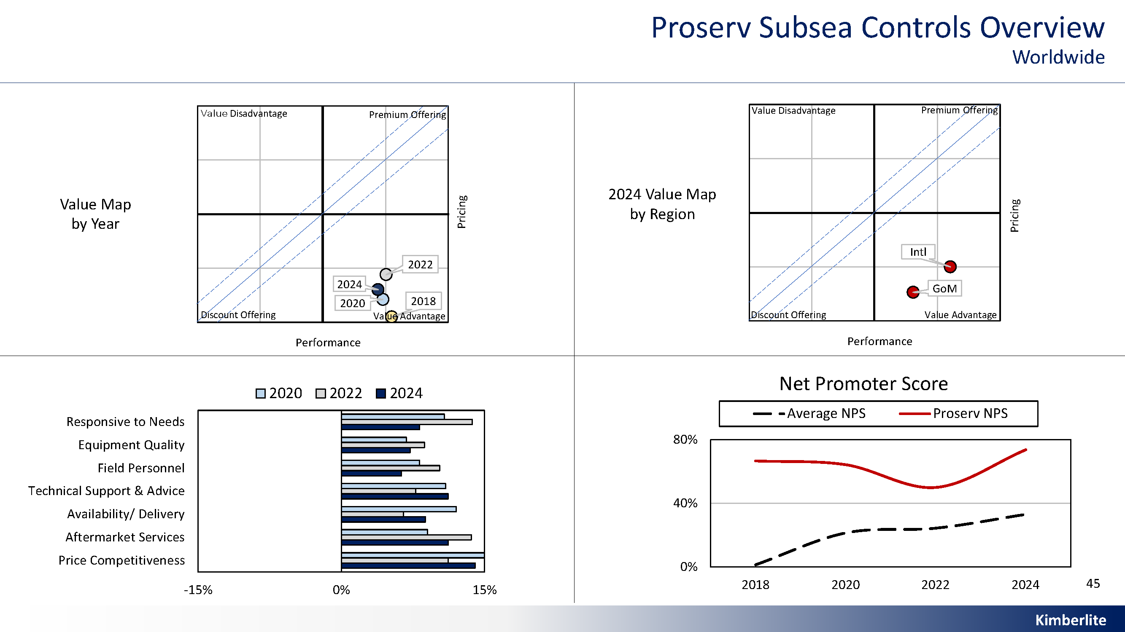
Leading Performance in Subsea Controls
Performance
Outstanding Performance & Value
Proserv is recognised for reliability, innovative technology, responsive aftermarket support and competitive pricing
Industry-leading Customer Loyalty
Proserv achieved a Net Promoter Score of 74% in subsea controls – more than double the industry average of 33
Trusted Industry Brand
Proserv demonstrated consistent delivery and technical excellence solidifying Proserv’s reputation as a leader in subsea controls

Slide 9
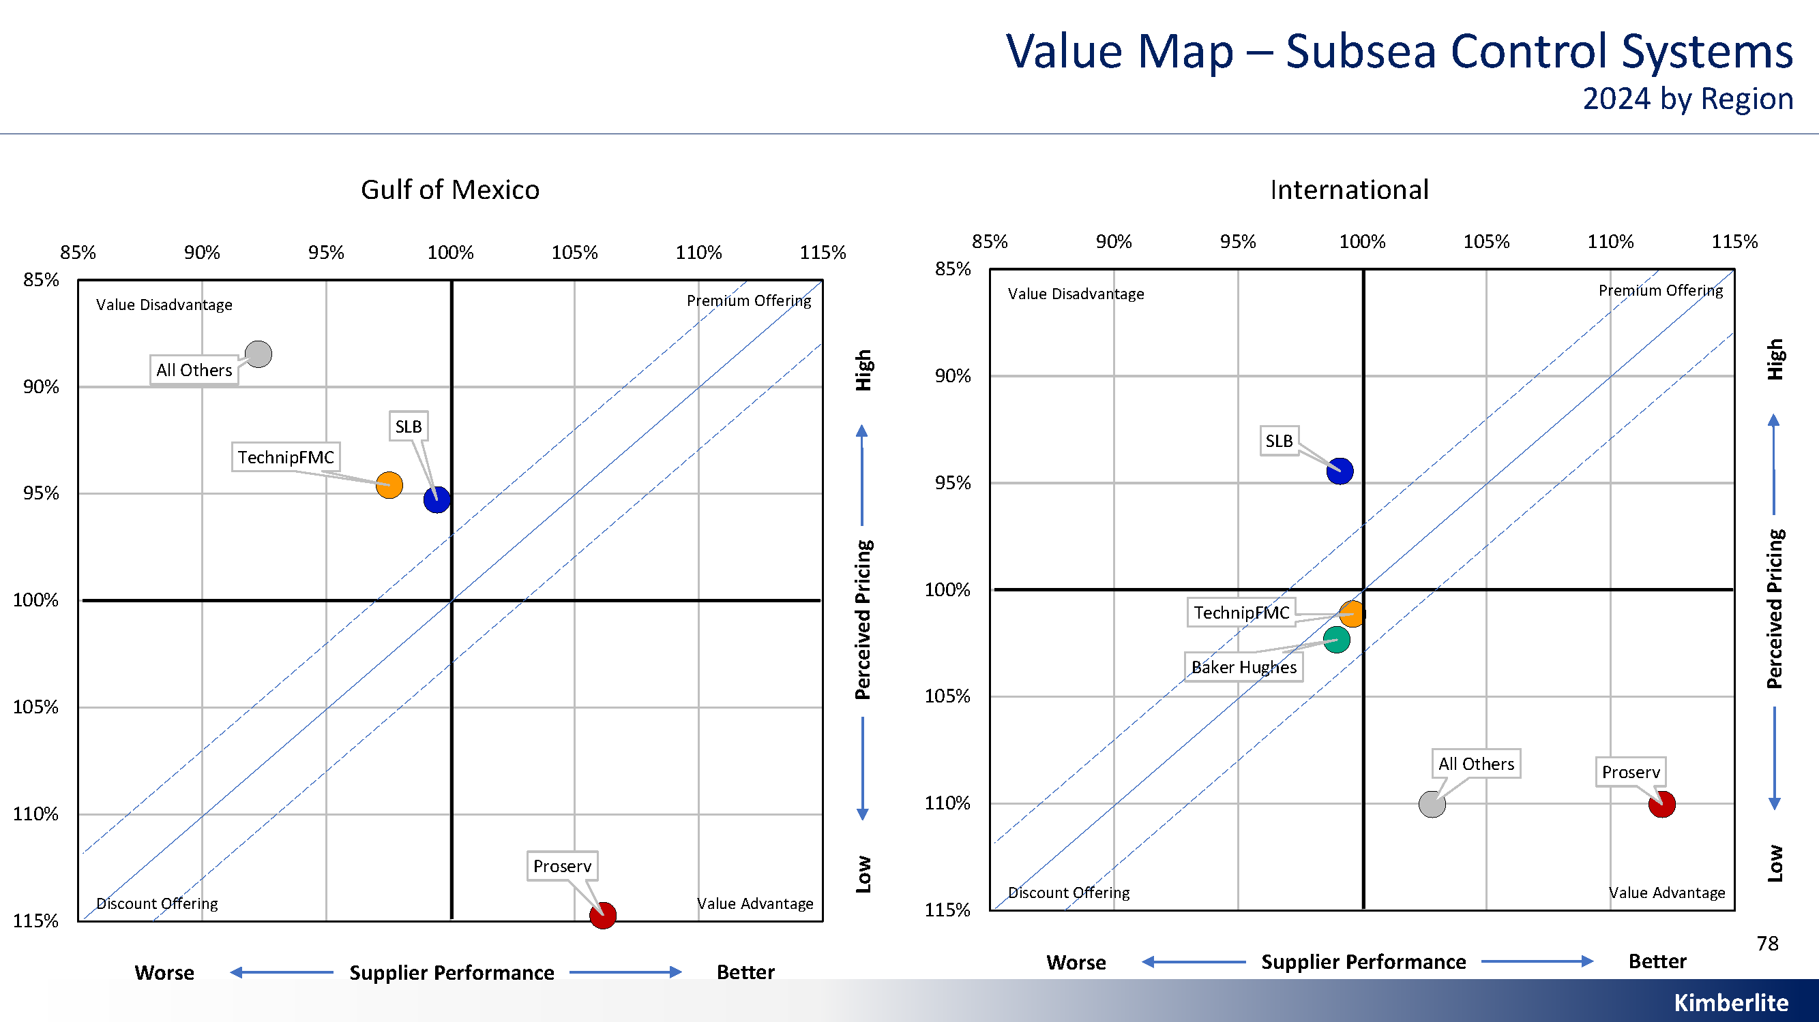
Proserv – Performance & Value Leader in Subsea Controls
Performance
Proserv stands out as the top performer in both value and service quality, earning strong client approval for its combination of technical excellence and competitive pricing.
While other major players like SLB, TechnipFMC, and Baker Hughes have their own strengths.
Proserv’s balance of cost-efficiency and performance sets it apart in the market.

Slide 10
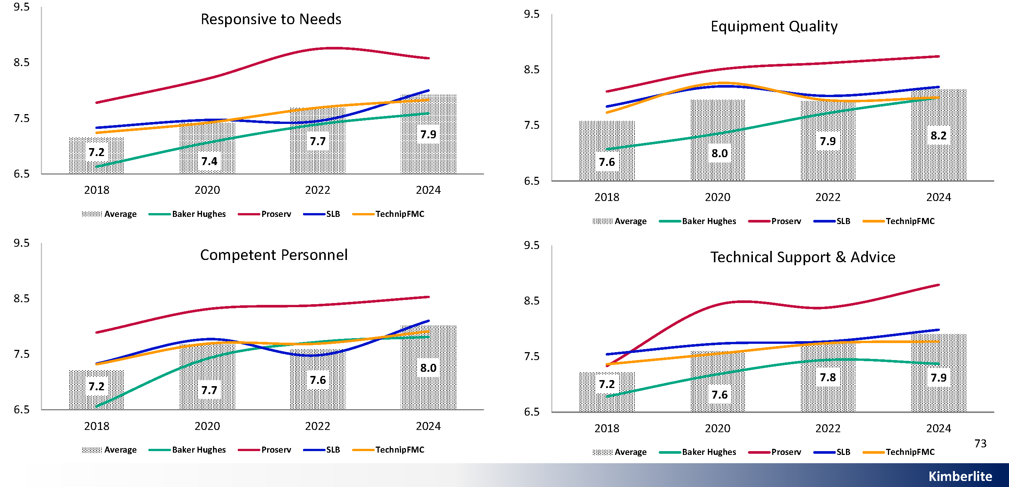
Subsea Control Systems
Performance Trends
What Operators Say
About Proserv
Best customer service, always helpful
Strong technical support, early engagement
Customised solutions
Aftermarket service exceeds expectations
Solutions extend asset life effectively
Cost-effective

Slide 11
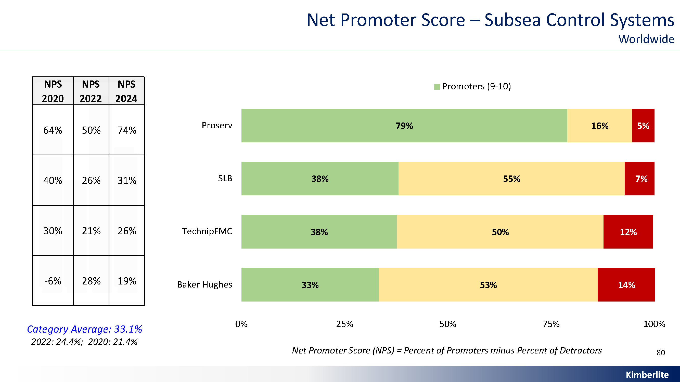
Net Promoter Score
Proserv Analysis
Operators’ Net Promoter Scores (NPS) highlight that Proserv consistently delivers a better experience in project execution and life-of-field support, as reflected across a significant number of subsea control system projects.
Proserv leads the industry in NPS for subsea controls—74%, compared to an industry average of 33%.

Slide 12
What Proserv does well and what Proserv needs to improve
Operator Image of Proserv
Key Strengths Highlighted
“Very customer focused and eager to work with clients.”
“Technical competence, collaboration, and controls system reliability.”
“Customized approach and brownfield solutions.”
“Experienced field engineers with good knowledge.”
“One of the best suppliers we’ve used.”
Areas Operators Flagged for Improvement
“Reduce lead time for equipment.”
“Small company – concerns about longevity.”
“Struggles with limited resources.”
“Lack of scale with large operators.”
“Take ownership of product reliability.”
“Ensure strong execution and accurate estimates.”

Slide 13
The Future of Controls

Slide 14

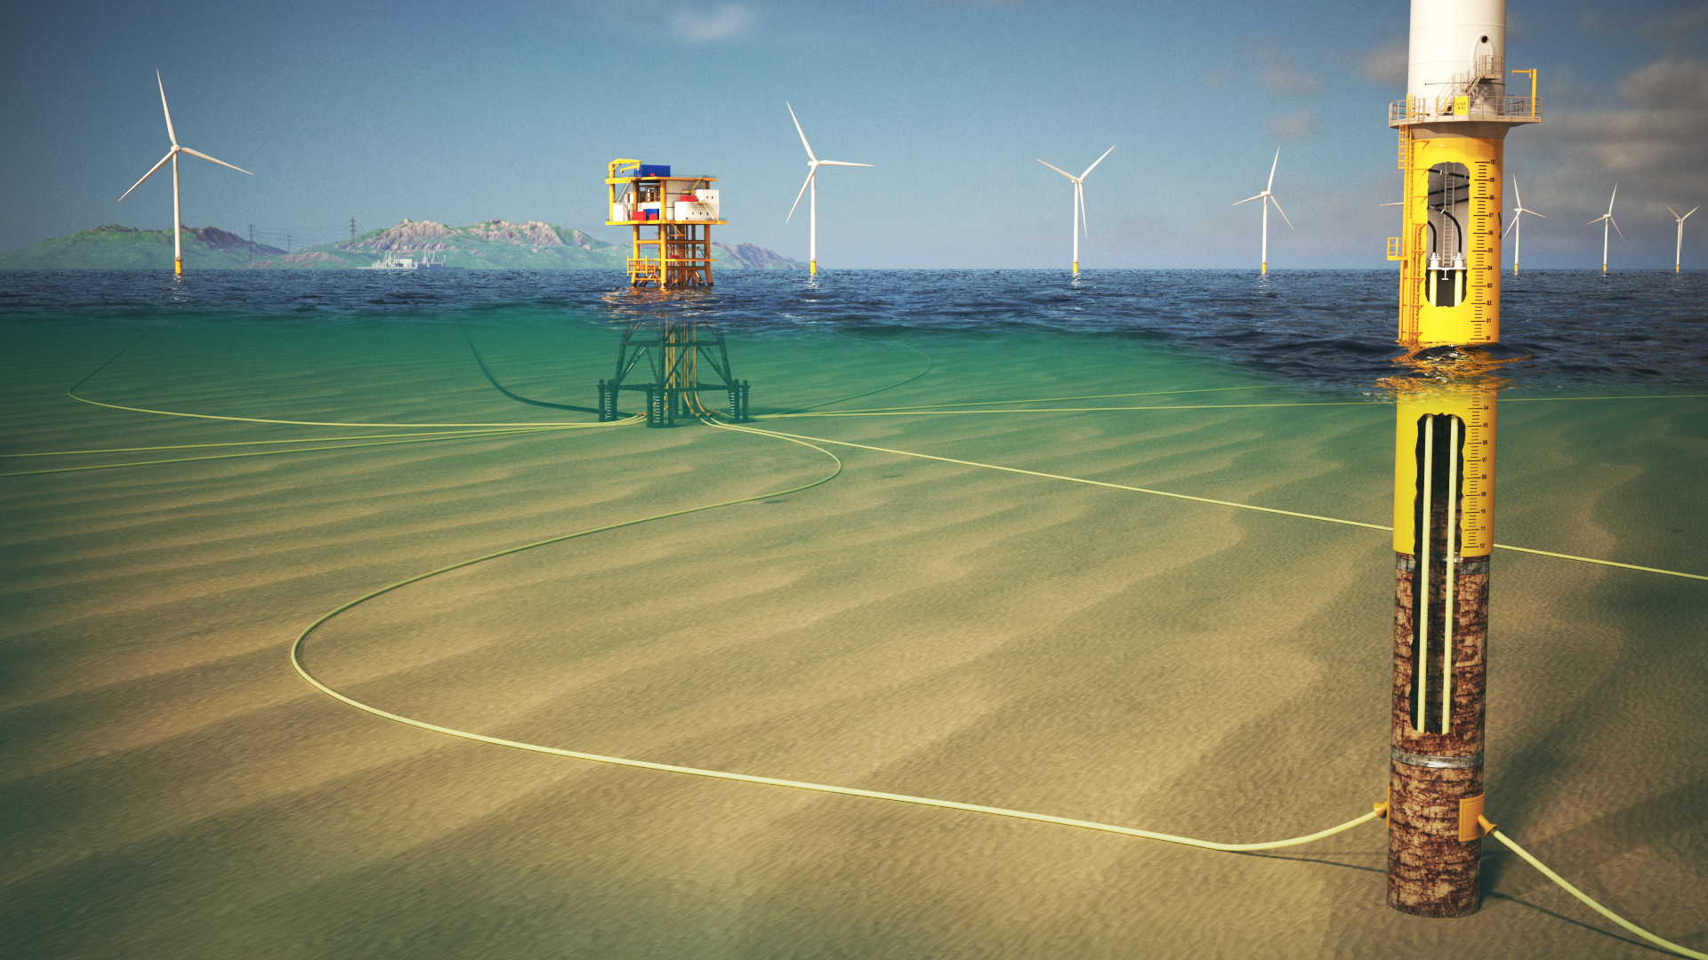
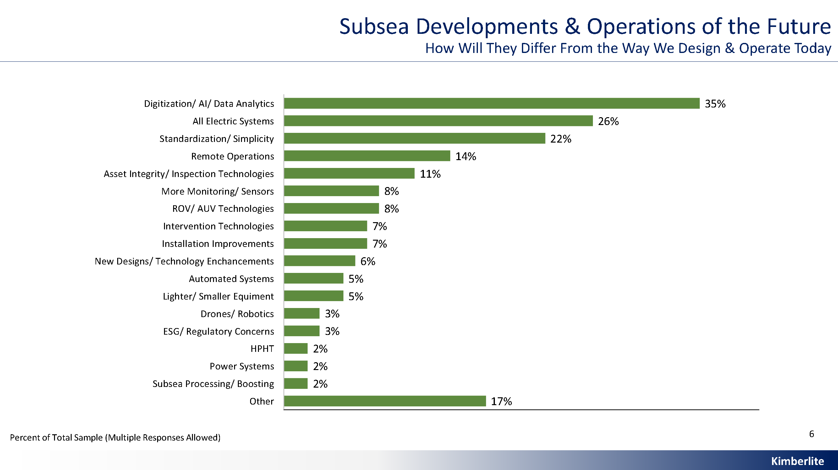
Technology Trends in Subsea Operations
Looking to the Future
Beyond supply chain challenges, the industry is increasingly focused on digitization, AI and data analytics to enhance subsea performance.
There is a growing momentum around all -electric systems, while predictive analytics and modelling are in high demand to:
Forecast interventions
Optimise reservoir performance
Improve life-of-field management

Slide 15

What will set Proserv apart in the future
Why Proserv?
Proserv stands out in the subsea controls market as a performance and value leader, trusted by operators for its responsive service, technology and customer-first approach.
As subsea assets mature, operators are looking for partners who can extend asset life without requiring complete system overhauls. Proserv’s expertise in retrofit solutions and legacy systems positions it perfectly for this segment.
Proserv is advancing in digital and next-generation controls technology. Crucially, it does so in a way that aligns with real operator needs—balancing innovation with proven reliability and ease of integration.

Slide 16
Internal Use Only

Slide 17
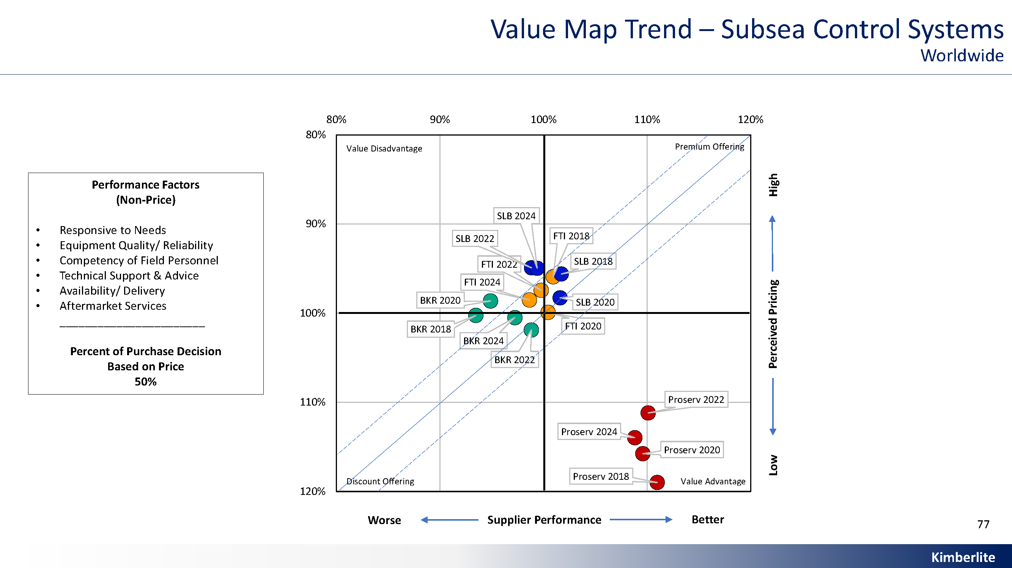
Subsea Control Systems
Value Map Trend

Slide 18
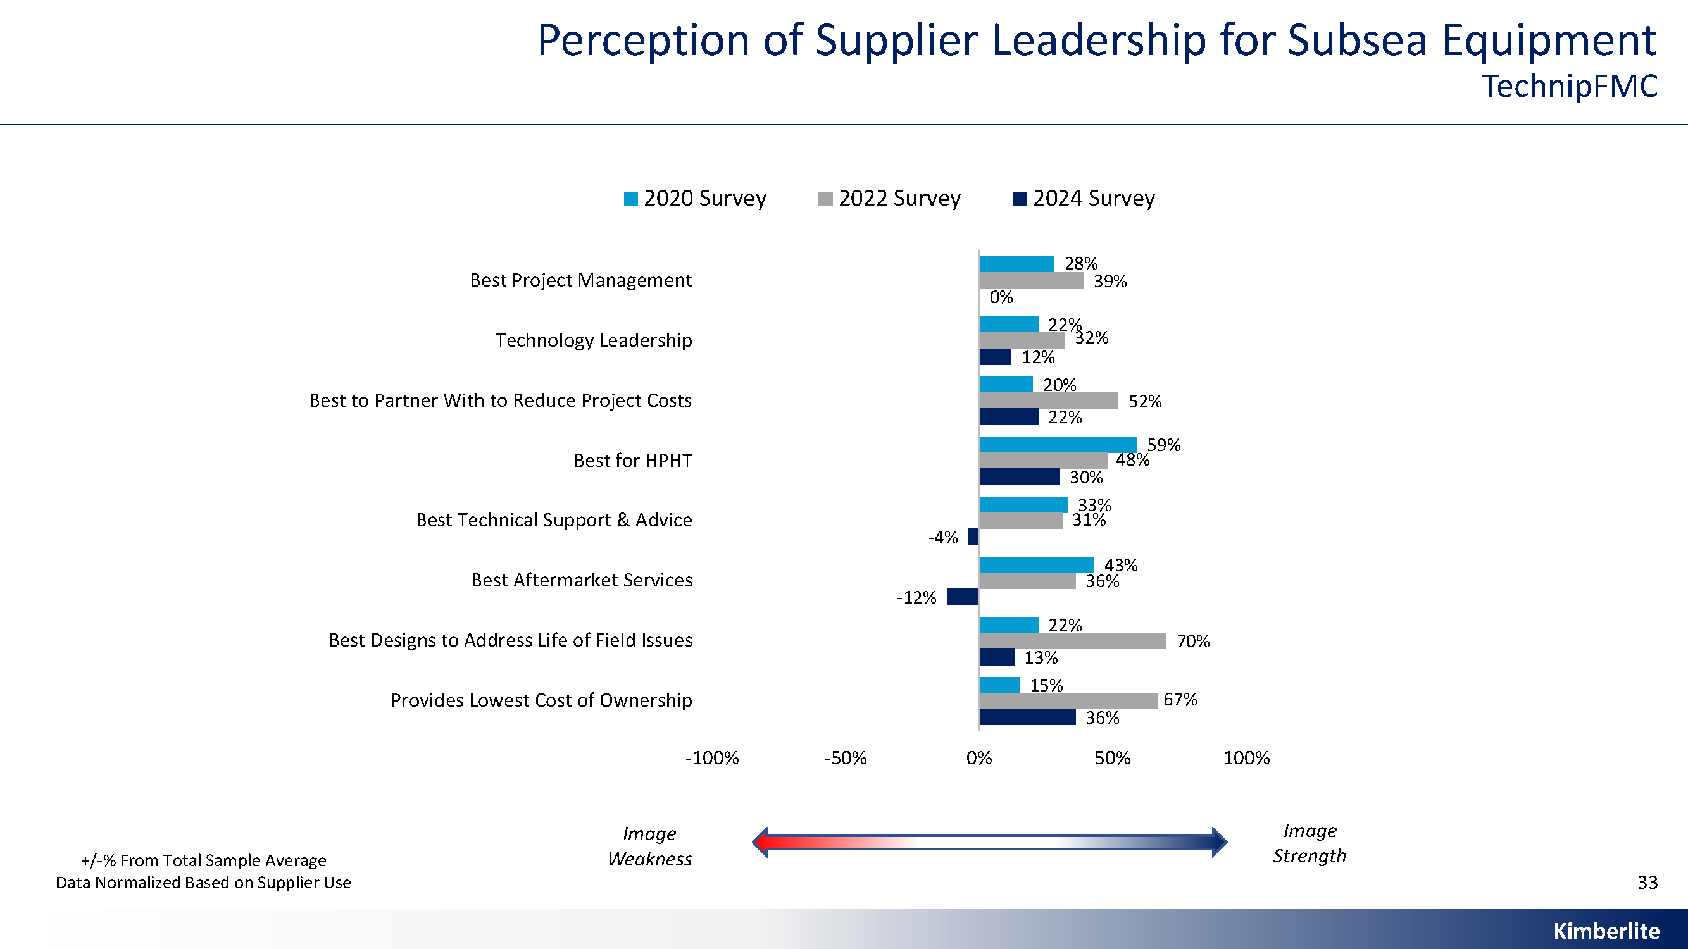
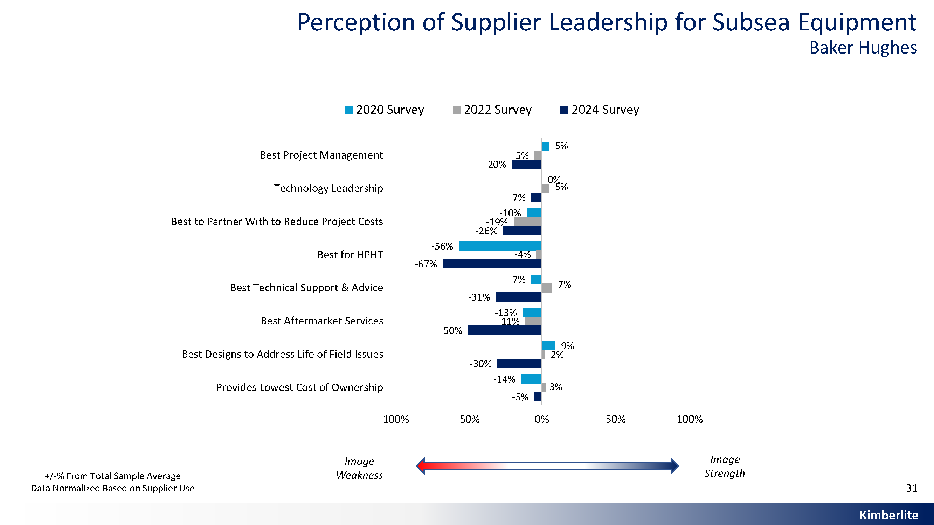
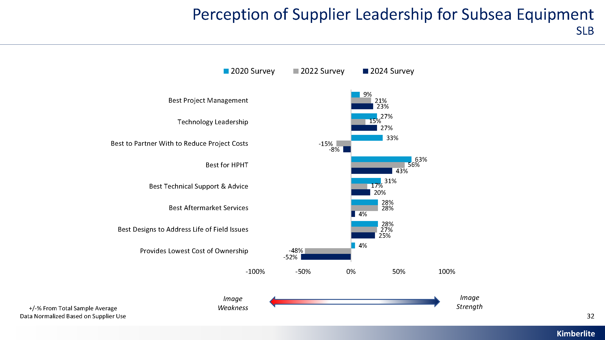
Subsea Equipment
Perception of Supplier Leadership
Data shows that TechnipFMC and SLB are strongly perceived as leaders in subsea equipment across nearly all key performance areas:
Technology leadership, project cost reduction, and HPHT solutions.
TechnipFMC leads in lowest cost of ownership and life-of-field designs, while SLB is recognized for technical support and partnership value.
In contrast, Baker Hughes has improved in some areas including technical support and designs for field life but still lags significantly in perception compared to its competitors, particularly in cost, HPHT, and aftermarket services.

Slide 19
Positioning Proserv as the agile, niche alternative
Sales Enablement
While TechnipFMC and SLB dominate in broad capability and perception, they are large, integrated companies that can be slow-moving, costly, and less flexible.
Proserv can position itself as:
More responsive and agile
Independent and unbiased
Collaborative
Sales teams could tailor messaging to show:
How Proserv’s brownfield retrofit solutions and other digital technologies can reduce costs
Aftermarket service support excellence
Customer-centric delivery models
Vision for the future
These insights let Proserv differentiate and disrupt not by competing head-to-head with industry giants, but by showing it can deliver solutions that are quicker, more intelligent, cost-effective —precisely the qualities the market continues to demand.

