Slide 1
Proserv
Control technologies for critical infrastructure
January 2025

Slide 2

How to use the Master Slide Deck
Welcome to the Proserv Master Slide Deck
This deck is a collection of approved slides for you to use in your presentations. It is not a presentation in itself – the idea is that you can flip through this deck and select the slides that are most appropriate for what you are looking to achieve. You do not need to use all of them – indeed, that is not advised, as it would result in repeated information and far too many slides.
How to use the slide deck
Select which slides are relevant to the presentation you are giving
Copy and paste those slides into your own presentation, ensuring you are using the official Proserv template to avoid any formatting errors and to remain on brand
***Do not adjust these slides with your own information in your presentations***
Add any relevant slides to your own presentation to complete.
Have a recommendation for an edit or a new slide? Please contact the marketing team or email aliz.kovacs@proserv.com

Slide 3
General Company Introduction slides
Contents
Proserv is a controls technology company
Proserv history and brand heritage (Brisco, CAC etc)
Control, monitoring, intelligence, optimisation quadrant – large
Control monitoring, intelligence, optimisation slide – small with space for additional messaging
Proserv’s vision for the future – digitalisation
Proserv’s approach to partnerships and collaboration
Proserv’s technology solutions, e.g. subsea controls, sampling etc
Why Proserv? VoC and Net Promoter scores
Why Proserv? We are specialists (stats)
Why Proserv? We are specialists (compared with subsea competitors)
Why Proserv? Proserv awards and accolades

Slide 4
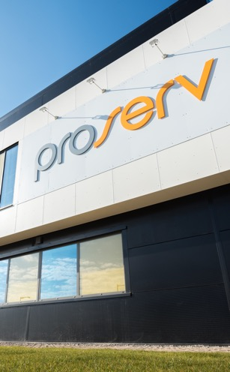
Control technologies for critical infrastructure
Who is Proserv?
Proserv is a controls technology company.
We improve the reliability, integrity, efficiency and productivity of critical infrastructure with industry leading controls technology.
Our Values
Forward as a Team
Right Thing, Right Way
Entrepreneurial Spirit
Serious about Service
Help, Share and Communicate
Over
60
years’ experience
13
global locations
Operating in
60+
countries
Over
800
employees

Slide 5
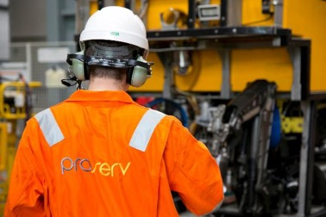
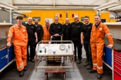
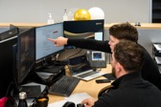

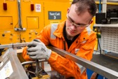
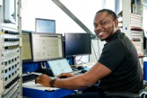
Our Values
Introduction
A FRESH PERSPECTIVE
Proserv has a distinctive delivery-focused culture. At the heart of everything that we do, the five Proserv values guide our decisions and behaviours. Internally, we refer to our values as FRESH.
Right thing,
right way
Serious about
Service
Forward as
a Team
Entrepreneurial Spirit
Help, Share and Communicate

Slide 6









Proserv has an extensive brand heritage spanning nearly 60 years
Solid core of controls experience
Proserv has evolved significantly over the years both through organic growth and strategic acquisition in order to develop our controls expertise.
Recent partnerships have further strengthened our move into intelligence solutions and renewables.
Historic brands
Partnerships
2006
2011
2012
2019
2020
2024
Weatherford EP Solutions established after acquiring CAC, Brisco, Autocon and Sicom
Proserv Technology is
re-branded as Proserv with new look logo and brand
Proserv acquires Weatherford EP Solutions
Proserv acquires SGC Metering to strengthen metering and measurement expertise
A strategic partnership developed with Synaptec to develop our renewables portfolio
Strategic partnerships agreed with Mocean Energy and Verlume to bring new renewable energy technologies into the business
1990s
2010s
2020s
1960s

Slide 7
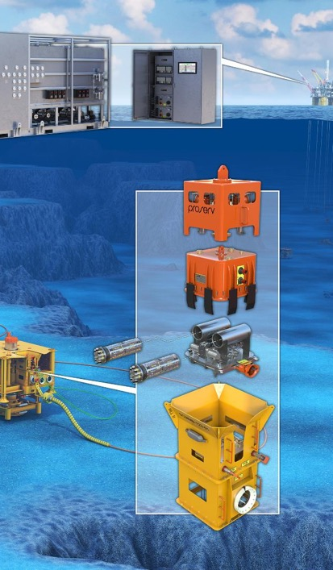




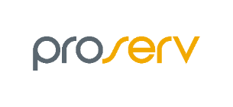










Proserv has an extensive brand heritage spanning over 60 years
Solid core of controls experience
2014
2019
2020
2022
2024+
2014
2019
2020
2022
2023+
Acquires EP Solutions
Acquires SGC Metering
Partnership with Synaptec
Acquires stake in Synaptec
Acquires EP Solutions
Acquires SGC Metering
Partnerships with Synaptec & Intelligent Plant
Acquires stake in Synaptec
Partnerships with Mocean Energy and Verlume
2011
2011
Today, we are driving progress in renewables and digitalisation
MODERN PROSERV FORMED
MODERN PROSERV FORMED
2006
2006
2002
2002
1980s
1970s
1960s
1980s
1970s
1960s
EP Solutions established
Sicom established
SGC Metering
Autocon established
Brisco
Proserv Technology established
CAC established
EP Solutions established
Sicom established
SGC Metering
Autocon established
Brisco
Proserv Technology established
CAC established
Notes:
Proserv has evolved significantly over the years both through organic growth and strategic acquisition in order to develop our controls expertise. Recent partnerships have further strengthened our move into intelligence solutions and renewables.

Slide 8


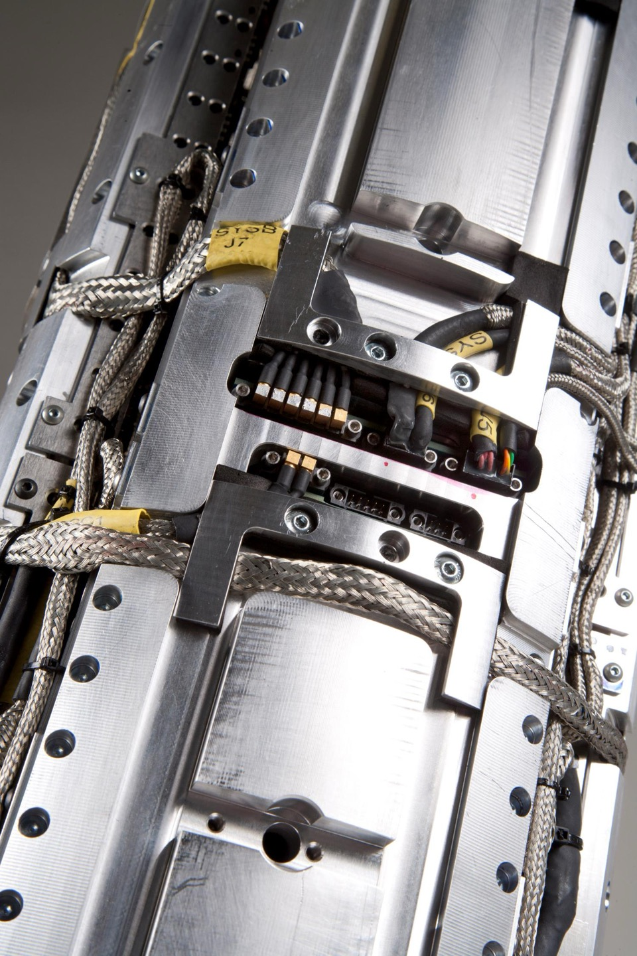



Characterised by significant investment, milestone wins, product innovation, acquisitions and alliances
60+ year heritage of market leadership
CAC (1963) and Brisco (1967) controls businesses established
Proserv sampling business established in Norway
INNOVATION
Multiplexed electro-hydraulic Wellcon SCM
HISTORIC WIN
Subsea control system – Talisman Ross field
INNOVATION
Developed Artemis subsea control system
INVESTMENT
Modern Proserv formed
1960s
1976
1992
1997
1999
2011
AQUISITION
Weatherford EP solutions: (Brisco,
CAC, Sicom and Autocon)
INNOVATION
Energy efficient WHCP launched
INNOVATION
Launched Artemis 2G SEM
HISTORIC WIN
ACT – Ithica Anglia co-exist SEM
INNOVATION
First subsea sampling cylinder
INVESTMENT
Artemis House built in Great Yarmouth
2013
2013
2014
2013
2016
2018
AQUISITION
SGC metering
ALLIANCE
Historic agreement with Dril-Quip
ALLIANCE
Synaptec
HISTORIC WIN
HIPPS on BHP
Shenzi
HISTORIC WIN
ECG™ on Dogger Bank wind farm A and B
ACQUISITION
Dron&Dickson UAE
2019
2020
2020
2021
2022
ALLIANCE
Ortomation.io and Viper Innovations
ALLIANCE
Proserv and SMS launch joint sampling centre in Malaysia
ALLIANCE
Partnerships with Mocean Energy and Verlume
HISTORIC WIN
ECG™ is deployed across the world’s largest wind farm – Dogger Bank
2022
2023
2024
Notes:
1960
Established to specialise in controls technology to the oil and gas industry
1990
Developed the first complete multiplexed electro-hydraulic subsea control system
2013
Acquired Weatherford’s subsea and topside controls business, EP solutions, to strengthen its position as a significant player in the global subsea controls market
2014
Launched Artemis 2G, a next generation subsea electronics module offering unparalled communications speeds and reliability
2016
Designed and built the world first fully certified subsea sampling cylinder
2018
Established Proserv’s flagship centre of excellence for subsea controls and engineering in Great Yarmouth
2019
Acquires SEG to enhance range of topside systems offerings into fiscal metering and PLC system integration
2020
Signed collaboration agreement with Dril-Quip to outsource the development and manufacturing of subsea control systems to Proserv
2020
Formed strategic alliances with power monitoring (Synaptec) firm
2021
Secured funding to develop ECG™ holistic cable monitoring system for offshore wind
2022
Acquired minority stake in power system monitoring expert, with first offshore wind contract awarded Feb 2022
2022
Formed a strategic alliance to further advance the development of optimisation software
2023
Proserv and SMS launch joint sampling service centre in Malaysia
2024
Partnerships – Mocean Energy, Verlume, FALCOR Engineering and Contracting, Historic win - ECG is going to be deployed on Dogger Bank C

Slide 9

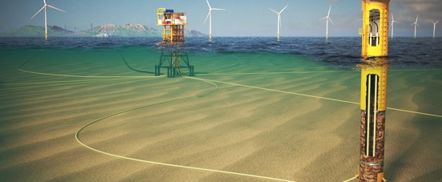







We improve the reliability, integrity, efficiency and productivity of critical infrastructure with industry leading controls technology
The Controls Technology Company
Control
Independent and reliable control systems for critical infrastructure.
Intuitive visualisation of asset integrity and performance.
Intelligence
Insights from advanced data analytics and machine learning to predict outcomes.
Optimisation
Improved performance and asset life extension through our expertise and technology.
Monitoring
ENERGY

Slide 10
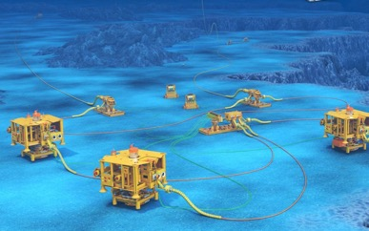
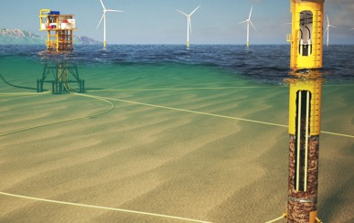


Our offerings are focused on solving the issues surrounding critical infrastructure
Proserv is a controls technology company
We improve the reliability, integrity, efficiency and productivity of critical infrastructure with industry leading controls technology
The Proserv difference
We ensure safe, reliable operations
We provide the reliable information you need to make informed decisions and actions
We provide the ability to predict maintenance needs before failures occur
We reduce operating costs and increase uptime
Control
Independent and reliable control systems for critical infrastructure.
Intuitive visualisation of asset integrity and performance.
Intelligence
Insights from
advanced data analytics and machine learning to predict outcomes.
Optimisation
Improved
performance and asset life extension through our expertise and technology.
Monitoring
ENERGY

Slide 11

Creating intelligence across the energy system
Focused on the future of energy
Data, analytics and AI/ML allows users to convert unused data into actionable information
Controls systems are OEM agnostic and enabling operators to connect one integrated system
Intelligent solutions offer reliability, predictability and unmatched access to data and real-time monitoring
Proserv at the epicentre of the world’s critical infrastructure
Reliable controls systems across the full Clean Energy market
The Proserv difference:
Reliable information you need to make informed decisions/actions
Safe, reliable operations
Ability to predict maintenance needs before failures occur
Reduced operating costs and increased uptime

Slide 12
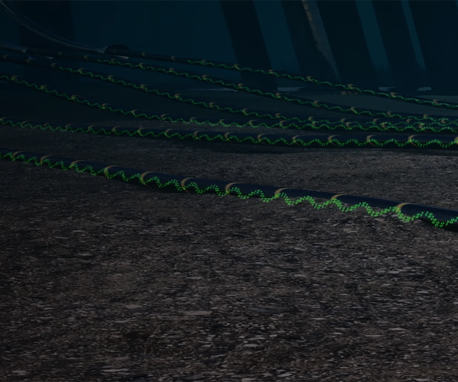




Leveraging our experience in oil & gas to deliver new solutions to the renewables industry
Our renewables journey so far
Proserv’s Renewables Evolution
  Oct 2019 New five-year Proserv technology roadmap is established
  Oct 2020 Strategic alliance with power monitoring experts Synaptec
  Mar 2021 Funding secured for ECG™ from Innovate UK
  Sep 2021 Industrial sponsorship for ECG™ from ScottishPower Renewables
  Dec 2021 Lands key cable monitoring deal on Dogger Bank Wind Farm A and B
  May 2022 Industrial sponsorship from Equinor to operate on the Hywind Scotland floating wind farm
  Jun 2022 Former RenewableUK CEO Hugh McNeal joins Proserv’s Board of Directors
  Aug 2022 MOU with technology start-up Ortomation.io to develop real time optimisation software
We are applying our existing expertise in control system integration and subsea environments to renewables. Steered by our philosophy around building transparent, OEM agnostic and scalable solutions, our technologies enable operators to optimise power generation and extend the life of critical wind farm infrastructure.
Key technology solutions
ECG™ holistic cable monitoring system
Wind Turbine and Floating Foundation Control and Monitoring Systems
Real-time optimisation
Innovation backed by industry
We are developing solutions that the industry wants and needs.
  Oct 2023 Lands key cable monitoring deal on Hywind Scotland floating offshore wind farm
  Mar 2024 Proserv, Synaptec and Megger sign MoU to collaborate on power cable monitoring and testing scopes
  Oct 2024 ECG™ wins Renewable UK’s Supply Chain Innovation of the Year award
  Oct 2024 ECG™ is deployed across the world’s largest wind farm – Dogger Bank

Slide 13
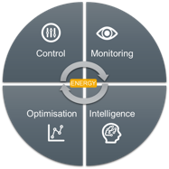
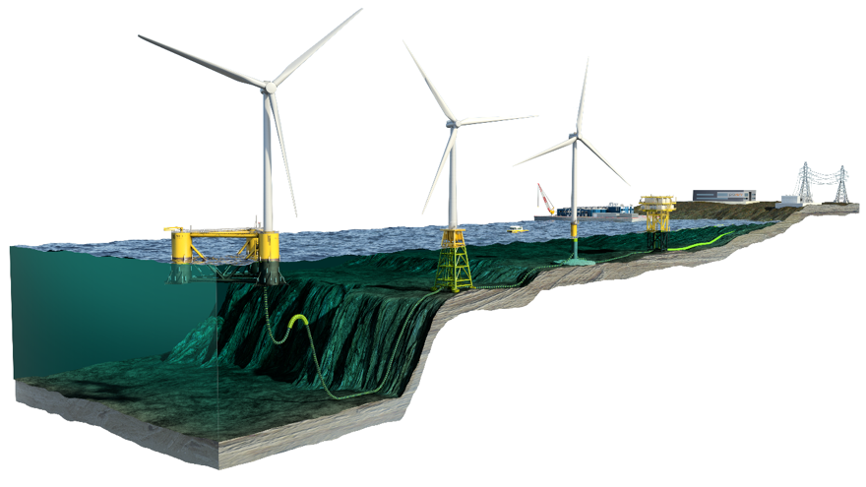
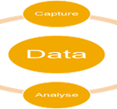
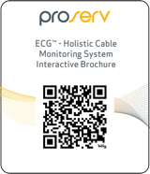
OEM agnostic control and monitoring technologies for critical infrastructure
Proserv’s direction in renewables
ECG™ - IAC & Export Cable Monitoring
Turbine Controls/ACT (Turbine, Pitch, Yaw)
SCADA/TIACS
Turbine / Field Control Optimisation
Blade Monitoring
Floating
Jacket
Monopile
5
2
Onshore Control Room
4
Onshore substation
Offshore Substation
3
4
1
1
Export
Power cable
IAC
Power cable
Scan the QR code to view our Interactive Digital Brochure

Slide 14





We have an open approach to collaboration
Partnerships
EMPOWERING CHOICE
EMPOWERING INNOVATION
Integrated solutions that save time, simplify logistics and drive standardisation.
Putting Proserv at the forefront of technology advancement.
HIPPS controls
Buoy controls
Tree controls
Advanced digital solutions
Notes:
This is the how of Proserv to create unique value through brining value by empowering innovation through partnerships. Which shortens the adoption cycle.
Empowering choice
Alliances can bring a positive impact to operations as companies come together to offer integrated solutions, saving time, simplifying logistics and driving standardisation. We have an agnostic approach towards alliances and can accommodate client requests whether as part of a partnership or standalone.
Empower innovation
Proserv partners with complimentary, emerging technology companies to create compelling solutions for customers. These relationships enable Proserv to be at the forefront of technology advancements as we continue to identify innovative ways to create value for our customers throughout the energy transition.

Slide 15








We offer a wide range of technology solutions
Products and services
g
Subsea Controls
Extend life of field without costly equipment replacement shutdowns by using a subsea controls system that is never obsolete.
Topside Controls
We design, manufacture, install and service the full range of production control equipment right across the energy value chain.
Cable monitoring
Enhance the ability to detect, locate and predict cable life expectancy with the Proserv ECG™ holistic cable monitoring system.
SCADA systems
We provide clients with the capability to monitor and control operations across a widely dispersed infrastructure to improve efficiency.
IWOCS
Providing temporary well control during subsea well installations, workovers and abandonments to meet each field’s unique configuration.
Measurement
Specialising in fiscal and custody transfer metering systems, to meet the most stringent of technical requirements.
Sampling
A range of solutions for sampling, incorporating sample containment, transportation cylinders, and chemical injection.
332
Subsea control modules supplied to clients
20,000
Production control systems manufactured
40,000
Sampling cylinders manufactured and certified
200
Metering control systems manufactured
1,000
Production control systems refurbished
6,000
Wellhead control systems supplied
New system
and design services
Installation and commissioning
Maintenance
Life Extension
Decommissioning
Brownfield upgrades

Slide 16
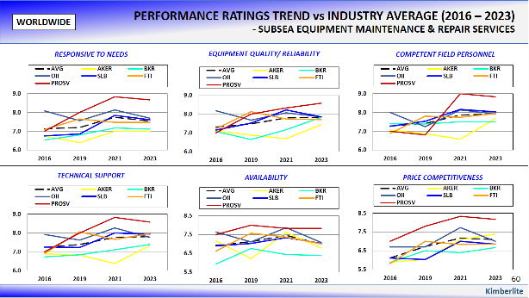
Of the Operators interviewed who have worked with Proserv, every one of them recommended us.
Industry recognition
We are no 1*
Subsea control systems I IWOCS services
I IRM services
We outperform our competition on all
key metrics:
Technical support
Competent field personnel
Equipment reliability
Availability
Responsiveness

Slide 17
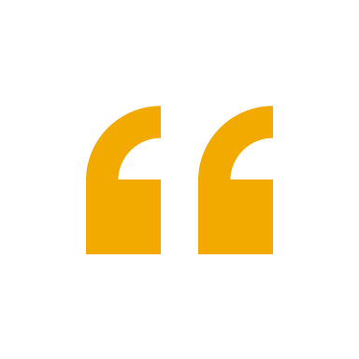
The report highlighted that some companies perceive Proserv as a small company
Operator Image of Proserv
A small disadvantage?
In reality, we are a dedicated and focused business, exclusively developing technology and executing controls projects that more than rival any OEM subsea controls capabilities.
Proserv specialise solely in controls, with over 40 years’ experience.
Over 100 dedicated controls engineers, 750 staff,
35 staff in our communications and electronics R&D facility in Trondheim, 4 manufacturing sites and services bases around the globe.
330+
subsea control modules (SCMs)
50+
ACT projects
85+
Open communications hubs
6000+
topside control panels
130+
subsea controls projects
Market Share
At 26%*, second only to TFMC for subsea controls supply in GOM for past two years.
Market leader for subsea controls in North Sea.
28%* global market share with independents – over double that of Aker and Baker Hughes.
Proserv seems to be very flexible. If you need an unusual solution, they can probably do it.
Beacon Offshore Energy
As a small supplier, Proserv provides good attention.
Hess*

Slide 18
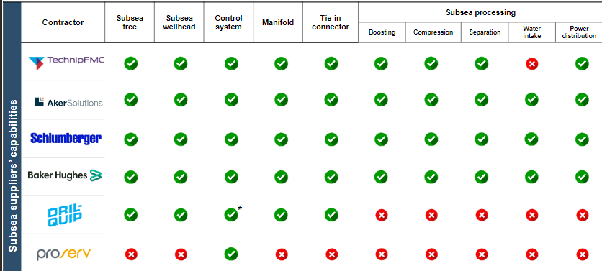








Proserv specialises solely in controls, with over 60 years’ experience
We are controls specialists
We are
controls experts
Notes:
Proserv are controls specialists. The other OEMs are much larger companies that cover the full range of a subsea production system. They are great companies for dealing with ‘dumb’ kit – i.e. trees, manifolds etc – pure manufacturing. However, subsea control systems are complex pieces of engineering and software. And research shows they are the one thing most likely to fail out of the entire production system. A subsea control system requires specialist knowledge and attention. This is why we specialise in controls. And we are so good at this one piece of the production system, that in 2019 Dril-Quip stopped manufacturing controls and specified that they would exclusively use our controls going forward. They made the choice to go partner up with a controls specialist. We are one green dot in this graph – but, when it comes to ensuring the best performance, best return on investment, best uptime – it’s the only green dot that matters.

Slide 19
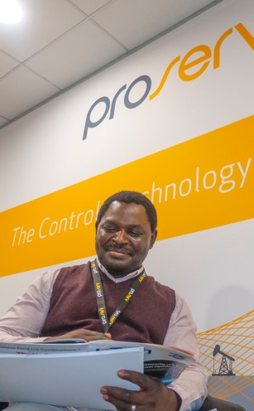







We are an award winning company
Why Proserv?
2024
Services & Solutions
EIC Awards 2024
Supply Chain Innovation Of The Year
RenewableUK Awards 2024
Early Career Professional Of The Year
OEUK Awards 2022
MEA Service Award
EIC Awards 2022
Service and Solutions Award
EIC Awards 2021
Export Award
EIC National Awards 2019
Workforce Engagement Award
Oil & Gas UK Awards 2018
Innovator & Technology Award
Subsea UK Awards 2017
Subsea Company of the Year
Subsea UK Awards 2015
Great Large Company of the Year
Offshore Achievement Awards 2015
Apprentice of the Year
Oil & Gas UK Awards 2014
Business of the Year
Spirit of Enterprise Awards 2014
Great Engineering & Manufacturing Company
Spirit of Enterprise Awards 2014
Technology of the Year
Middle East Oil & Gas Awards 2013
Entrepreneur of the Year
Ernst & Young Awards 2013
2022
2021
2019
2018
2017
2015
2014
2013

Slide 20
Slides on our environmental, social and governance commitments
General Environmental, Social, Governance (ESG) slide
Environmental commitment slide –net zero by 2040
Technology ethos slide with environmental messaging and real example via SCM
Social slide, incorporating awards and FRESH values
General HSE slide with net zero messaging
Global HSE Performance Report

Slide 21






Proserv’s sustainability ambition: Our purpose, commitment and values
Our ESG Commitment
Purpose:
At Proserv, our purpose is to improve the reliability, integrity, efficiency and productivity of critical infrastructure with industry leading controls technology. We will achieve this through our corporate strategy and by acting responsibly on the sustainability issues that are most important to our business and society.
Commitment:
Our commitment to sustainability guides us as we develop better technologies, better working environments and, ultimately help develop a cleaner, safer and more equitable world for future generations. We strive for best practice in all areas and to meet the Sustainable Development Goals specifically 7, 8, 9, 12 and 13 wherever possible.
Values:
The power of our values comes from their simplicity. They bring to life the simple truths about what it means to work here:
  Forward as a Team
  Right Thing, Right Way
  Entrepreneurial Spirit
  Serious about Service
  Help, Share and Communicate

Slide 22
Net zero by 2040
Our ESG Commitment
Our mission
Proserv will help to protect the planet’s future by becoming a Net Zero company by 2040. We will do this considering a reduction target aligned to a 1.5°C pathway for our operations and supply chain.
Our mission is to extend the life and improve the reliability of energy assets and in doing so supports our customers by reducing Scope 3 downstream emissions.
How will we become Net Zero?
CALCULATE greenhouse gas emissions for operations and supply chain
REDUCE we will reduce carbon emissions generated per $1m revenue and continue to develop our Net Zero Roadmap
SUPPORT the supply chain in doing the same by targeting 70% of our suppliers (by spend) will have net zero targets by 2035
BALANCE the remainder using carbon offsets
ENVIRONMENT
* Slide to be approved
Notes:
Proserv has a voluntary committee called the Carbon Action Group (CAG). This group provides advice and support to site representatives around the company, sharing data and progress on our efforts to reduce Proserv’s carbon footprint across all scopes. Site representatives at each facility develop their own initiatives and targets, initially focusing on reducing emissions created by travel, power, water and waste. This ensures that targets are realistic and that solutions can be tailored to each site, according to local conditions.
Proserv’s strategy aims to reduce, balance and support across all three emissions scopes.
SCOPE 1: all direct emissions from activities under our control.
SCOPE 2: indirect emissions from power sources purchased and used by Proserv.
SCOPE 3: all other indirect emissions from Proserv activities occurring from sources that we do not own or control.
carbon neutral refers to the state of achieving net zero carbon emission, whereas net zero refers to zero carbon dioxide emission

Slide 23
Working for the future
Our ESG Commitment
At Proserv, our commitment to sustainability guides us as we develop better technologies, better working environments and, ultimately help develop a cleaner, safer and more equitable world for future generations. We strive for best practice in all areas and to meet the UN Sustainable Development Goals wherever possible.
ENVIRONMENT
SOCIAL
GOVERNANCE
Reduce harmful emissions
Responsible carbon offsetting
Encourage our supply chain to show evidence of doing the same
Employment quality
Training and development
Diversity and human rights
Community and engagement
Corporate structure
Ethics and compliance
Protecting our people
Protecting our assets

Slide 24
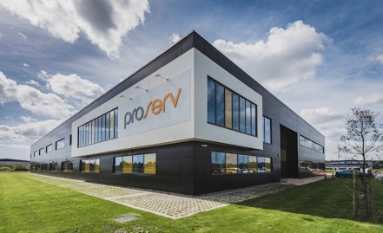






Our ESG Commitment
Proserv approach to managing our own environmental impacts
?
Why?
Acting on climate change matters to our customers, our business, our partners and the communities in which we operate. To meet our Net Zero by 2040 ambition, we’re genuinely reducing the environmental impact of our global business.
How?
We are committed to Net Zero operations and supply chain by 2040. By 2040, our energy use intensity will be minimised and hope to use 100% renewable electricity for all our sites . Where we can, we will increase generation of our own electricity and even export any surplus for use by others.
As well as our own operations, we will be working with our suppliers to achieve Net Zero throughout our supply chain.
The products and services we provide are and will continue to reduce our customer emissions.
Carbon emissions
We closely monitor carbon emissions from our activities. In 2024 we set 2023 as our carbon baseline and are in the process of calculating our complex supply chain emissions.
Renewable energy
100% of the electricity we procure in the UK is from certified natural renewable sources and in GY, we generate a small proportion from our own on-site solar energy.
Our waste
Where we control the contract, we send zero waste to landfill in the UK and 45% of waste is recycled globally.
Plastic
All UK and Norwegian sites use reusable cups for drinking minimising our plastic footprint.
We use minimal quantities of plastic packaging for our products.
Energy efficiency
Through measuring what we use on each site, we are laser focused on using less, the greenest unit of energy is the one we don’t use.
In 2024, we started to mease energy use intensity (energy used per sqm). 46% of our facilities are already performing better than ‘good practice’ benchmarks.
Proserv Gt. Yarmouth
Zero waste to landfill
100% renewable electricity
Rooftop solar generation – investigating significant expansion
0% single use plastic drinking cups
80 kWh / units of energy per sqm per year (2023) beating the CIBSE 92 kWh ‘good practice’ benchmark
2024 Investment in replacing workshop lighting with ultra efficient LED lighting and control system. This initiative alone is targeting to reduce the sites carbon footprint by 10%
Wild garden area promoting biodiversity

Slide 25
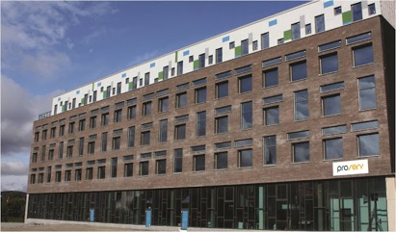
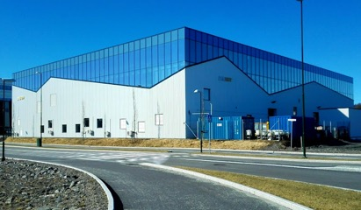
Our ESG Commitment
Proserv approach to managing our own environmental impacts – Norway
Proserv Trondheim
Our lowest emitting site meeting requirements already
Just 1 tonne of CO2e emissions through operational use
Connected to a low carbon district heat network providing heat mainly based on surplus heat from waste incineration
Zero waste to landfill
>95% renewable electricity
0% single-use plastic drinking cups
93 kWh / units of energy per sqm per year (2023) beating the CIBSE 96 kWh ‘good practice’ benchmark
2024 Investment in refurbing the office area focusing on increasing efficiency via LED lighting and control
Proserv Stavanger
Our second-lowest emitting site
Zero waste to landfill
>95% renewable electricity
0% single-use plastic drinking cups
Connected to 100% climate-neutral district heating network, based on recovered waste heat from waste incineration and supplemented with biogas
Tripple glazed and super insulated facility

Slide 26
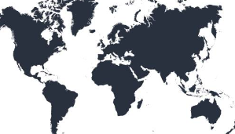
2023 Global data – Acting on climate change: Our people and operations
Global HSE Performance Report
Waste 330 tonnes generated The same weight as 1½ Statues of Liberty (Source: Robbreport.com) | Recycling 45% of our dry waste is recycled. 120 tonnes, equivalent to 1 wind turbine nacelle (Source: London.gov.uk) | Waste to landfill 92 tonnes sent to landfill Equivalent to 18 elephants (Source: Wikipedia)
Water 9,754 M3 used Equivalent to 4 Olympic-size swimming pools (Source: Wikipedia) | Energy 4,674,644 kWh of energy consumed (77% Elec, 23% Gas) Equivalent to 237 homes’ electricity use for one year (Source: EPA US calc & Royal Museums Greenwich) | Carbon emissions 2,701 tonnes CO₂e Equivalent to driving to the moon and back in an average gasoline-powered car over 14 times! (Source: EPA US calc)
Global Stats

Slide 27
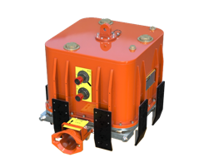

Our mission is to extend the life and improve the reliability of energy assets
Our technology ethos
Reliability commitment: We provide the energy industry with best-in-class quality across all our solutions that never go obsolete
56%
less greenhouse
emissions*
We reduce our customers’ carbon footprints
We extend the life of assets
Our solutions optimise the performance of equipment, helping to prevent hydrocarbon leaks and decrease fluid and energy use.
We use intelligent solutions
By using digital technology and real-time monitoring, we can remotely support our clients, alleviating the need for travel.
Our technology ethos is to reuse, refurbish and upgrade equipment wherever viable, lessening both equipment disposal and manufacture.
TECHNOLOGY HIGHLIGHT
Subsea control module reliability:
Removes need to retrieve and service the SCM during its lifespan
No support vessel to assist with the retrieval of the module
The result: Approximately
77 tonnes CO2e saved.

Slide 28
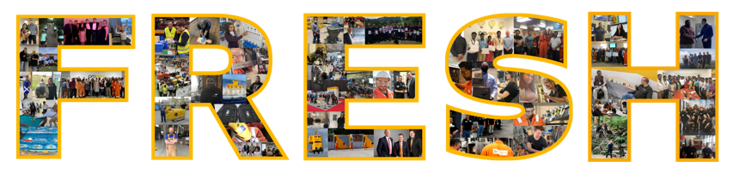
People are at the core of Proserv
Our people
We care about our people and how we conduct ourselves as a business. Supported by our FRESH values, our mission is to allow our people to continually develop, thrive and reach their full potential in a safe working environment.
We support knowledge sharing and empower our employees
Access to coaching and mentoring, learning libraries and webinars
Apprenticeship and graduate schemes to support the next generation of control experts
Forward as a Team
Right Thing, Right Way
Entrepreneurial Spirit
Serious about Service
Help, Share and Communicate

Slide 29
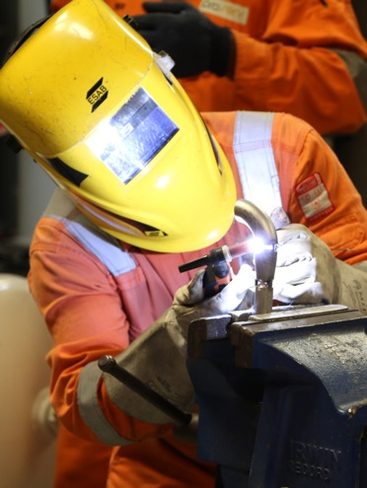

Our aim is to have everyone home safe, every day
Health and Safety and Environment
Doing things the right way is wired into our FRESH values and we adhere to high standards of governance, integrity and regulatory compliance.
Every Proserv employee is empowered to take ownership of health, safety and environmental performance as part of his or her daily working duties and is authorised to stop any job which is deemed to be unsafe.
Example safety campaigns
Global safety day
Workforce engagement in safety surveys
Safety campaigns
Mental health awareness
Get active days
Our mission
To be a carbon net zero company by 2040.

Slide 30
Offering slides
Control – industry intelligence (Kimberlite)
Control overview
Control solutions examples
Monitoring – industry intelligence (Kimberlite)
Monitoring
Monitoring solutions examples
Intelligence– industry intelligence (Kimberlite)
Intelligence
Intelligence solutions examples
Optimisation - industry intelligence (Kimberlite)
Optimisation
Optimisation solutions examples

Slide 31

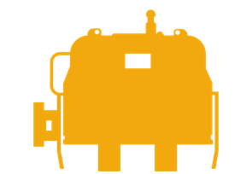

Obsolescence and reliability issues are still needing to be addressed
Control
“[we want] remote operation and control, increased reliability, increased flexibility, enhanced “in-situ” repair.”
ExxonMobil, Africa
On average, an SCM is changed out 2.3* times over the life of a typical well (20 years), with a turnaround time of 9.6* months.
Proserv Analysis
We are well placed as operators seek out value-based alternatives for subsea control systems and retrofit options for obsolete control systems.
21%
believe that improved equipment reliability has the single biggest impact on improving life of field economics*
76%
Of all subsea control systems will face obsolescence issues
30%
Average share of subsea fields facing obsolescence issues with subsea equipment
91% of all Proserv SCMs installed on producing subsea wells have never been recovered.*
*Source: Proserv

Slide 32


Independent and reliable control systems for critical infrastructure
Control
Our best-in-class controls and SCADA systems are designed with reliability and performance in mind and are OEM agnostic. With the flexibility and capability to co-exist with other equipment, Proserv can support systems for the life of field, ensuring that your controls or SCADA system is never obsolete.
Use of controls to produce data and information on asset performance
Supported by field service engineers focused on uptime performance
Innovative designs and a track record of seamless coexistence with third party systems
Future-proofed solutions – designed to never become obsolete
Components designed beyond industry standards
Fibre, copper, hydraulics and satellite communications links
Key technologies
Subsea controls systems
HIPPS controls
Topside control systems

Slide 33





Our controls solutions
Control
Greenfield and brownfield solutions
High pressure subsea tiebacks
Subsea intervention and workover
Our systems are designed to not just meet short-term first production goals, but to ensure the long-term performance that sustains production with minimal intervention. We offer unrivalled equipment reliability and provide the most cost effective technology solutions for sustainable production on greenfield and brownfield developments.
We provide dedicated control systems to meet the stringent safety requirements for high pressure environments. Our systems offer unrivalled data speed, reliability and flexibility to provide the requisite monitoring, control and shutdown functions for HIPPS to prevent the over pressurisation of your subsea assets.
Proserv provides fully integrated
(IWOCS) to deliver temporary well
control during subsea installations,
workovers and abandonments. We can offer our clients a comprehensive unlimited package solution to meet each field’s unique configuration.
Metering Control Systems
Wind Control Systems
We provide complete metering solution. Proserv has over 30 years’ experience in system integration and delivering metering control systems on a global scale.
We provide Floating Foundation- and Wind Turbine Control Systems, which offer the ability to manage real-time monitoring to accurate, live decision-making.

Slide 34

Subsea equipment monitoring and surveillance expenditures continue to increase
Monitoring
“We will be using more intelligent well tools and applications with standardized components and more reliable downhole metering and monitoring solutions.”
Shell, North Sea
12%
believe that monitoring and accurate measurements has the single biggest impact on improving life of field economics*
Measurement
Sampling
34%
of operators are willing to consider virtual subsea flowmeters in place of a physical multiphase flowmeter
33%
operators in G0M report using or planning to use subsea sampling over the next 2 – 3 years
Proserv Analysis
There is an increased emphasis and use among operators for monitoring and surveillance to drive data analysis and future digitization initiatives.
THE MARKET
44%
average share of subsea fields using condition monitoring systems

Slide 35
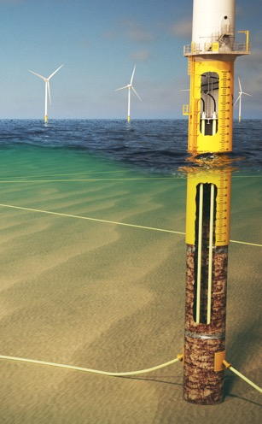
Intuitive visualisation of asset integrity and performance
Monitoring
Proserv specialises in real-time monitoring for hard-to-reach locations and extreme environments. Supporting a philosophy of maximising returns and life extension, keeping a close eye on the functioning of critical equipment is fundamental.
Open data for full flexibility, adding context and extracting value
Utilise information via an operator’s data historian
HMI visualisation design principles for intuitive monitoring
Retrofit solutions for existing systems
Increase visibility over asset condition anticipated life expectancy
Direct ongoing operational expenditure (OPEX)
Maximise the asset’s value
Key technologies
ECG™ cable monitoring
Smart Box remote monitoring
Subsea sampling system
Flow metering
SCADA

Slide 36
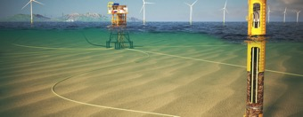
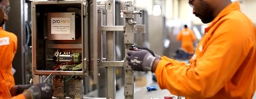
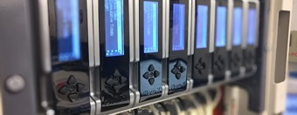
Our monitoring solutions
Monitoring
ECG™
Holistic Cable Monitoring System
Smart Box
Well Monitoring
Fiscal and Custody Transfer Metering Systems
ECG™ introduces a step-change in traditional monitoring methods, offering comprehensive visibility across cable assets. Adopting an integrated and scalable approach, ECG™ provides real-time analysis with insights through an intuitive user interface. Enabling proactive decision-making, improving utilisation and reducing OPEX costs, ECG™ delivers complete peace of mind.
Unplanned shut downs can cost operators up to one percent of total annual production. The Proserv Smart Box is a real time monitoring solution for evaluating onshore and offshore wells in remote sites; shut downs are detected instantly, avoiding prolonged production losses and lowering operating costs.
We deliver tailor-made solutions using a variety of industry standard products and our own in-house developed software suite of add-on enhancements. Our modules include meter diagnostics, condition-based monitoring, flow calculation verification and live dynamic uncertainty, all of which can be used independently or linked together and interfaced to your existing or new metering solution.

Slide 37
Digitalisation is the top technology development desired by operators
Intelligence
“We have started to use more digitalized solutions to optimize the field architecture and made our installation campaigns more efficient and effective while reducing engineering costs and delivery time” Petrobras, SE Asia
Operators worldwide report plans to increase use of digitalisation technologies, automation, all electric systems and remote operations to drive additional efficiencies and shape the future of subsea operations.
Proserv Analysis
Our digitalisation technologies and partnership with Synaptec has fast tracked Proserv into this space.
49%
Believe that digitalisation will have a major impact on future subsea operations
22%
Believe that digitalisation and data analytics will change the way we design and operate subsea developments and operations
13%
believe that digital technologies / software / AI has the single biggest impact on improving life of field economics
Operators were asked: how will digitalisation change / impact subsea operations?
More reliable operations
More data and data management
Better decision making
Remote ops and monitoring
Cost savings
Better safety
Communications / share data

Slide 38
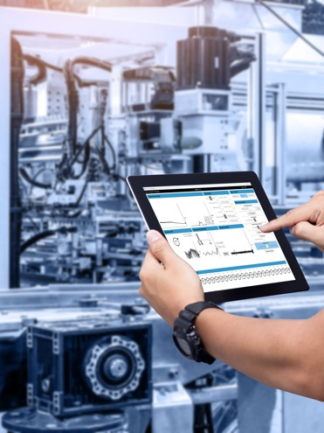
Insights from advanced data analytics and machine learning to predict outcomes
Intelligence
Proserv supports operators with early root cause analysis and interception strategies, enabling engineering and maintenance teams to act early on the insights we can provide so that any performance anomalies are examined long before they become trips or alarms for the control room team.
Providing field data intelligence via the control system
Machine learning, open-source data and data analytics
Smart systems offering intelligence, automation and predictability
OEM agnostic, flexible and scalable
Provision of subject matter diagnostic expertise
Connectivity across an entire asset
Full digitalisation across our product and service portfolio
Key technologies
SCADA with data analytics
Advanced monitoring and surveillance dashboards
Prognosis metering

Slide 39
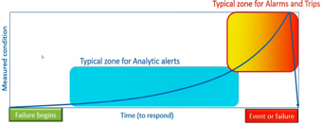

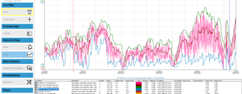
Our intelligence solutions
Intelligence
Predictive Maintenance Visulisation
Asset Enhancement
Intelligence (AEGIS)
Advanced
SCADA
Proserv offers condition monitoring and world leading visualisation tools that are 100% focused on Human Factors rather than classic SCADA / HMI evolutions. Combined with the analytics and machine learning that run in the background, our solution provides enhanced predictive maintenance and asset optimisation.
Asset Intelligence (AEGIS) has been designed to shield producers from overdue maintenance by providing real-time updates and notifications regarding the service status of your assets. It displays the oilfields/windfarms and platforms/turbines, providing detailed information on topside and subsea equipment.
Proserv is revolutionizing SCADA with advanced analytics, allowing you to Visualise, understand and act on your asset data. From whole portfolio management to individual
turbine insight, Proserv
brings together data analytics
with our industry expertise
into one easy solution.

Slide 40
Maintenance and repair services continue to support life extension and production optimisation
Optimisation
“Design for robustness, reliability and easy operation for maintenance and monitoring is all we need in the future.”
ONGC, India
Life of field services costs increase with well age:
Older than 10 years
$1.08m / year
Less than 10 years
$702k / year
80%
Subsea operators reported having subsea wells requiring equipment maintenance or repair in 2021, impacting an estimate of 10% of the subsea well installed base worldwide.
Proserv analysis
Proserv has the brand heritage and expertise to maintain numerous brands, including Brisco, CAC, EP Solutions.
32%
Equipment inspection, maintenance and repair comprise the largest portion of the typical subsea operator’s annual life of field services expenditures.
2.28
Number of suppliers used by operators for IRM services.
INSPECTION FREQUENCY
39%
of operators conduct annual inspections of their subsea production equipment and address maintenance and repairs proactively
28%
of operators conduct periodic inspections greater than 1 year interval and address all repair work immediately.

Slide 41
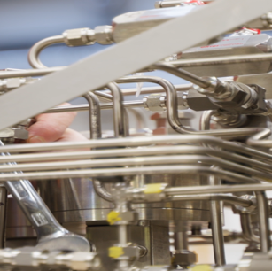
Improved performance and asset life extension through our expertise and technology
Optimisation
Our controls solutions have the power to reinvigorate and optimise performance reliability, boosting the productivity of inefficient and failing systems, extending their life, and so preventing wasteful and carbon intensive replacement.
Our independence and OEM agnostic approach give us a renowned bandwidth of expertise, allowing us to be agile and to tailor solutions to any given situation.
Obsolescence management
Brownfield upgrades
Inspection, repair and maintenance
Asset optimization
Third party equipment and component supply/rental
Digital dashboards for field performance monitoring
Key solutions
Augmented Controls Technologies (ACT)
AEGIS – Asset Enhancement Global Intelligence Solution

Slide 42

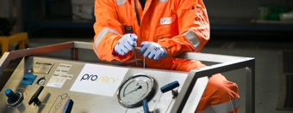
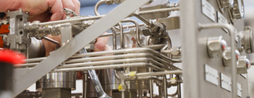
Our optimisation services
Optimisation
Production Maximisation with Subsea Sampling
Instrumentation
and Calibration
Proserv ACT
Augmented Controls Technology
Subsea sampling supports production maximisation by providing accurate, at
source, production chemistry.
Knowing the chemistry of fluids and solids inside the pipeline allows you to calibrate subsea multi-phase flow meters, assists in efforts to reduce production losses and supports the unrestricted flow of fluids from
reservoir to refinery.
Proserv carries an extensive rental fleet of general purpose and zone-rated equipment, enabling clients to control, monitor, measure and report during testing and maintenance activities both on and offshore.
Our rental fleet is available for short and long-term rental periods and includes optios for hydrostatic testing flushing & fluid cleanliness umbilical and electrical test equipment.
Proserv ACT is a simple and cost-effective way to maintain production, without full system replacement. Rather than discard all the old technology and equipment, not all of which necessarily needs changing, a more cost-effective solution is to work with the current system.

Slide 43
Slides on specific products and services
Subsea
Subsea control systems
Proserv ACT
Topside
Topside controls
Track record and brand heritage
ECG™
Intelligent supervisory control and data analytics
Asset Intelligence
Measurement
Prognosis
Dynamic Uncertainty Calculations
Valid8
Sampling
Sampling overview
IWOCS
IWOCS overview
Electrical services
(MEA and USA only)
Interactive Digital Brochures

Slide 44
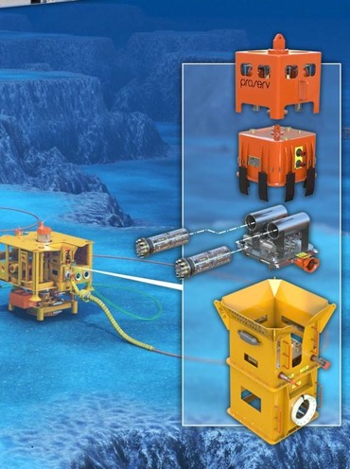
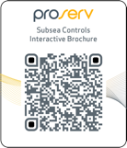
Reliable and flexible systems that never become obsolete
Subsea control systems
Unrivalled equipment reliability for sustainable and profitable production.
Five pledges underpin our subsea controls for both greenfield and brownfield developments.
Reliability: We provide a best in industry warranty for all the subsea control equipment supplied
Never obsolete: We will issue certificates guaranteeing that the subsea control system will never become obsolete
Delivery: We will stand by our commitment to the most competitive delivery
Flexibility: we will collaborate with its partners, not dictate solutions, to extend the life of subsea fields in the most economical way possible; guaranteeing continued support for your installed system for its entire life
Track record We have delivered over 300 control systems to 40 operators for 84 subsea fields over 30 years.
New developments
We offer flexible, high
speed communications
for all greenfield
scenarios
Existing OEM
infrastructure
Our co-exist technology
enables you to expand,
enhance and upgrade,
irrespective of what
your existing OEM says
Scan the QR code to view our Interactive Digital Brochure

Slide 45
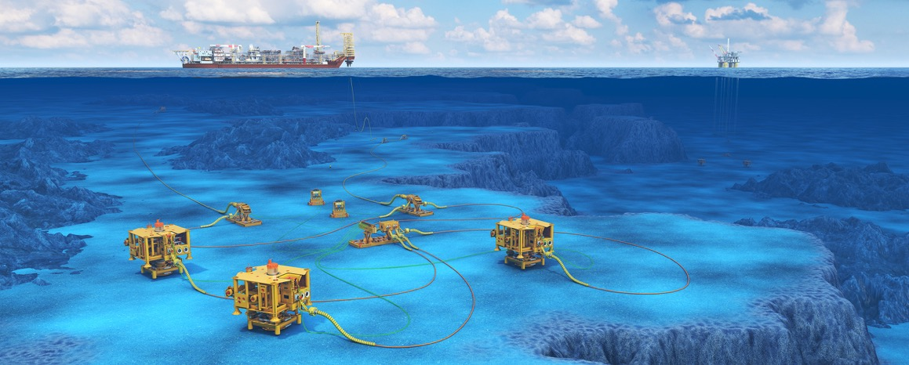


Operators face many challenges that OEMs either can’t or won’t address
The Proserv ACT toolkit
Obsolete equipment or OEM support
Risk of failure and poor reliability
Extend field for additional wells
Extend well life
Additional instrumentation
ACT
Augmented Controls Technologies
RETROFIT A2G SEM UPGRADE
SCM REFURBISH
CO-EXIST / EMULATE
SYSTEM UPGRADE
ADAPTABLE SOLUTIONS
MECHANICAL UPGRADES ETC
HIPPS EXTENSION
Notes:
Risk of Failure and Poor Reliability on already installed systems
Failed wells without adequate support from the OEM require an alternative control solution to reinstate well production without full system replacement
Long Term Obsolescence Support for Extended Well Life
Support for extended field life and even for original design life may have limited part obsolescence support and / or engineering support from the OEM
Extending Fields for Additional Wells
Adding wells to brownfield subsea systems requires interfacing with existing and often unsupported aging technology both subsea and topside
Additional Instrumentation for Production Optimisation
Instrumentation to provide essential information to maximise remaining production may not be supported by the existing control system

Slide 46
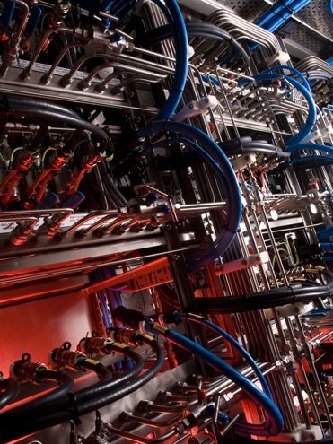
We design, manufacture, install and service the full range of production control equipment
Topside controls
As a global original equipment manufacturer with a well established track record of installed systems, we use our local content staffed service centres to inspect, maintain, repair or replace active production equipment in the field.
Field development
Commissioning / installation
Flushing, testing and calibration
Shutdown support / on-site services
Life of Field (Asset Intelligence)
Inspection, repair and maintenance
Production optimisation
Pipeline services
Services and aftermarket
Equipment rental
Training programmes
Spare parts sales
Partner alliance programme
Consignment stocking
Equipment enhancement
Rehabilitation and recertification
Equipment overhaul

Slide 47
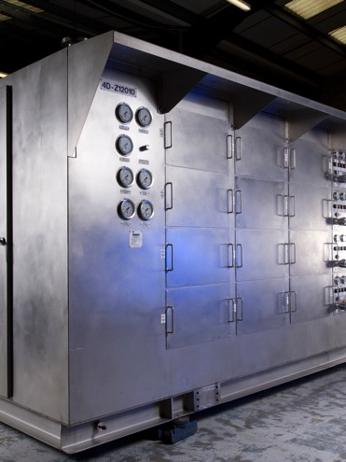





Over 50 years’ experience providing engineering, manufacturing and service
Topside controls
At Proserv, we are proud of our history. Our portfolio of brands each have a strong track record of proven project delivery.
By bringing these businesses together under one cohesive organisation, we were able to enhance our market presence and extend our global reach and support coverage. We have the knowledge and experience to support and maintain the brands below.
20,000+
Production control systems manufactured
6,000+
Wellhead control systems supplied
40,000+
Sampling cylinders manufactured and certified
1,000
Production control system refurbishments

Slide 48
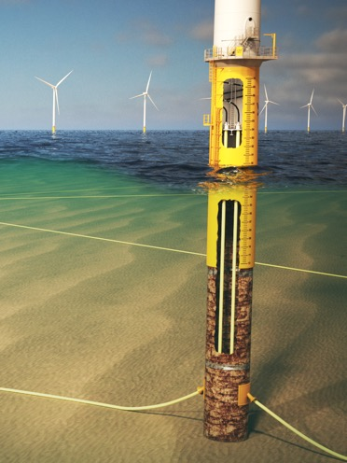


ECG™ holistic cable monitoring system offers comprehensive visibility across cable assets
Cable monitoring
An online, synchronous cable monitoring system
Adopting an integrated and scalable approach,
ECG™provides real-time analysis with insights
through an intuitive user interface.
Maximise power transmission and increase efficiencies
Reduce failures as a result of intelligent monitoring
Protect against serious events with warnings of developing faults
Save OPEX and vessel costs with planned intervention
Plan lower cost interventions around weather and resource availability
Peace of mind about the condition and integrity of your cable.
Distributed temperature sensing
Distributed acoustic sensing
Passive termination monitoring
Strain sensing
Power quality monitoring
Environmental data
AIS data and more

Slide 49

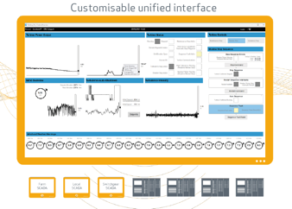
Visualise, understand and act on your asset data
Intelligent supervisory control and data analytics
Revolutionising SCADA with advanced analytics
From whole portfolio management to individual turbine insight, Proserv brings together data analytics with our industry expertise into one easy solution.
Receive intuitive insights to guide your decision making
Protect against obsolescence with a fully flexible and compliant system
Safeguard your assets with leading cyber security and data sovereignty
Optimise your assets and reduce system maintenance and downtime
Save OPEX costs with fewer interfaces
Dedicated system support from Proserv for the life of your wind farm.
Turbine and data agnostic
Advanced visualisation
Custom sequencing
Unlimited scalability
Suited to generation, transmission and distribution

Slide 50

Asset Enhancement Global Intelligence Solution
Asset Intelligence
Proserv’s Asset Enhanced Global Intelligence Solution (AEGIS) is a user-friendly intelligence solution providing real-time monitoring of the condition of assets during their entire lifecycle.
User-Friendly Condition Monitoring Solution
Always on point: provides real time asset information
Historic data: enables asset condition monitoring and provides historic data of asset performance
All around support: supports all your teams, including managers, maintenance and operational teams, inspection planners and risk analysts
Best service: serves as the hub for service data, reports and drawings
Optimised workflow: presents workflow status of each asset and total maintenance progress
Reports: allows configurable reporting.
AEGIS can:
Increase uptime and reliability
Reduce unplanned downtime
Cut maintenance costs and interventions
Improve safety and environmental integrity
Extend the life of ageing assets

Slide 51
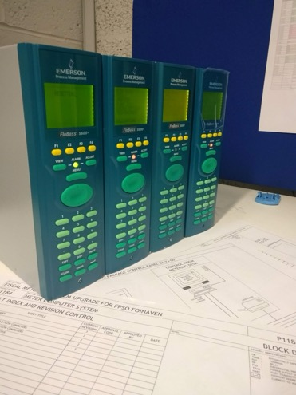





We are an independent, OEM agnostic solution provider
Measurement
Designing, manufacturing and supporting high accuracy fiscal metering systems for the oil and gas industry. Working globally upstream, midstream and downstream.
Being independent allows Proserv to provide the right engineered solution regardless of manufacturer, to best meet your needs.
Specialising in brownfield system refurbishment and life extension
Experts in live installations with no loss of flow
We provide software solutions to enhance system accuracy and visibility
200+
30
2,000+
30
4,000+
SUPPLIED SYSTEMS
Designed, manufactured, sold and serviced
YEARS SUPPORTING
Measurement control
systems
STREAMS MEASURED
Across all installed
systems
ANNUAL SUPPORT CONTRACTS
Systems supported globally
DAYS
LTI FREE
No lost time incidents for
11+ years

Slide 52
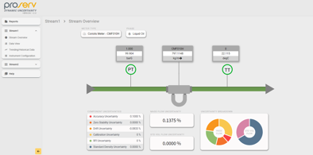
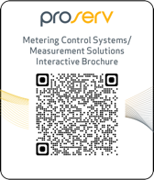
Unlock precision with Dynamic Uncertainty Calculations
Dynamic Uncertainty
Flow measurements are meaningless without an accompanying statement of uncertainty and associated confidence level.
Traditional manual uncertainty analysis are not only labour-intensive but also costly and infrequent.
Proserv Dynamic Uncertainty Calculations is a cutting-edge, standalone software solution that performs real-time flow measurement uncertainty calculations.
Pinpoint Accuracy: calculates component uncertainty for every instrument (TT,PT,FT,GC etc.)
Comprehensive Insight: determines overall uncertainty in Mass Flowrate and Standard Volume Flowrate for any stream
Scan the QR code to view our Interactive Digital Brochure

Slide 53

Protect your system and minimise financial exposure
Dynamic Uncertainty Calculations
THE COST OF ERRORS - getting it wrong costs money
Just a 1% under-reading of 85,000 barrels per day @ $100 a barrel:
$30 million per year
Proserv has developed a full set of advanced dynamic uncertainty calculations to monitor uncertainties in metering systems, allowing the operator to act quickly and decisively to mitigate the issue.
Real-time monitoring of uncertainty in oil and gas metering
Ability to identify instruments that have drifted out of calibration
Reduces financial losses and potential penalties
Allows operators to identify any trends in the system
FEATURES
Acts as a condition-based monitoring system to provide an early warning system
Suitable for a wide range of flow meter types, manufacturers and equipment needed for flow measurement systems

Slide 54
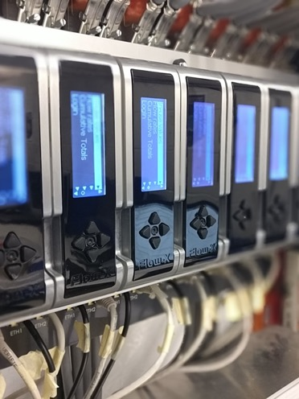
Unlock the potential of your metering system
Valid8 flow computer calculation verification engine
Calculation verification performed live, at the touch of a button, with no need for offline verification using third party software.
Reduces need to mobilise engineers offshore for manual intervention
Produces more accurate batch totals
Minimises maintenance costs
Allows for automatic control of sampling and stream switching
Verify calculations directly from the supervisory computer
FEATURES
Extensive library of calculations
Auditable records of previous results
Condition based monitoring of dual HART transmitters
Batch load recalculation based on proof results and lab values for standard density and water

Slide 55


Over 40 years’ experience providing engineering, manufacturing and service
Sampling and injection
SAMPLING AND INJECTION SOLUTIONS
Sampling cylinders
Downhole sampling
Subsea sampling
Topside sampling
Chemical delivery
TOPSIDE TESTING
Flushing and fluid cleanliness
Hydrostatic test equipment
Electrical test equipment
Umbilical test equipment
Pressure testing services
SERVICES
Calibration services
Product support
Field operation support
Training and technical support
Service and recertification
40,000
Sample cylinders manufactured,
sold and serviced
10
Subsea sampling systems engineered and manufactured
750
Downhole samplers, manufactured, sold and supported worldwide
3,000
Sampling and injection solutions
engineered
Scan the QR code to view our Interactive Digital Brochure

Slide 56

A fully independent service solution across the life of field
IWOCS
Proserv has a 40-year track record in the design, manufacture and rental of intervention workover control systems (IWOCS) globally.
Ability to react quickly to client needs and work on any tree
Large rental fleet at our disposal including hydraulic and electro-hydraulic systems
Over 20 years of experience in workover solutions
Systems can use multiple control fluids
Emergency disconnect cutting solution as standard
Equipment is designed to fit into limited access areas
Simple options for quick installation
SIT – to eliminate offshore failures / prove system interface
A wide range of pressures and functions

Slide 57
Industrial and hazardous area equipment and services
Electrical services
Engineering
Wholesale
Junction box assembly
E&I
Inspection
and Maintenance
Survey and data gathering of ex equipment on installations
Equipment maintenance and repair
Management of clients’ ex registers
Visual, close and detailed inspections
Electronic tagging and marketing of ex equipment
Implementation of ex strategies
E&I
Installation and maintenance
E&I modification scopes
E&I installation scopes
Testing and inspection services
Shutdown maintenance personnel
CAP437 lighting installations
Supply of hazardous area and industrial electrical equipment
Fixed ex LED lighting
Temporary and portable ex LED lighting
Ex cable glands and thread conversion accessories
Ex junction boxes
Industrial enclosures
Cable containment
Wiring accessories
Identification products
Leading certified assembler of Weidmüller junction box enclosures in the UAE
Authorised to assemble junction boxes under ATEX and IECEx certification for leading European manufacturer, Weidmüller
Assembly service includes: design, population, drilling and tapping

Slide 58








Scan the QR codes to view our Interactive Digital Brochures
Interactive Digital Brochures

Slide 59
Company information – locations and people
Contents
UK
Middle East and India
USA
Norway

Slide 60









Executive Leadership
Davis Larssen
Chief Executive Officer (CEO)
Christine Thorne
Executive Assistant
David Nemetz
Chief Operating Officer (COO)
Ben Swan
Chief Financial Officer (CFO)
Tore Erntsen
Chief Technology Officer (CTO)
Morag McGowan
Director Human Resources
Iain Smith
Senior VP Sales & Strategic Accounts
Alastair Moody
General Counsel
Ewen MacLean
Vice President Commercial

Slide 61












Operations Leadership
David Nemetz Chief Operating Officer (COO)
Steven Antczak
Group FPA Director
Geert Kooi
SVP
Subsea Controls
Angus Rodger
SVP
Topside Controls/ Specialist Sales
Chris Denton
Director Supply Chain
Simon Harvey
Director QHSE
Crawford Tennant
VP IWOCS
Janice MacLeod
VP
Measurement
David Marshall
Director Project Management Office
Alan Peek Director Engineering
Paul Cook
VP ECG
Sean Andersson
VP
Sampling
3
Business Units
Operations Functions

Slide 62

Proserv’s 13 facilities across the world
Global locations
Sommermeyer Facility
Houston, TX
Cumbernauld Facility
Cumbernauld, UK
Doha Facility
Doha, Qatar
Chennai Facility
Chennai, India
Westhill Facility
Westhill, UK
Trondheim Facility
Trondheim, Norway
Abu Dhabi Facility
Abu Dhabi, UAE
Skene Facility
Westhill, UK
Greenbank Facility
Aberdeen, UK
Great Yarmouth Facility
Great Yarmouth, UK
Stavanger Facility
Stavanger, Norway
Dammam Facility
Dammam, Saudi Arabia
Dubai Facility
Dubai, UAE

Slide 63

Site Leadership
Sommermeyer Facility
Anthony Carrea
Cumbernauld Facility
Janice MacLeod
Skene Facility
Crawford Tennant
Great Yarmouth Facility
Mark Whiteside
Trondheim Facility
Mirza Duvnjak
Doha Facility
Trevor Ogilvie
Abu Dhabi Facility
Angus Rodger
Chennai Facility
Suresh Subramanian
Westhill Facility
Davis Larssen
Greenbank Facility
Sean Andersson
Stavanger Facility
Rune Godejord
Dammam Facility
Chris Chambers
Dubai Facility
Nicola Birnie

Slide 64




We have five facilities in the UK
United Kingdom
People
331
Operating Bases
Aberdeen, UK Great Yarmouth, UK Cumbernauld, UK
Global Centres of Excellence
Subsea Controls Manufacturing and Engineering (GREAT YARMOUTH)
Measurement Centre of Excellence (CUMBERNAULD)
Sampling and IWOCS Centres of Excellence (ABERDEEN)
Specialty Services and Expertise
Subsea production systems, control and monitoring
Measurement and metering systems
Intervention workover controls (IWOCS)
Production sampling and subsea sampling
Equipment instrumentation and calibration

Slide 65
Our HQ is based in Aberdeen, Scotland, with centres of excellence throughout the UK
United Kingdom facilities
WESTHILL,
ABERDEEN
Corporate Headquarters
SKENE,
ABERDEEN
IWOCS Centre of Excellence
Workshop: 4,500 sqm
Yard: 6,600 sqm
150 tonne SIT area
Warehouse:1,059 sqm
Test/Assembly: 800 sqm
Manufacturing: 691 sqm
Production: 1,194 sqm
Test Bay: 3 x 30,000psi
GREENBANK, ABERDEEN
Sampling Centre of Excellence
Site: 800 sqm
Workshop: 186 sqm
Testing laboratory: 100 sqm
Office: 550 sqm
CUMBERNAULD
LANARKSHIRE
Measurement Centre of Excellence
Management team
ARTEMIS HOUSE,
GREAT YARMOUTH
Subsea Controls Centre of Excellence
Office: 2,100 sqm
Workshop: 3,900 sqm
External: 1,219 sqm
Clean rooms: 1
Crane: 20t (1)
External test facility

Slide 66

We have five operational bases in the Middle East and India
Middle East and India
People
276
Operating Bases
Dubai, UAE Abu Dhabi, UAE Dammam, Saudi Arabia
Doha, Qatar Chennai, India
Global Centres of Excellence
Design, Engineering and Supply of Production Control Systems (DUBAI)
Service Centre of Excellence Middle East and Africa – (ABU DHABI)
Global Centre of Engineering (CHENNAI)
Specialty Services and Expertise
Topside production equipment
Offshore services support
Flushing
Hydraulic power units (HPUs)
Test and control
Instrumentation and calibration
Sampling services
Custom client training programmes
Third party product sales (trading)

Slide 67
We have a strong footprint in the Middle East
MEA and India facilities
DUBAI
UAE
Centre of Excellence for the Design and Manufacture of Topside Production Equipment
DAMMAM
ARABIA SAUDIA
Controls Technology Supply and Service Centre
Office: 150 sqm
Warehouse: 800 sqm
Assembly: 800 sqm
External yard: 1,00 sqm
DOHA
QATAR
Controls Technology Supply and Service Centre
Internal: 2,000 sqm
External: 300 sqm
CHENNAI
INDIA
Global Engineering Centre of Excellence
Assembly: 1,700 sqm
Test: 205 sqm
Fabrication: 1,600 sqm
Warehouse: 245 sqm
External yard: 750 sqm
Crane: 10 ton (1)
ABU DHABI
UAE
Service Centre of Excellence for the Middle East and Africa
Site: 2,850 sqm
Service workshop: 1,050 sqm
Office: 800 spm

Slide 68

Our Houston specialist facility serves the Gulf of Mexico and beyond.
USA
HOUSTON
USA
Subsea Controls Centre of Excellence
Office: 2,657 sqm
Shop Space: 2879 sqm
Warehouse: 376 sqm
External Yard: 420 sqm
Cranes: 3 ton crane (1), 5 ton crane (4
People
80
Operating Base
Houston, Texas
Global Centres of Excellence
Design Engineer and Supply of Production Control Systems (HOUSTON)
Specialty Services and Expertise
Subsea production systems
Sampling services
Intervention workover controls
Hydraulic Power Units (HPU’s)
Topside Production Equipment
Piping, tubing and electrical installations
Operational assurance services

Slide 69
We have a strong presence in Norway
Norwegian facilities
MOSEIDVEIEN FACILITY
STAVANGER
Design and Manufacture of Subsea Technologies and Manufacture and Rental of Production Equipment
Office: 2,239 sqm
Warehouse: 274 sqm
Production: 1,440 sqm
Service laboratory: 1,253 sqm
Test: 458 sqm
Crane: 10 ton (2)
Office: 1,500 sqm
Test & assembly: 148 sqm
Workshop: 34 sqm
Warehouse: 245 sqm
Storage & shipping: 200 sqm
STRANDVEIEN FACILITY
TRONDHEIM
Subsea Research and Development Hub
People
107
Operating Bases
Stavanger, Norway Trondheim, Norway
Global Centres of Excellence
Flagship R&D Centre for Subsea Communications Systems (TRONDHEIM)
Third-party Equipment Sales (Trading Centre) (STAVANGER)
Specialty Services and Expertise
Rapid response solutions engineering
Subsea equipment lifecycle services
Production sampling
Topside production equipment
Third-party product sales (trading)
Production equipment rental
Equipment instrumentation and calibration

