Slide 1
Subsea Controls
Control technologies for critical infrastructure

Slide 2
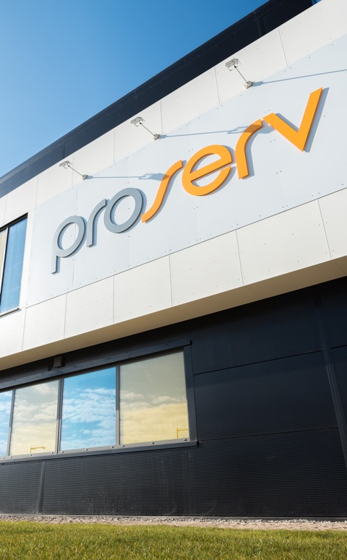
Control technologies for critical infrastructure
Introduction
Proserv is a controls technology company.
We improve the reliability, integrity, efficiency and productivity of critical infrastructure with industry leading controls technology.
Our Values
Forward as a Team
Right Thing, Right Way
Entrepreneurial Spirit
Serious about Service
Help, Share and Communicate
Nearly
60
years’ experience
13
global locations
Operating in
60+
countries

Slide 3






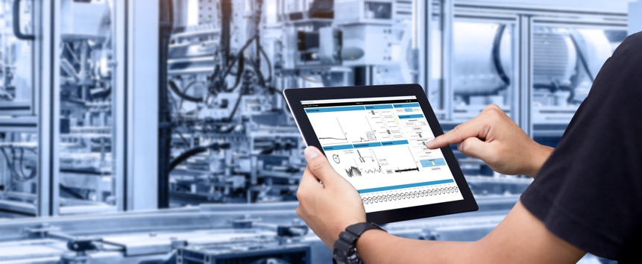
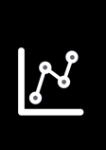

We improve the reliability, integrity, efficiency and productivity of critical infrastructure with industry leading controls technology
The Controls Technology Company
Control
Independent and reliable control systems for critical infrastructure.
Intuitive visualisation of asset integrity and performance.
Intelligence
Insights from advanced data analytics and machine learning to predict outcomes.
Optimisation
Improved performance and asset life extension through our expertise and technology.
Monitoring
ENERGY

Slide 4
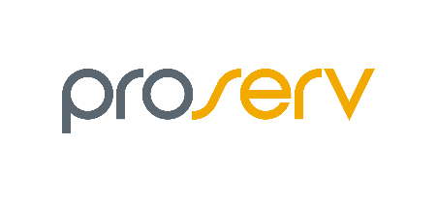










Proserv has an extensive brand heritage spanning nearly 60 years
Solid core of controls experience
2014
2019
2020
2022
2023+
Acquires EP Solutions
Acquires SGC Metering
Partnerships with Synaptec & Intelligent Plant
Acquires stake in Synaptec
2011
Today, we are driving progress in renewables and digitalisation
MODERN PROSERV FORMED
2006
2002
1980s
1970s
1960s
EP Solutions established
Sicom established
SGC Metering
Autocon established
Brisco
Proserv Technology established
CAC established
Notes:
Proserv has evolved significantly over the years both through organic growth and strategic acquisition in order to develop our controls expertise. Recent partnerships have further strengthened our move into intelligence solutions and renewables.

Slide 5
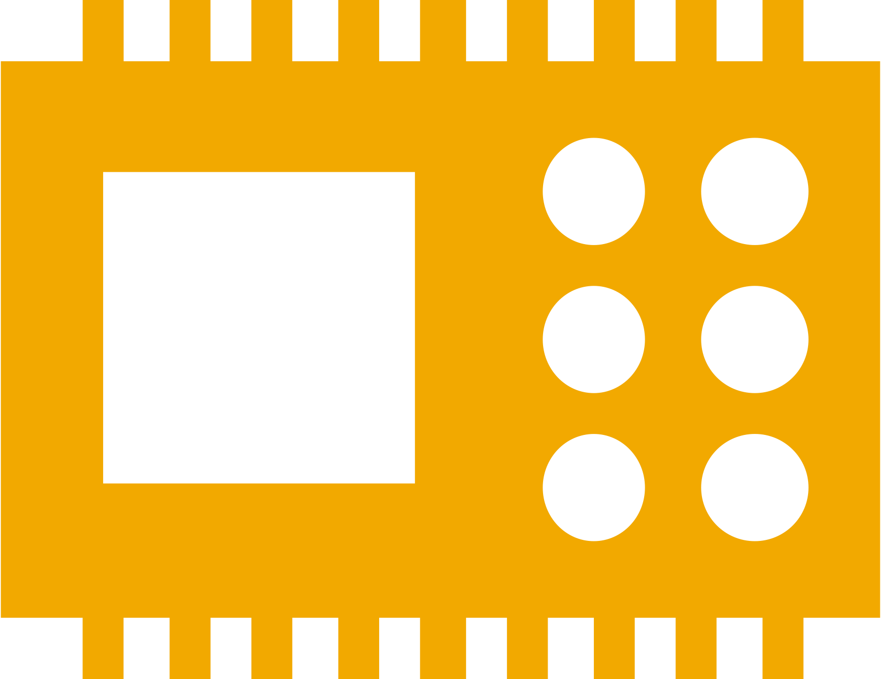










We offer a wide range of technology solutions
Products
g
Subsea Controls
Extend life of field without costly equipment replacement shutdowns by using a subsea controls system that is never obsolete.
Topside Controls
We design, manufacture, install and service the full range of production control equipment right across the energy value chain.
Cable monitoring
Enhance the ability to detect, locate and predict cable life expectancy with the Proserv ECG™ Electro Cable Guard
holistic cable monitoring system.
SCADA systems
We provide clients with the capability to monitor and control operations across a widely dispersed infrastructure to improve efficiency.
IWOCS
Providing temporary well control during subsea well installations, workovers and abandonments to meet each field’s unique configuration.
Measurement
Specialising in fiscal and custody transfer metering systems, to meet the most stringent of technical requirements.
Sampling
A range of solutions for sampling, incorporating sample containment, transportation cylinders, and chemical injection.
300
Subsea control modules supplied to clients
20,000
Production control systems manufactured
40,000
Sampling cylinders manufactured and certified
200
Metering control systems manufactured
1,000
Production control systems refurbished
5,000
Wellhead control systems supplied
New field and design services
Installation and commissioning
Maintenance
Field Extension
Decommissioning
Brownfield upgrades

Slide 6

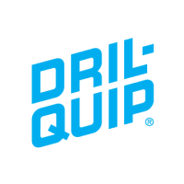




We have an open approach to collaboration
Partnerships
EMPOWERING CHOICE
EMPOWERING INNOVATION
Integrated solutions that save time, simplify logistics and drive standardisation.
Putting Proserv at the forefront of technology advancement.
HIPPS controls
Buoy controls
Tree controls
Advanced digital solutions
Notes:
This is the how of Proserv to create unique value through brining value by empowering innovation through partnerships. Which shortens the adoption cycle.
Empowering choice
Alliances can bring a positive impact to operations as companies come together to offer integrated solutions, saving time, simplifying logistics and driving standardisation. We have an agnostic approach towards alliances and can accommodate client requests whether as part of a partnership or standalone.
Empower innovation
Proserv partners with complimentary, emerging technology companies to create compelling solutions for customers. These relationships enable Proserv to be at the forefront of technology advancements as we continue to identify innovative ways to create value for our customers throughout the energy transition.

Slide 7
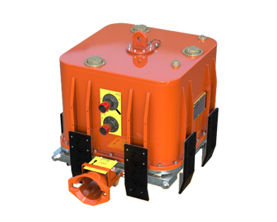

Our mission is to extend the life and improve the reliability of energy assets
Our technology ethos
Reliability commitment: We provide the energy industry with best-in-class quality across all our solutions that never go obsolete
56%
less greenhouse
emissions*
We reduce our customers’ carbon footprints
We extend the life of assets
Our solutions optimise the performance of equipment, helping to prevent hydrocarbon leaks and decrease fluid and energy use.
We use intelligent solutions
By using digital technology and real-time monitoring, we can remotely support our clients, alleviating the need for travel.
Our technology ethos is to reuse, refurbish and upgrade equipment wherever viable, lessening both equipment disposal and manufacture.
TECHNOLOGY HIGHLIGHT
Subsea control module reliability:
Removes need to retrieve and service the SCM during its lifespan
No support vessel to assist with the retrieval of the module
The result: Approximately
78 tonnes CO2e saved.

Slide 8
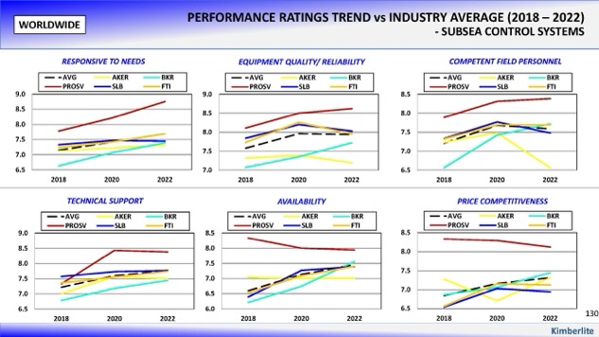
We are recognised as an industry leader in control systems and technologies
Industry recognition
We have the capability and expertise to deliver.
Over 100 dedicated control engineers
750 staff
35 R&D experts
13 manufacturing and service bases around the globe
Operating in over 60 countries
We are no 1*
Subsea control systems I IWOCS services I IRM services
In a recent report*, of the Operators interviewed who have worked with Proserv, every one of them recommended us.
We outperform our competition on all
key metrics:*
Technical support
Competent field personnel
Equipment reliability
Availability
Responsiveness

Slide 9

The report highlighted that some companies perceive Proserv as a small company
Operator Image of Proserv
A small disadvantage?
In reality, we are a dedicated and focused business, exclusively developing technology and executing controls projects that more than rival any OEM subsea controls capabilities.
Proserv specialise solely in controls, with over 40 years’ experience.
Over 100 dedicated controls engineers, 750 staff,
35 staff in our communications and electronics R&D facility in Trondheim, 4 manufacturing sites and services bases around the globe.
300+
subsea control modules (SCMs)
50+
ACT projects
85+
Open communications hubs
6000+
topside control panels
130+
subsea controls projects
Market Share
At 26%*, second only to TFMC for subsea controls supply in GOM for past two years.
Market leader for subsea controls in North Sea.
28%* global market share with independents – over double that of Aker and Baker Hughes.
Proserv seems to be very flexible. If you need an unusual solution, they can probably do it.
Beacon Offshore Energy
As a small supplier, Proserv provides good attention.
Hess*

Slide 10
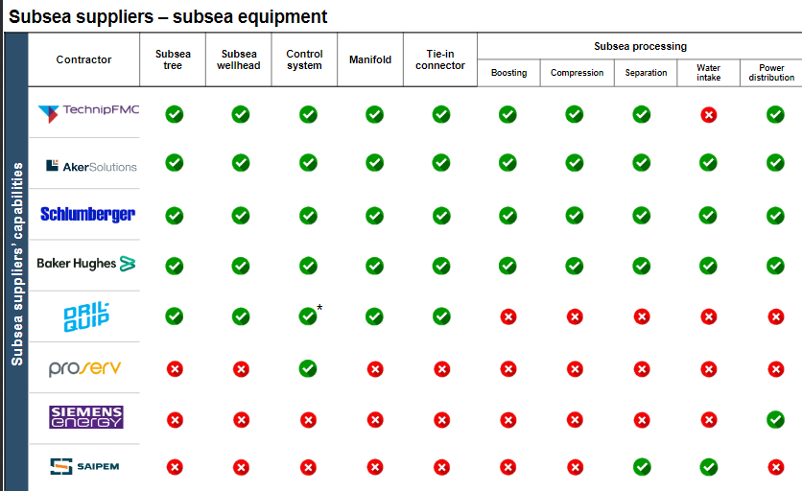
Proserv specialises solely in controls, with over 60 years’ experience
Market Share
At 26%*, second only to TFMC for subsea controls supply in GOM for past two years.
Market leader for subsea controls in UK North Sea.
28%* global market share with independents – over double that of Aker and Baker Hughes.

Slide 11
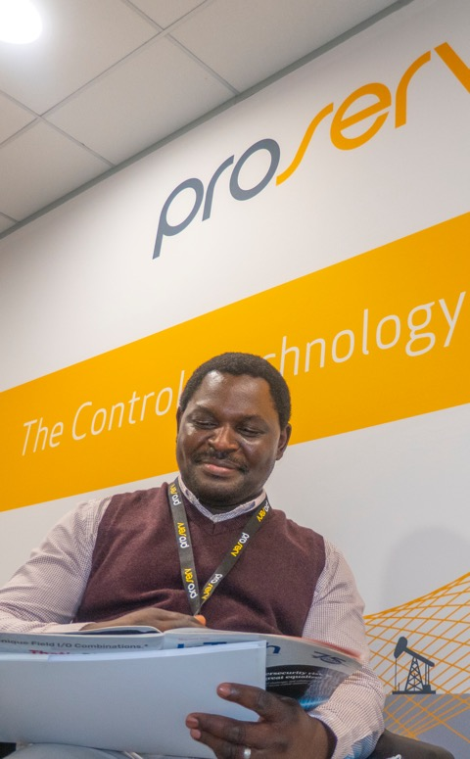







We are an award winning company
Why Proserv?
2022
Early Career Professional Of The Year
OEUK Awards 2022
MEA Service Award
EIC Awards 2022
Service and Solutions Award
EIC Awards 2021
Export Award
EIC National Awards 2019
Workforce Engagement Award
Oil & Gas UK Awards 2018
Innovator & Technology Award
Subsea UK Awards 2017
Subsea Company of the Year
Subsea UK Awards 2015
Great Large Company of the Year
Offshore Achievement Awards 2015
Apprentice of the Year
Oil & Gas UK Awards 2014
Business of the Year
Spirit of Enterprise Awards 2014
Great Engineering & Manufacturing Company
Spirit of Enterprise Awards 2014
Technology of the Year
Middle East Oil & Gas Awards 2013
Entrepreneur of the Year
Ernst & Young Awards 2013
2021
2022
2019
2018
2017
2016
2015
2014
2013

Slide 12
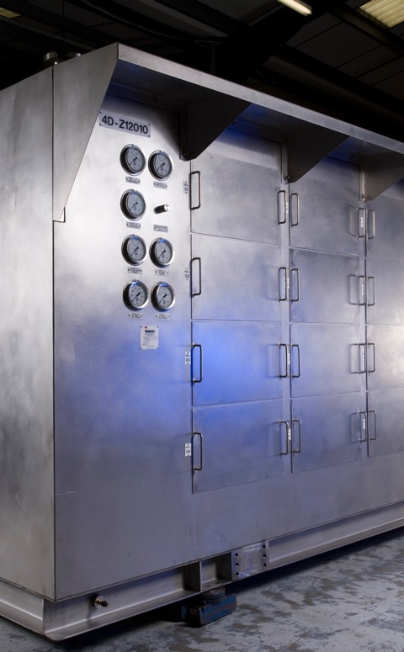

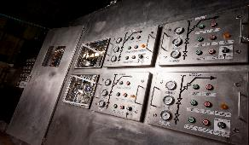
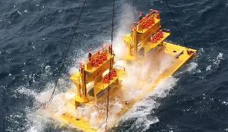
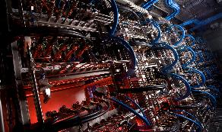
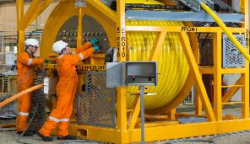
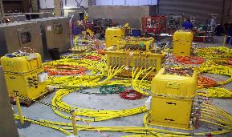
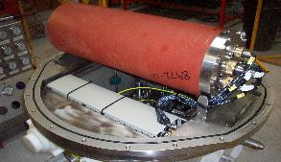
Our Services
Our Offerings
Topside Controls
Subsea
Controls
Automation Systems
IWOCS
Brownfield Upgrades
Maintenance & Extension

Slide 13
Subsea Controls

Slide 14

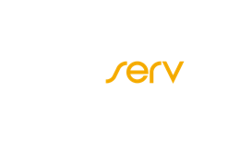
Of all the challenges with
subsea production equipment,
industry data highlight that
subsea control systems
are the primary point of failure

Slide 15

The industry is not satisfied with their SCS Suppliers
LISTENING TO INDUSTRY WIDE OPINIONS
21%
53%
Proserv Analysis
These figures are improving but reliability of a subsea controls system remains as one of the biggest issues and contributors to Total Cost of Ownership for operators producing from a subsea field
Believe that subsea equipment reliability has the single biggest impact on improving subsea operations.
Believe that subsea controls systems need advancement through better reliability.
The Kimberlite report
104 key technical and commercial decision makers
Covering 4,826 subsea wells across the globe
Representing 50 unique subsea oil and gas operators

Slide 16
And for good reason
LISTENING TO INDUSTRY WIDE PROBLEMS
22
45%
Proserv Analysis
91% of all Proserv SCMs installed on producing subsea wells have never been recovered.
The average mean time between failure of a SCS is approximately 22 months.
Of subsea control system purchases in the next two years are anticipated to be for retrofit and/or replacement of existing systems.
The most common failing components include electrical components such as control modules/
SCMs along with SEMs and sensors and gauges.
Notes:
Approximately 15% of the respondents interviewed cite that their subsea control systems do
not meet their reliability requirements and that the average mean time between failure is
approximately 22 months. These findings reflect an improvement from the 2018 and 2020
surveys in which 28% and 22% of respondents respectively expressed dissatisfaction with the
reliability performance of their subsea control systems and reported an average MTBF of 17.2
months in 2018.
Consequently, approximately 45% of subsea control system purchases in the next two years are
anticipated to be for retrofit and/or replacement of existing systems further supporting the
concerns and issues around the reliability of subsea control systems.
Costs associated with poor reliability, and equipment or OEM support becoming obsolete rarely effect project start up costs or initial Capital Expenditure. However they have a significant impact on the full cost of operation for a subsea field
Ensuring that once a Subsea Control System, and critically the Subsea Control Module is installed subsea, that it remains in place and in operation for the entire life of field it of the upmost importance
DSV Mobilisation $100k
DSV Hire for 3 days $300k
DSV Demobilisation $100k
OEM Staff for installation and testing $50k
Spare SCM $500k
Repair of failed SCM $350k
Sub total $1.5m
Loss of Production $900k

Slide 17

Control system reliability
Notes:
OREDA (Offshore Reliability Data) was established 35 years ago by 11 Major Oil & Gas companies. It is a comprehensive bank of reliability data from operations in the North Sea, GoM, WOS, Angola, Adriatic & Caspian.

Slide 18
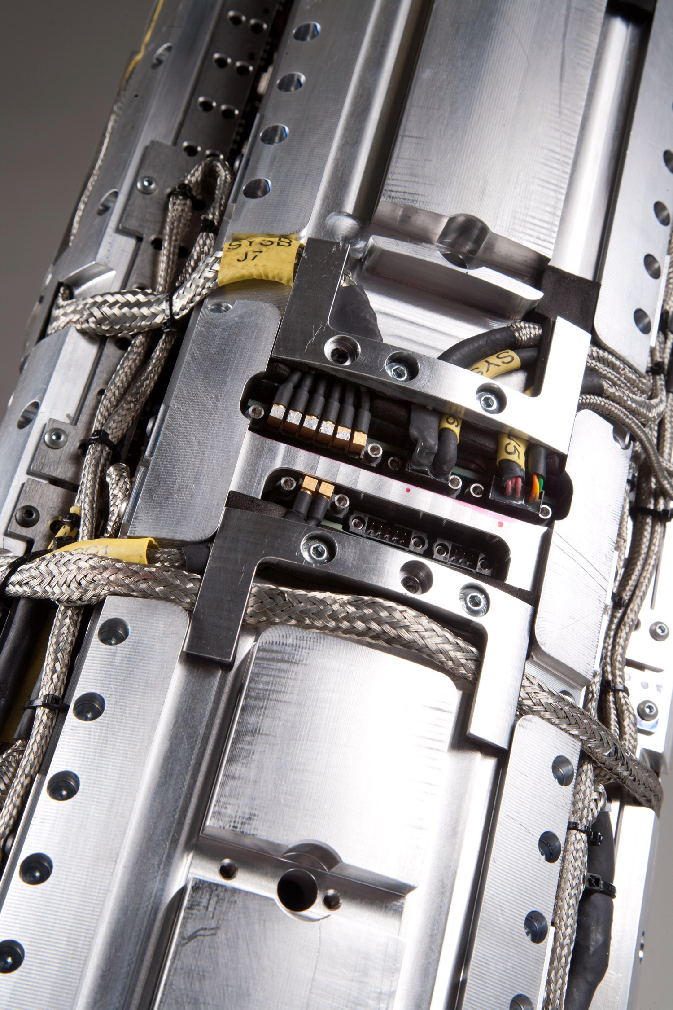
Subsea control module MTBF* (critical** failures)
SPCS
3-5 Years
Typical ”major international operator” mean time between failure
18.5 Years
Calculated industry mean time between failure
= 575 SCMs / 2,224 operational years
45 Years
Proserv mean time between failure
= 195 SCMs / 1,158 operational years

Slide 19
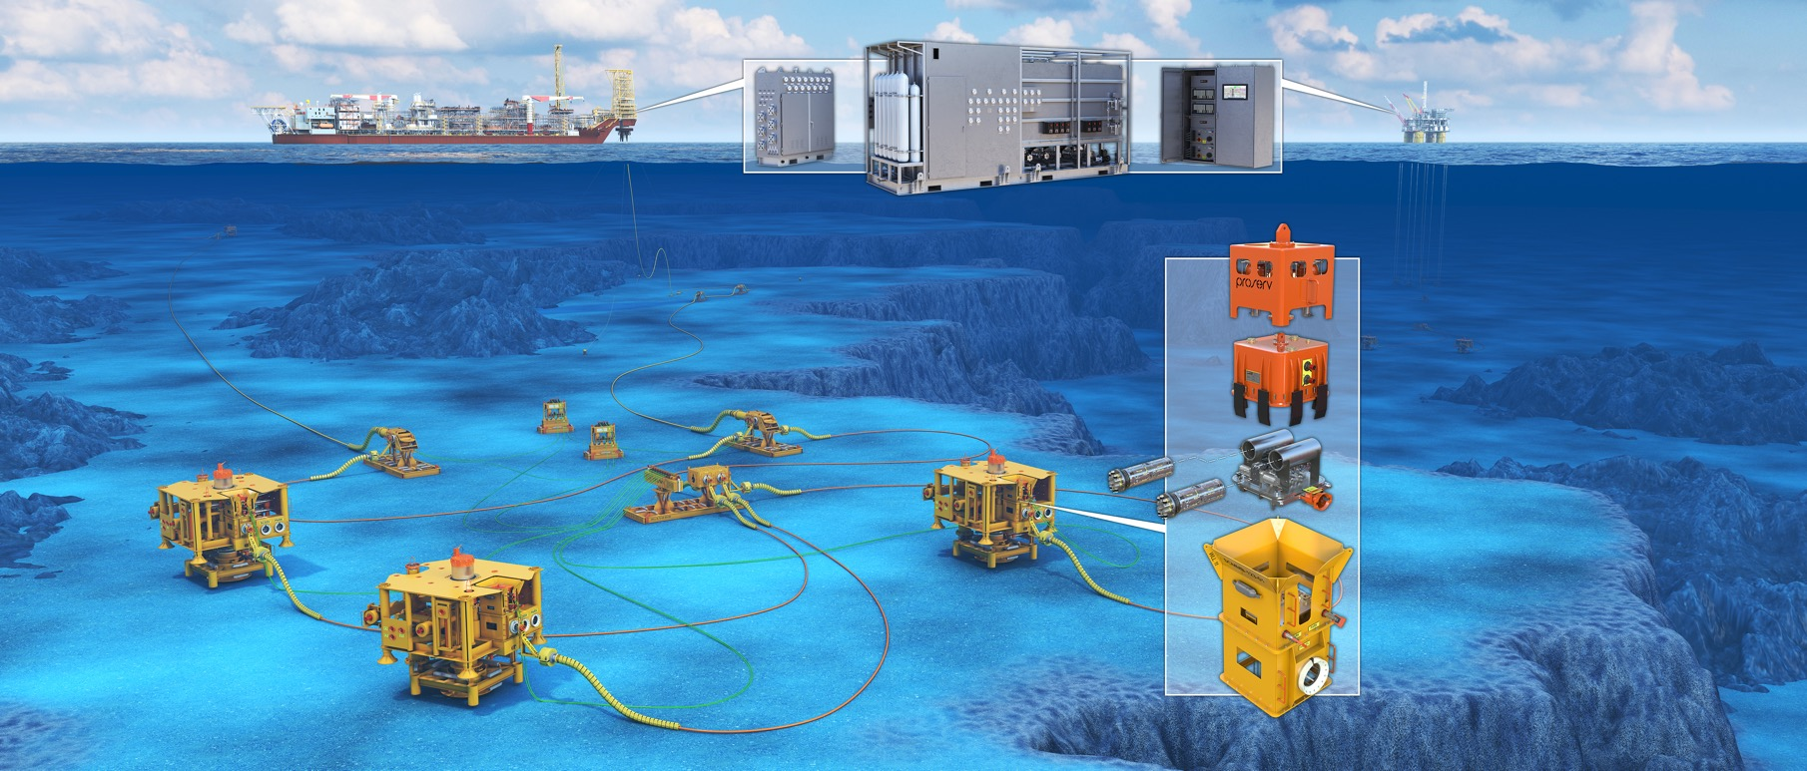
Proserv subsea controls

Slide 20
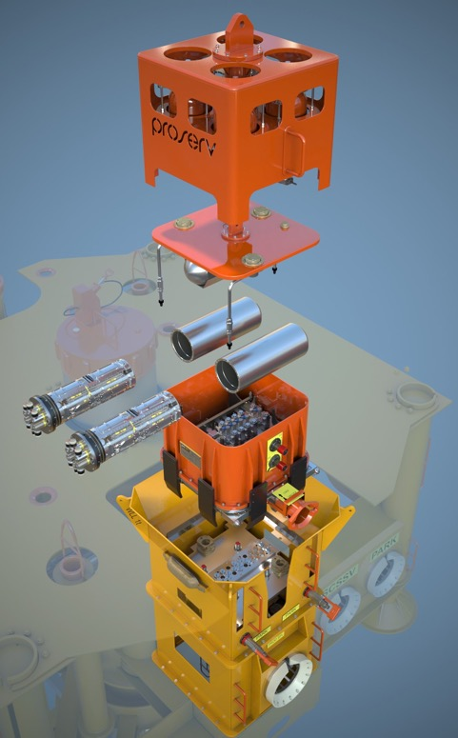
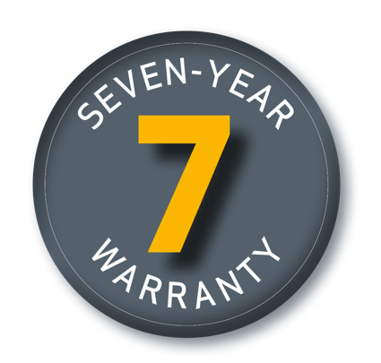
Seven year warranty
Our subsea controls
GO FURTHER
As we believe our innovative technology is the most reliable on the market, our subsea control systems are now backed by a seven-year warranty.*
Notes:
^{Proserv’s pledge}
Our disruptive subsea control systems support long-term production, ensure reliable operational performance and are designed to never become obsolete throughout the life of field.
When data shows that subsea control systems may fail after just 22 months**, we know Proserv’s controls will go much further - safeguarded by warranty.

Slide 21

Never obsolete
When we say NO we mean
NEVER
OBSOLETE
Notes:
For a control and monitoring systems to be labelled as obsolete, either a production critical component or an assembly is no longer physically produced and/or is no longer directly supported by the OEM.
Ensuring that a full system will never go obsolete requires the design and engineering of both component and assembly level systems. This ensures that new generation products are always backwards compatible.
True control of our design
Ownership of critical component design and manufacture
Removes risk of obsolescence

Slide 22
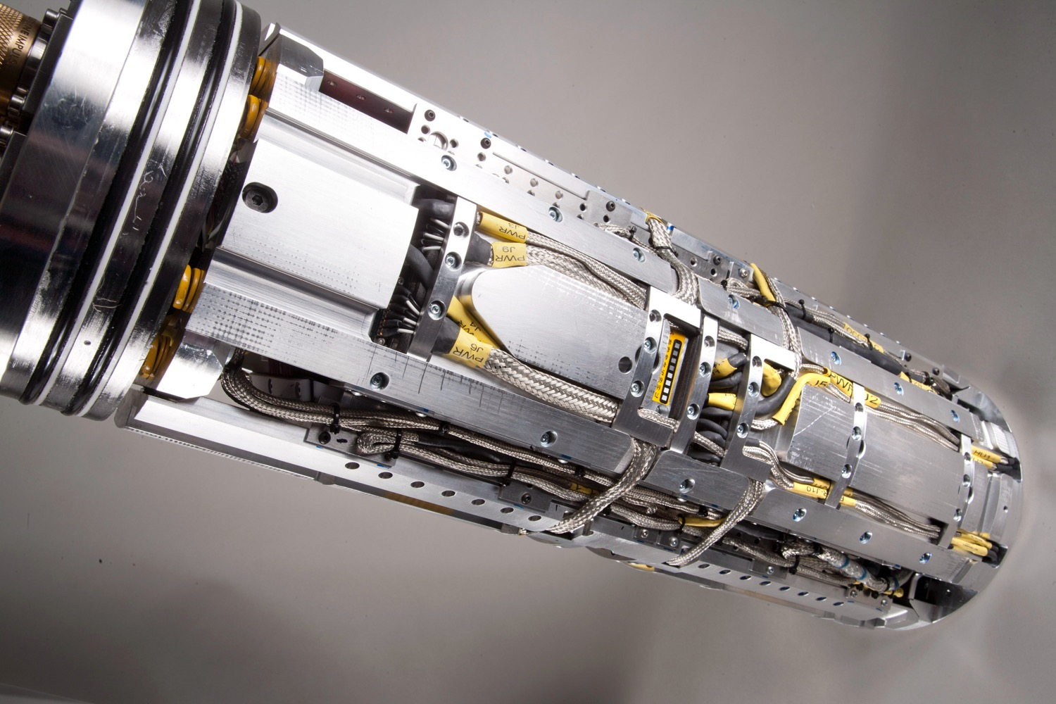
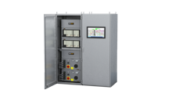
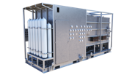
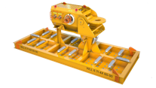
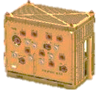
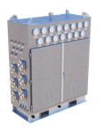
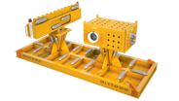
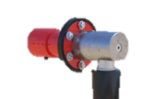




We control our full subsea control system
MCS
HPU
SUTU
CIU
TUTU
S/EDU
H/EFL
SCM
SEM
PROSERV
DESIGN
BUILD
TYPICAL OEM
DESIGN
BUILD

Slide 23
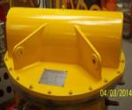
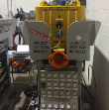
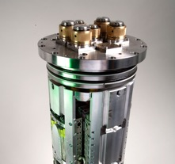
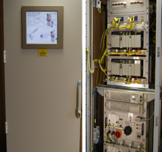
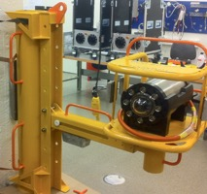
Brownfield upgrade options with Proserv means that you are no longer tied to the OEM
OPERATOR CHALLENGES
Obsolete equipment or OEM support
Risk of failure and poor reliability
Extend field for additional wells
Extend well life
Additional instrumentation for production optimisation
Retrofit A2G SEM Upgrade
SCM refurbishment
Co-exist
Topside upgrade
Adaptable solutions
Proserv Augmented Controls Technology (ACT)

Slide 24
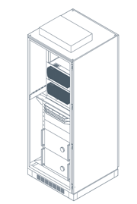

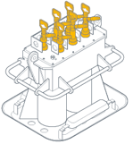
How Proserv can co-exist on any subsea field
Proserv SEM
Proserv SEM
Proserv SEM
Topside Production Control Unit
SCM
SCM
SCM
TUTU
SDU
Proserv SEM
Proserv TPCU
Existing Umbilical
Existing Umbilical
SCM
SDU
SDU
Existing subsea field
TPCU
Proserv SCM
Open Communication Hub (OCH) if required
Proserv SCM
Proserv co-exist equipment options

Slide 25
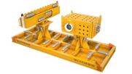
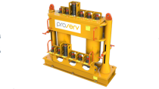
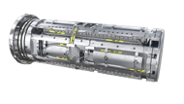
Our experience developing and delivering subsea controls speaks for itself
130
50
300
450
85
6,000
SUBSEA
PROJECTS
DELIVERED
ACT
PROJECTS
COMPLETED
SUBSEA CONTROL MODULES
SUBSEA ELECTRONICS MODULES
OPEN
COMMS
HUBS
TOPSIDE CONTROL PANELS
SUBSEA TECHNOLOGY TIMELINE
1963
1980
1992
1999
2007
2014
Proserv has been manufacturing control systems for over 60 years
First
subsea control module
First multiplexed Electro-Hydraulic SCM
Artemis subsea control system developed
SICOM OCC modem technology
Artemis 2G
subsea electronics module
Notes:
HISTORY
1976 - Proserv has been manufacturing control systems in the UK for almost 50 years.
1980 - The design and prototype of our own SCM using our in-house spool-type control valves.
1992 - First complete multiplexed Electro-Hydraulic SCM was developed
1999 - Artemis subsea control system was developed adding deep-water ROV deployment
2007 - Inclusion of SICOM OCC modem technology
2014 - Launch of latest generation subsea electronics Artemis 2G
TRACK RECORD
Over 300 subsea control modules supplied
Over 130 subsea controls projects completed for operators and service companies
Over 6,000 surface and platform control panels designed, manufactured and supplied
Over 450 subsea electronics modules delivered
Over 50 Augmented Control Technology (ACT) projects delivered
Over 85 open communications hubs delivered for subsea greenfield and brownfield projects

Slide 26
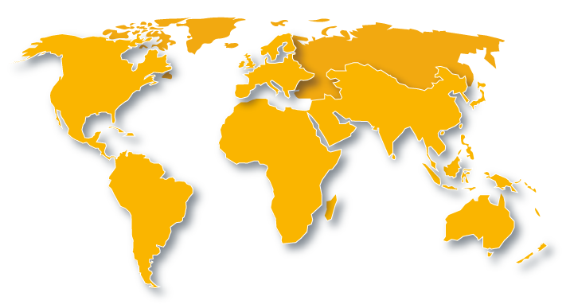





Proserv has over 300 SCMs installed worldwide on OEM trees
112
70
221
47
40
58
8
18
18
32
312 installed base

Slide 27
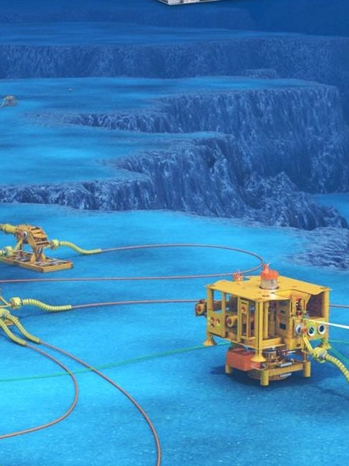

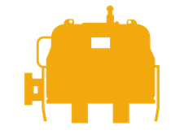


Strategic agreement between Dril-Quip and Proserv
This is a significant milestone for Proserv in our journey to become the industry’s only truly independent and focused controls provider of choice.
Follows Dril-Quip’s strategic decision to consolidate the supply and development of control systems with a dedicated subsea controls provider.
Drill-Quip provides the tree, we provide the controls
Non-exclusive agreement
Allows for joint collaboration
Proserv Controls is still independent, and able to provide high-integrity control solutions for production hardware of any customer’s choice.
Dril-Quip
Dril-Quip is a leading manufacturer of highly engineered drilling and production equipment for use onshore and offshore, which is particularly well suited for use in deep water, harsh environments and severe service applications.
www.dril-quip.com

Slide 28
Case Studies

Slide 29
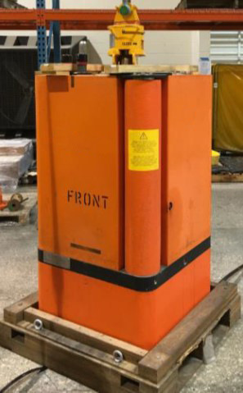

North Sea legacy subsea control module (SCM) – refurbishment
Case Study
The challenge
Refurbish a legacy SCM and upgrade with new Proserv A2G subsea electronics module (SEM)
Reuse all hydraulic parts and sensors, replacing only if necessary
Upgrade module to support redundant power/signal
Why Proserv was chosen
Market leading SEM reliability
Flexible system with an open, high bandwidth topside interface
The benefit to the customer
Cost effective, since most SCM parts are durable and will now be reused
Co-exist compatible with standard legacy OEM SCMs
Redundant supply and communication
New interfaces such SIIS level 1, 2, 3 available
Major operator, 2019
North Sea
MODPOD SCM
Notes:
Upgrade of 5 GE 2k SCM
Contract award : Jan 2018
EFAT: Feb 2019 - approx. 1 year after contract signed
Delivery: 2019
Scope of Work
Refurbish GE 2k MODPOD and upgrade with new A2G SEM
Reuse all hydraulic parts and sensors, replace only if necessary
Upgrade module to support redundant power/signal
Deliverables:
5 off refurbished SCMs, upgraded with new A2G SEMs
MCS inclusive integrated solution with ABB and 6 off Topside Power and Communication Unit (TPCU) prepared for 12 wells
HPU combined for topside and subsea wells
Benefits
Cost effective, since most SCM parts are durable and will now be reused
High bandwidth and open topside interface
Co-exist compatible with standard GE MODPOD SCM’s
Redundant supply and communication
Flexible system
Market-leading SEM reliability
New interfaces such SIIS level 1, 2, 3 a.o.
available if required
Open and flexible topside interface

Slide 30

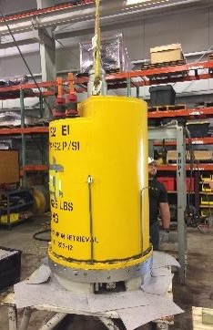
SCM retrofit due to obsolete OEM and technology upgrade
Case Study
The challenge
Client is experiencing poor reliability and future support for legacy SCMs
Consists of 3 umbilicals, each with up to ten SCMs, approx. 4-12 km step out
Why Proserv was chosen
Proserv’s A2G upgrades the SCMs to dual SEM architecture
Upgrade will co-exist with existing production SCMs in a phased change out
No additional modifications to existing OEM SCMs, except SEM upgrade
The benefit to the customer
Life of field extension (20 years extension)
Increased reliability and availability (Dual SEMs)
Lower cost to provide upgrade with local support
Still utilises existing inventory (spares)
Full MCS upgrade
Major operator, 2018/19
Gulf of Mexico
A2G SEM Upgrade and SCM refurbishment
Notes:
The Challenge
The client have been experiencing poor reliability with AK iCon SCMs on the Griffin field in the GOM. The field has three umbilicals approx. 12 km step out distances, each with up to 10 SCMs installed.
BHP approached Proserv who are currently in the FEED design of a major field upgrade which consists of the following Proserv SCM upgrade option.
Provide complete Life of Field services for AK Gen 4 SCMs.
Upgrade 6 Single SEM SCMs with Dual A2g SEM options providing greater availability and reliability.
Upgrade existing MCS with all new MCS using Rockwell PLCs
Provide a change out plan that allows co-exist with existing modules on each umbilical
Provide new Running tool
Proserv successfully completed co-exist testing with two AK SCMs onshore in Houma.
Later the subsea test module was deployed and this successfully co-existed with the production SCMs , finally proving that the Proserv system will operate without modifcations to existing OEM SCMs.

Slide 31
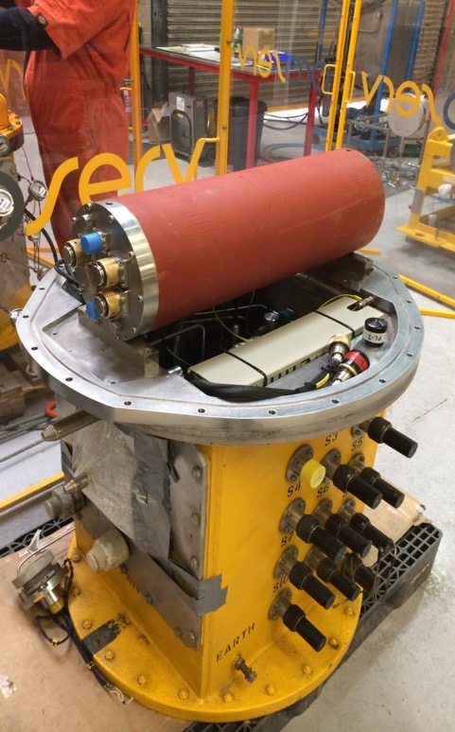
Obsolete SCM and technology upgrade - Ithaca Anglia
Case Study
The challenge
Upgrade and replace two obsolete Aker (FSSL) SCMs and upgrade topside facilities to include new MCS/EPUs
Why Proserv was chosen
New MCS required full integration into existing topside infrastructure without compromise to production
Existing SCMs are to be maintained for the subsea mechanical and electrical interfaces, which couldn’t be changed out
Inductive couplers and hydraulic couplers no longer available
The benefit to the customer
Extended field life at much reduced cost compared with total subsea change out and addressed obsolescence issues with electronics.
Provide continuing support for SCM, electronics and topside MCS
Ithaca Anglia upgrade 2014
North Sea
SEM upgrade and SCM refurbishment
Notes:
The Challenge
The client have been experiencing poor reliability with AK iCon SCMs on the Griffin field in the GOM. The field has three umbilicals approx. 12 km step out distances, each with up to 10 SCMs installed.
BHP approached Proserv who are currently in the FEED design of a major field upgrade which consists of the following Proserv SCM upgrade option.
Provide complete Life of Field services for AK Gen 4 SCMs.
Upgrade 6 Single SEM SCMs with Dual A2g SEM options providing greater availability and reliability.
Upgrade existing MCS with all new MCS using Rockwell PLCs
Provide a change out plan that allows co-exist with existing modules on each umbilical
Provide new Running tool
Proserv successfully completed co-exist testing with two AK SCMs onshore in Houma.
Later the subsea test module was deployed and this successfully co-existed with the production SCMs , finally proving that the Proserv system will operate without modifcations to existing OEM SCMs.

Slide 32
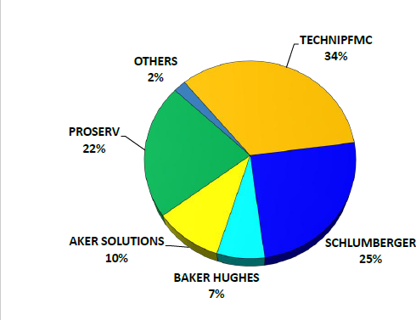




Often perceived as a “small” company
Operator Image of Proserv
‘Large’ OEM Company:
generalists
Pipelines and manifolds
Trees
Wellheads and connectors
Power and processing
Controls
A small disadvantage?
Proserv is a dedicated and focused controls technology business, exclusively developing technology and executing “controls” projects that more than rival any OEM subsea controls capabilities.
Proserv specialises solely in controls, with over 60 years’ experience.
Over 100 dedicated controls engineers,
750 staff, 35 R&D staff in Trondheim,
4 global subsea manufacturing sites and services bases around the globe.
Market Share
At 43%, second only to TFMC for subsea controls supply in GOM for past two years.
Market leader for subsea controls in UK North Sea.
21% global market share with independents - double that of Aker and Baker Hughes.
300+ subsea control modules (SCMs) supplied to clients globally
20+ Augmented Control Technology (ACT) projects
50+ Open communications hubs (OCH) delivered for subsea greenfield and brownfield projects
6000+ topside control panels designed, manufactured and supplied to clients globally
120+ subsea controls projects completed for operators and service companies
Controls specialists

Slide 33

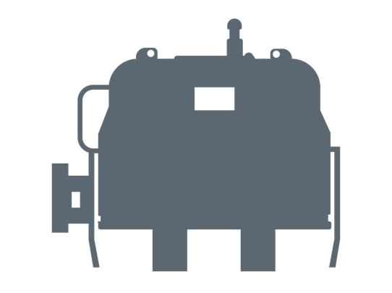




Operators report that the reliability of subsea control systems remains a key concern
Market sentiment
THE FACTS
LISTENING TO INDUSTRY WIDE OPINIONS**
On average, a subsea control system has a critical failure every 22 months**
21%
believe that subsea equipment reliability has the single biggest impact on improving subsea operations.
The subsea control module & subsea electronics are responsible for 73%
of all critical subsea system failures**
33%
believe that subsea controls systems need advancement through better reliability
Proserv Analysis
These figures have improved in the past four years, suggesting a general trend towards improved subsea controls reliability. In that time, Proserv has increased market share, supplying more controls systems and retrofits to more customers worldwide.
Subsea electronic failures & obsolescence continue to be a costly concern for operators
Source: **Critical failure defined as a failure which causes production to be ceased **Kimberlite – an independent study 2020
104 key technical and commercial decision makers
Covering 4,499 subsea wells across the globe
Representing 50 unique subsea oil and gas operators
Notes:
When we talk about failures and issues occurring before deployment subsea, we refer to these as effecting “Quality”
When we talk about failures and issues occurring after deployment subsea, we refer to these as effecting “Reliability”

Slide 34
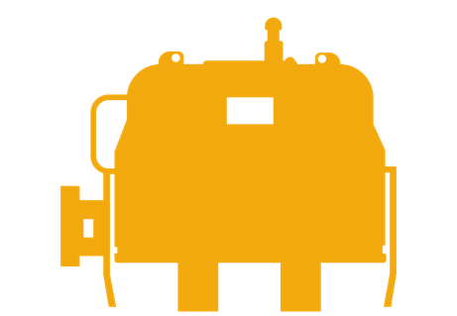
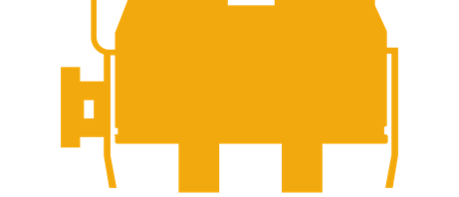
The cost to replace faulty SCMs goes well beyond simple equipment considerations
On average, a subsea control module (SCM) is changed out 2.2 times over the life of a typical well (20 years).
An SCM replacement can easily cost an operator $2.3m per event and well over $100m throughout the life of an average subsea field*.
91% of all Proserv SCMs installed on producing subsea wells have never been recovered.
68%
Of all subsea control systems will face obsolescence issues
91% of all Proserv SCMs installed on producing subsea wells have never been recovered.
5
Typically subsea control systems begin to face obsolete equipment issues after five years
*cost estimates do not include shut in production costs
Source: Proserv
Notes:
Costs associated with poor reliability, and equipment or OEM support becoming obsolete rarely effect project start up costs or initial Capital Expenditure. However they have a significant impact on the full cost of operation for a subsea field
Ensuring that once a Subsea Control System, and critically the Subsea Control Module is installed subsea, that it remains in place and in operation for the entire life of field it of the upmost importance
DSV Mobilisation $100k
DSV Hire for 3 days $300k
DSV Demobilisation $100k
OEM Staff for installation and testing $50k
Spare SCM $500k
Repair of failed SCM $350k
Sub total $1.5m
Loss of Production $900k

