Slide 1
Proserv
Measurement Solutions for the Norwegian Market

Slide 2
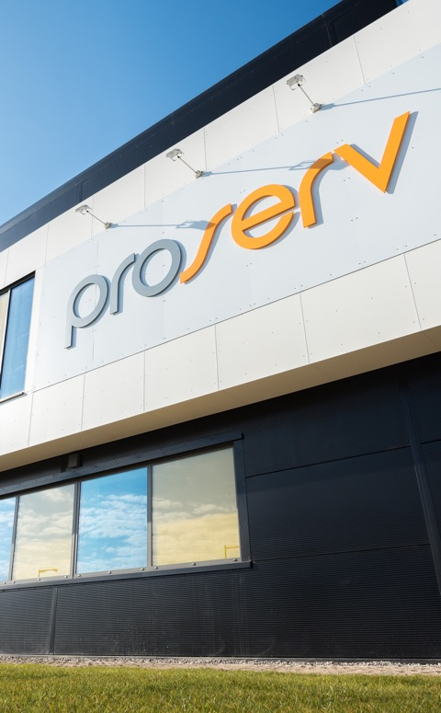
Control technologies for critical infrastructure
Introduction
Proserv is a controls technology company.
We improve the reliability, integrity and productivity of critical infrastructure with industry leading controls technology.
Our Values
Forward as a Team
Right Thing, Right Way
Entrepreneurial Spirit
Serious about Service
Help, Share and Communicate
Nearly
60
years’ experience
14
global locations
Operating in
60+
countries

Slide 3
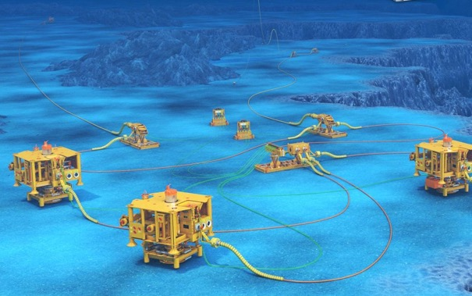
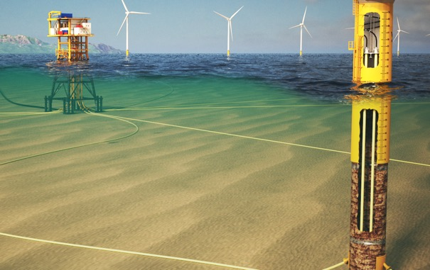



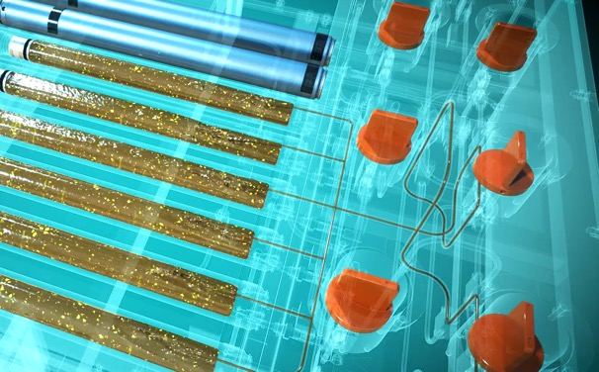
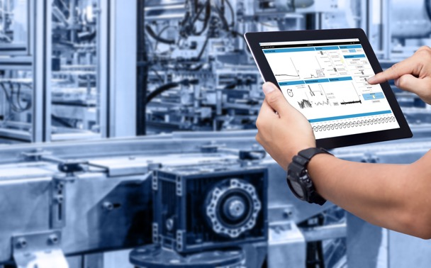
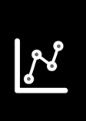

Proserv is a controls technology company
We improve the reliability, integrity, efficiency and productivity of critical infrastructure with industry leading controls technology
The Proserv difference
We ensure safe, reliable operations
We provide the reliable information you need to make informed decisions and actions
We provide the ability to predict maintenance needs before failures occur
We reduce operating costs and increase uptime
Control
Independent and reliable control systems for critical infrastructure.
Intuitive visualisation of asset integrity and performance.
Intelligence
Insights from
advanced data analytics and machine learning to predict outcomes.
Optimisation
Improved
performance and asset life extension through our expertise and technology.
Monitoring
ENERGY

Slide 4
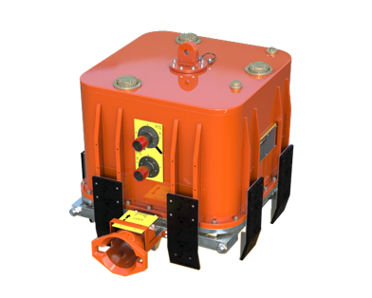

Our mission to extend the life and improve the reliability of energy assets
Reliability commitment: We provide the energy industry with best-in-class quality across all our solutions that never go obsolete
56%
less greenhouse
emissions*
We reduce our customers’ carbon footprints
We extend the life of assets
Our solutions optimise the performance of equipment, helping to prevent hydrocarbon leaks and decrease fluid and energy use.
We use intelligent solutions
By using digital technology and real-time monitoring, we can remotely support our clients, alleviating the need for travel.
Our technology ethos is to reuse, refurbish and upgrade equipment wherever viable, lessening both equipment disposal and manufacture.
TECHNOLOGY HIGHLIGHT
Subsea control module reliability:
Removes need to retrieve and service the SCM during its lifespan
No support vessel to assist with the retrieval of the module
The result: Approximately
78 tonnes CO2e saved.

Slide 5






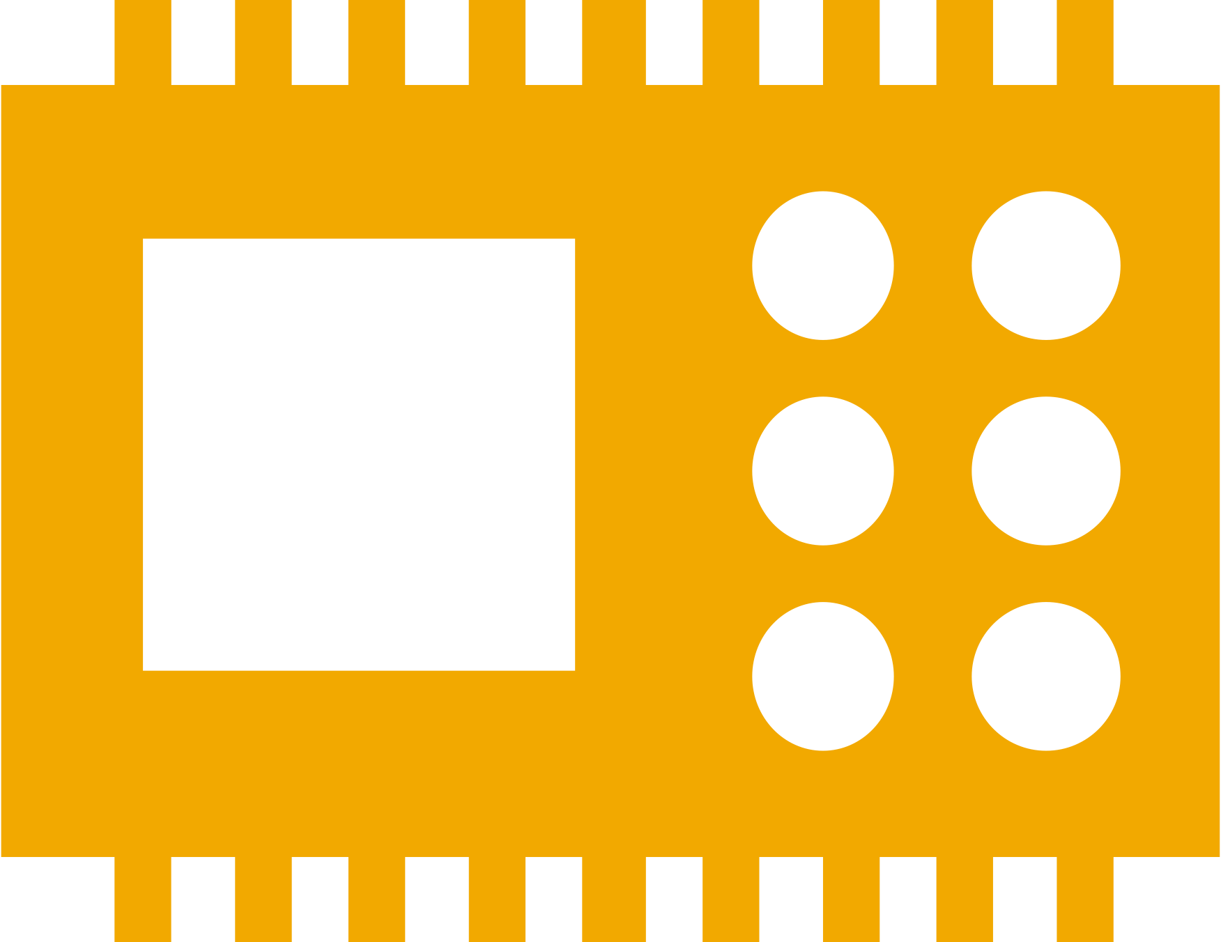



We offer a wide range of technology solutions
Products
g
Subsea Controls
Extend life of field without costly equipment replacement shutdowns by using a subsea controls system that is never obsolete.
Topside Controls
We design, manufacture, install and service all the oil and gas production control equipment from the top of the wellhead to the pipeline.
Cable monitoring
Enhance the ability to detect, locate and predict cable life expectancy with the Proserv ECG™ Electro Cable Guard
holistic cable monitoring system.
SCADA systems
We provide clients with the capability to monitor and control operations across a widely dispersed infrastructure to improve efficiency.
IWOCS
Providing temporary well control during subsea well installations, workovers and abandonments to meet each field’s unique configuration.
Measurement
Specialising in fiscal and custody transfer metering systems, to meet the most stringent of technical requirements.
Sampling
A range of solutions for sampling, incorporating sample containment, transportation cylinders, and chemical injection.
300
Subsea control modules supplied to clients
20,000
Production control systems manufactured
40,000
Sampling cylinders manufactured and certified
200
Metering control systems manufactured
1,000
Production control systems refurbished
5,000
Wellhead control systems supplied
New field and design services
Installation and commissioning
Maintenance
Field Extension
Decommissioning
Brownfield upgrades

Slide 6
Measurement Solutions

Slide 7
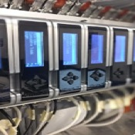
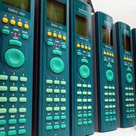

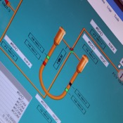
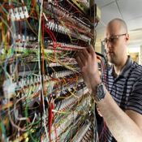
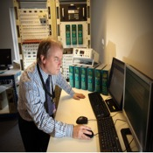
Providing measurement solutions for over 30 years
Introduction
200+
30+
Designed, manufactured, sold and serviced
SUPPLIED SYSTEMS
YEARS SUPPORTING
Measurement control systems
2,000+
STREAMS MEASURED
Across all installed systems
30+
ANNUAL SUPPORT CONTRACTS
Systems supported globally
4,000+
DAYS LTI FREE
No lost time incidents for 11+ years
Notes:
And I guess just to set the scene on our Sampling experience,
we have been involved in controlled Sampling and Injection solutions for over 40 years and have a fairly thorough range of support offerings.
We manufacture Downhole sampling systems offering Single phase, or Positive Displacement Samplers and associated equipment.
As mentioned, I will be talking about Subsea Sampling Systems, for which we design and build both ROV and Diver operable units.
And we also engineer and construct manual and automated Topside Production Sampling systems….for example, our innovative portable Topside Mini Separator…
And so we plan to hold webinars on these subjects along with others related to the science of sampling in the future….

Slide 8
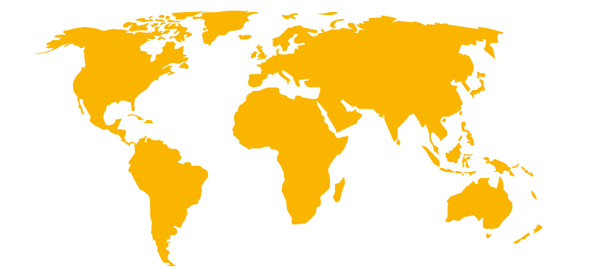





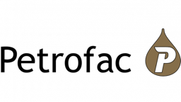









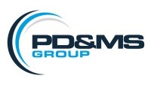

Historically supplied and supported solutions
Our Global Legacy
MAJOR
OWNER
INDEPENDENT
EPC

Slide 9
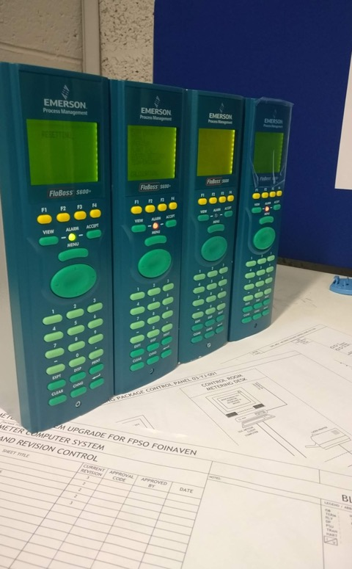
We are an independent solution provider
Metering controls
We supply metering control systems for new and existing installations.
Specialise in fiscal, custody transfer and allocation metering systems
  Import, export, injection, fuel, flare, separator, etc.
Multi sector
  Upstream, midstream, downstream.
  Onshore and offshore
Designed to meet international technical requirements.
  API, ISO, AGA, NORSOK, etc.
Centre of Excellence for system design
Asset life extension upgrades and modifications

Slide 10
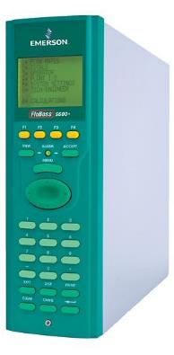
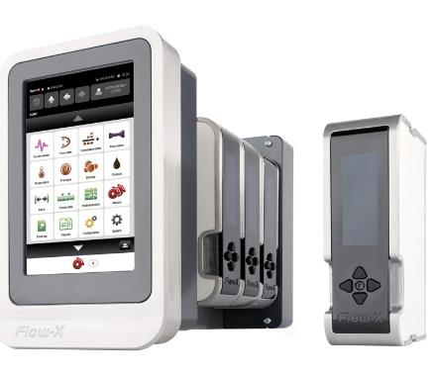
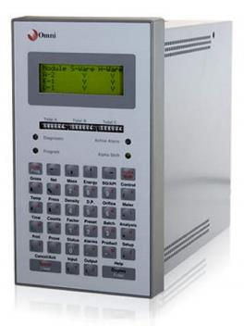
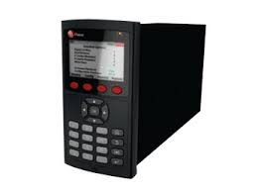
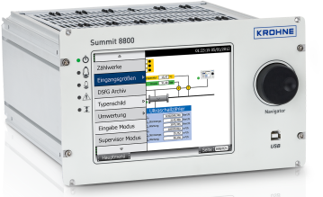
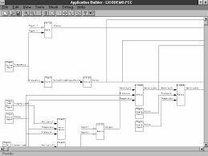
We combine market leading products with our in-house software and hardware capabilities.
Metering controls
Flow Computers
Emerson S600+
Spirit lT Flow-X
Omni
Krohne Summit 8800
Virtual Flow Computer
Supervisory Systems
eXLerate
Citect
System Platform

Slide 11
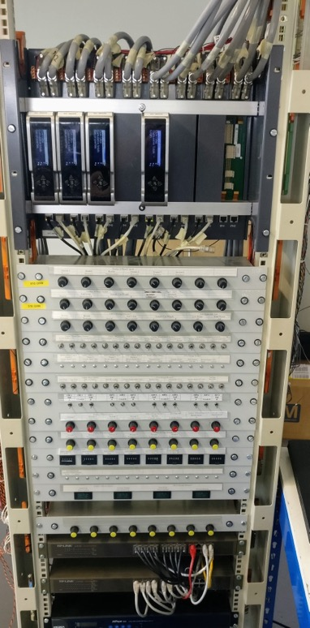
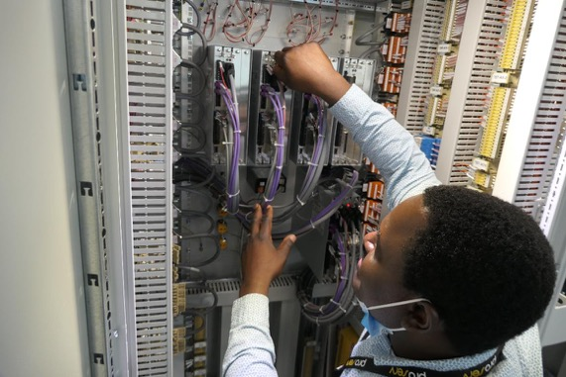
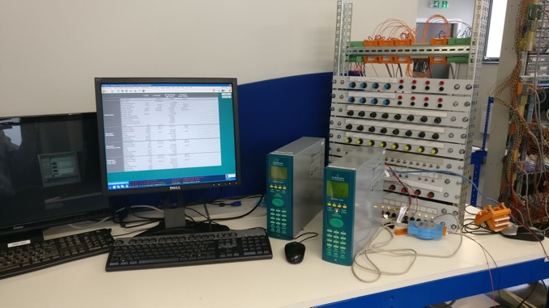
On time to customer expectations
Deliver
All projects allocated a lead engineer
Highly experienced hardware and software engineering teams (avg. 14.3 years)
Experience of producing single or multi-bay systems, and existing panel modifications
A team of dedicated staff available to carry out installation and commissioning - on and offshore

Slide 12
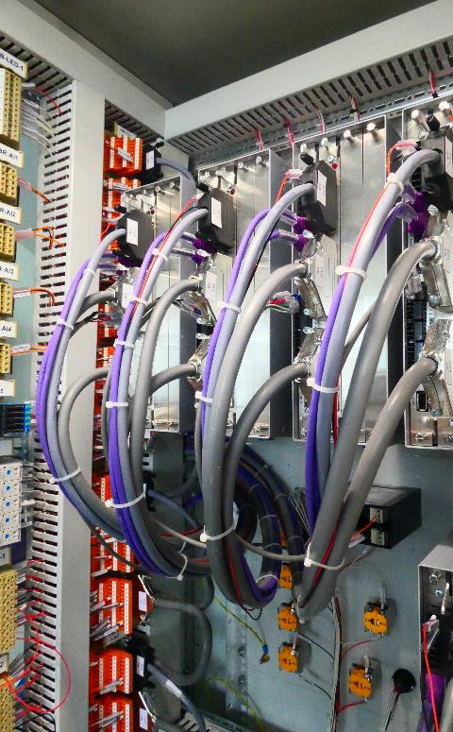
Case studies - on time to customer expectations
Deliver
PROJECT 1
Upgrade of obsolete metering system
Site survey performed and report issued
>70 metering streams
Hybrid of VFCs and Flow-X flow computers
Dual redundant Citect supervisory system
Panel refit on site
Live installation with no loss of production
PROJECT 2
New control panel supplied by Proserv
Site survey performed by Proserv and report issued to client.
Replacement of FMC flow computers with S600+
Dual redundant eXLerate supervisory package
Condition based monitoring and validation built into supervisory
Built in flow computer calculation validation using valid8
Secure read-only remote access to the metering system included

Slide 13
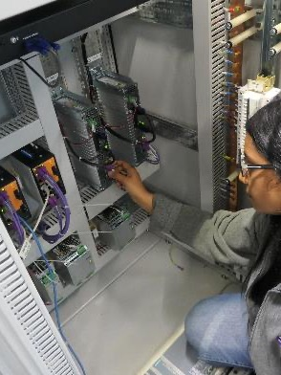
Case studies - on time to customer expectations
Deliver
PROJECT 3
Bespoke metering panel for a mobile Prover.
Dual redundant S600+ flow computers and eXLerate supervisory package
Custom panel build due to space restrictions and effects of transit
Unique technical solutions to accommodate a dual stream master meter prover
Custom meter database created for the different meters under test
PROJECT 4
Virtualised multiphase metering system.
Subsea tieback to existing installation
8 wells, with capcity for up to 18
PVT model integrated into supervisory package
VFC to perform totalisation and some topside metering
All installed on a single virtual machine, to run on the client’s host server
Secure remote access included

Slide 14
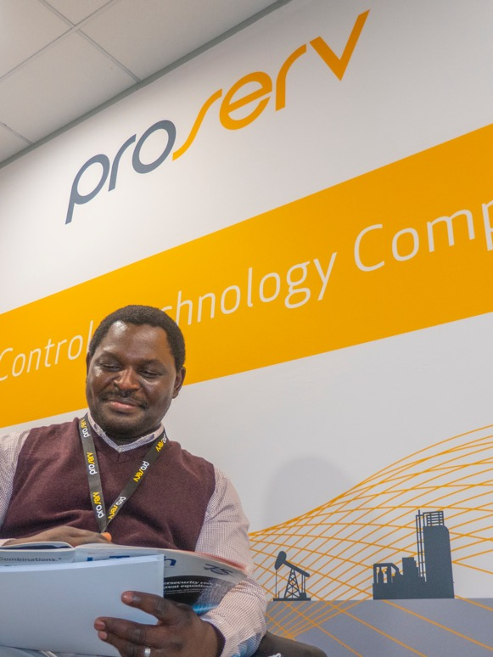
Service and support help desk
Support
A dedicated technical support helpdesk is available, allowing email and telephone access to a team experienced engineers.
24/7 access and availability to the helpdesk (with support contract)
Guaranteed mobilisation within 48hrs
Remote access capability for more responsive support
Annual or bi-annual system health check mobilisations
Site surveys
Feasibility studies
Managed anti-virus solutions
Monthly status and obsolescence reports
Metering control system operator and technician training
Flow measurement training
Independent flow measurement consultancy and support

Slide 15
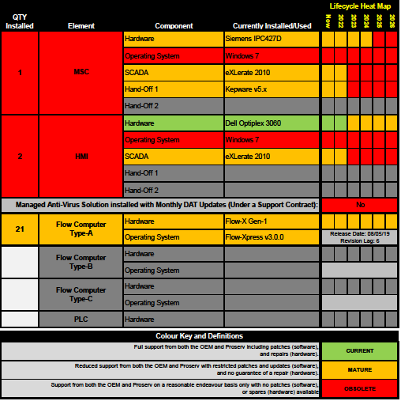
Obsolescence Management
Support
Customers with support contracts receive a monthly “traffic light” report on metering system obsolescence.
This provides visibility on required upgrades.

Slide 16
Driving digital disruption
Software as a service
Prognosis Pro
DP Meter Diagnostics
Valid8
Calculation verification
Dynamic Uncertainty
Real time driven data
In response to the drive for digitisation in the industry, Proserv has pioneered a suite of software packages to enhance the measurement control systems offering.
The Software Suite offers measurement solutions that enhance the asset lifecycle, saving both time and money:
Less safety risks
Less logistical issues
Reduction in routine inspections and maintenance
Improved efficiency and reduced carbon footprint
Assurance of compliance and accuracy
Audit precision
The software supports the industry requirement for Condition Based Monitoring (CBM) and ensures efficiencies are made where possible.

Slide 17



Product Overview
Software as a service
Prognosis Pro
DP Meter Diagnostics
Valid8
Calculation verification
Dynamic Uncertainty
Real time driven data
A next generation of CBM, that reduces the risk of errors in measurement by alerting you instantly to any potential fault with your DP meter or transmitters, identifying and quantifying the fault.
Real time monitoring and reporting of measurement uncertainty, providing an early warning system minimising financial exposure.
Calculation verification performed live, with no need for offline verification using third party software.

Slide 18
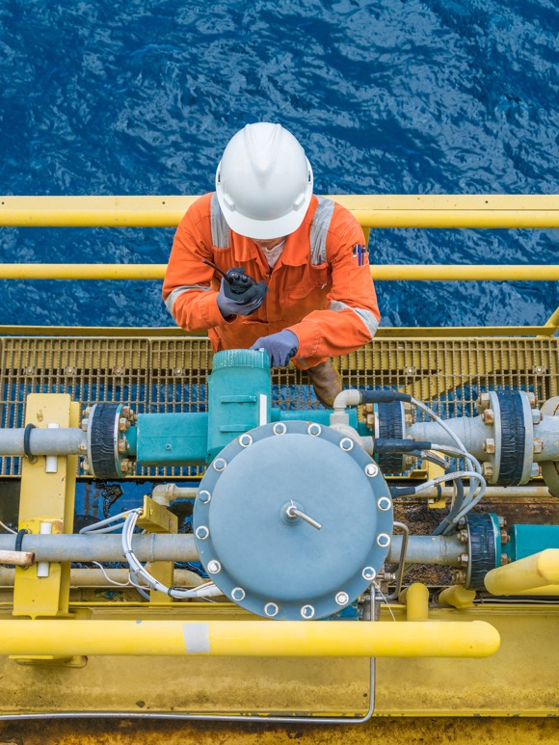

The next generation of meter diagnostics
Prognosis meter diagnostics
Offering advanced data analytics, Proserv provides enhanced identification of wet gas or plugged impulse. Our solution exclusively includes
DP Diagnostics’ Predict software, which evaluates how much the diagnosed fault is affecting the measured flow.
Protect against serious events with immediate warning alerts
Reduce downtime and maintenance
Increase safety of on-site personnel
Save on meter recalibration costs
Minimise exposure and prevent revenue loss
User friendly and easy to install and configure
FEATURES
Real-time meter system accuracy
Condition based monitoring and diagnostics
Early indication of measurement issues
No future operator intervention required
Powered by

Slide 19
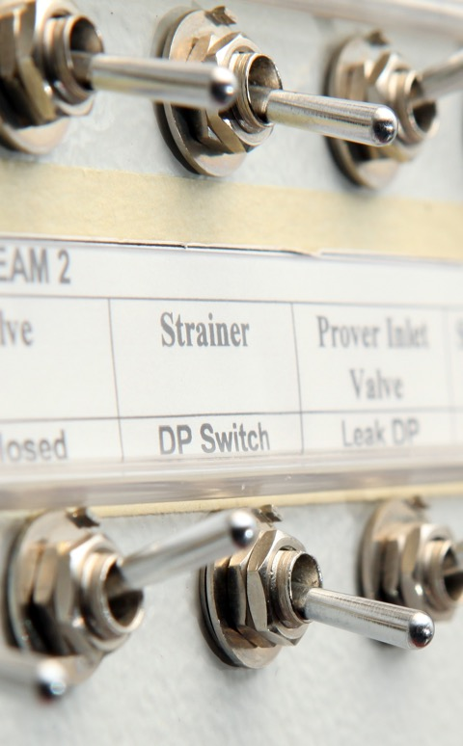
Protect your system and minimise financial exposure
Dynamic Uncertainty Calculations
THE COST OF ERRORS - getting it wrong costs money
Just a 1% under-reading of 85,000 barrels per day @ $100 a barrel:
$30 million per year
Proserv has developed a full set of advanced dynamic uncertainty calculations to monitor uncertainties in metering systems, allowing the operator to act quickly and decisively to mitigate the issue.
Real-time monitoring of uncertainty in oil and gas metering
Ability to identify instruments that have drifted out of calibration
Reduces financial losses and potential penalties
Allows operators to identify any trends in the system
FEATURES
Acts as a condition-based monitoring system to provide an early warning system
Suitable for a wide range of flow meter types, manufacturers and equipment needed for flow measurement systems

Slide 20
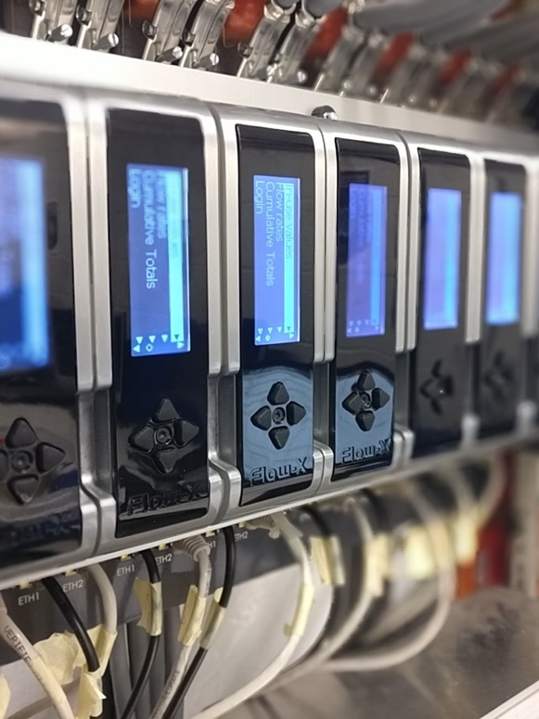
Unlock the potential of your metering system
Valid8 flow computer calculation verification engine
Calculation verification performed live, at the touch of a button, with no need for offline verification using third party software.
Reduces need to mobilise engineers offshore for manual intervention
Produces more accurate batch totals
Minimises maintenance costs
Allows for automatic control of sampling and stream switching
Verify calculations directly from the supervisory computer
FEATURES
Extensive library of calculations
Auditable records of previous results
Condition based monitoring of dual HART transmitters
Batch load recalculation based on proof results and lab values for standard density and water

Slide 21
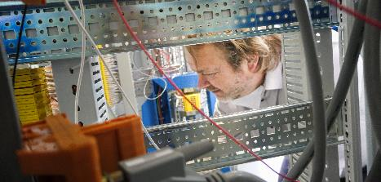
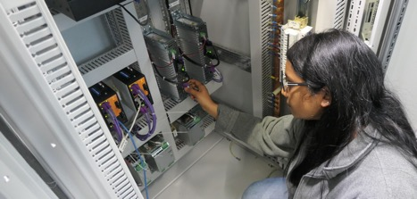
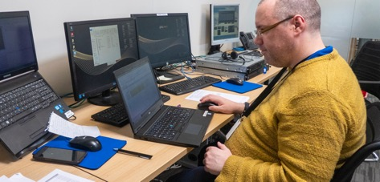
Measurement
Summary
Bespoke systems designed to customer requirements
Modern technology and innovative design methods to enhance reliability and functionality
Unparalleled metering experience and understanding of flow measurement control systems
Specialists in design and manufacture of control panels
ISO9001:2015 approved control systems and project management processes to guarantee the highest quality standards
Dedicated service and support helpdesk
Annual support contracts to ensure continuous technical support
Obsolescence management to identify risk and manage asset lifecycle
On-site system health checks to optimize reliability
Metering consultancy service to provide independent flow metering advice
Dedicated software development team
Designing measurement software solutions enhancing asset integrity, saving both time and money.

Slide 24


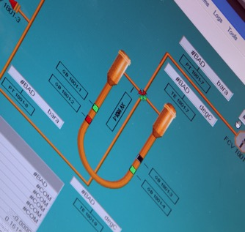
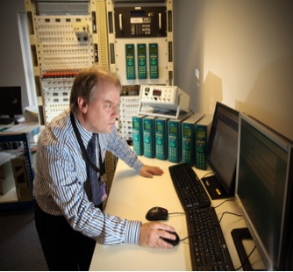

Providing measurement solutions for over 30 years
Introduction
200+
SUPPLIED SYSTEMS
Designed Manufactured, sold and serviced
2,000+
STREAMS MEASURED
Across all installed systems
30+
YEARS SUPPORTING measurement control systems
4,000+
LTI FREE
No lost time incidents for 11+ years
30+
ANNUAL SUPPORT CONTRACTS
Systems supported globally
Notes:
And I guess just to set the scene on our Sampling experience,
we have been involved in controlled Sampling and Injection solutions for over 40 years and have a fairly thorough range of support offerings.
We manufacture Downhole sampling systems offering Single phase, or Positive Displacement Samplers and associated equipment.
As mentioned, I will be talking about Subsea Sampling Systems, for which we design and build both ROV and Diver operable units.
And we also engineer and construct manual and automated Topside Production Sampling systems….for example, our innovative portable Topside Mini Separator…
And so we plan to hold webinars on these subjects along with others related to the science of sampling in the future….

Slide 25





Historically supplied and supported solutions
Our Norwegian Legacy
Gyda 2000
Varg 2015
Ula 2000
Oselvar / Tambar 2009
Skarv 2022
Hammerfest 2004
TrollB 2020
Askelaad 2020
NjordB 2017
Varg 2009
Foinaven 2015
Rafnes Noretyl 2002
KlorVCM 2016
Notes:
And I guess just to set the scene on our Sampling experience,
we have been involved in controlled Sampling and Injection solutions for over 40 years and have a fairly thorough range of support offerings.
We manufacture Downhole sampling systems offering Single phase, or Positive Displacement Samplers and associated equipment.
As mentioned, I will be talking about Subsea Sampling Systems, for which we design and build both ROV and Diver operable units.
And we also engineer and construct manual and automated Topside Production Sampling systems….for example, our innovative portable Topside Mini Separator…
And so we plan to hold webinars on these subjects along with others related to the science of sampling in the future….

Slide 26






Our environmental commitment
Our vision
Proserv will help to protect the planet's future by ensuring we remove more greenhouse gases from the atmosphere than we emit.
Our mission
To be a carbon net zero company by 2050 or sooner.
How will we become net zero?
REDUCE emissions through increased efficiencies
BALANCE the remainder through carbon offsetting programmes
SUPPORT our supply chain to show evidence of the same
Notes:
carbon neutral refers to the state of achieving net zero carbon emission, whereas net zero refers to zero carbon dioxide emission

Slide 27




Historically supplied and supported solutions
Our Norwegian Legacy
Equinor
TrollB
2020
Askelaad 2020
Repsol
Gyda
2000
Varg
2015
Hammerfest 2004
KlorVCM 2016
Rafnes Noretyl
2002
Teekay Petrojarl
Foinaven 2015
INEOS
Varg
2009
NjordB
2017
Aker BP
Ula
2000
Oselvar / Tambar
2009
Skarv
2022

