Slide 1
ECG™
Holistic Cable Monitoring System

Slide 2
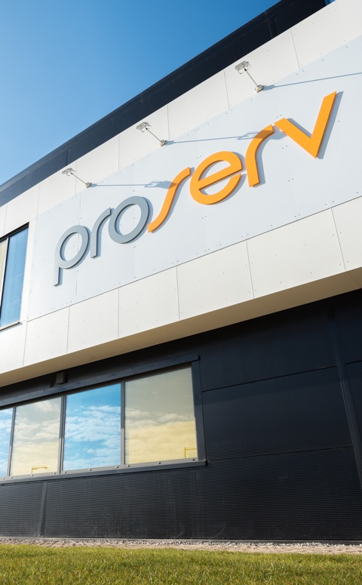
Control technologies for critical infrastructure
Who is Proserv?
Proserv is a controls technology company.
We improve the reliability, integrity, efficiency and productivity of critical infrastructure with industry leading controls technology.
Our Values
Forward as a Team
Right Thing, Right Way
Entrepreneurial Spirit
Serious about Service
Help, Share and Communicate
Nearly
60
years’ experience
13
global locations
Operating in
60+
countries

Slide 3










Proserv has an extensive brand heritage spanning nearly 60 years
Solid core of controls experience
Proserv has evolved significantly over the years both through organic growth and strategic acquisition in order to develop our controls expertise. Recent partnerships have further strengthened our move into intelligence solutions and renewables.
Historic brands
Partnerships
2006
2011
2012
2019
2020
Weatherford EP Solutions established after acquiring CAC, Brisco, Autocon and Sicom
Proserv Technology is
re-branded as Proserv with new look logo and brand
Proserv acquires Weatherford EP Solutions
Proserv acquires SGC Metering to strengthen metering and measurement expertise
Strategic partnerships developed with Intelligent Plant and Synaptec to develop our digital and renewables portfolio
1990s
2010s
2020s
1960s

Slide 4
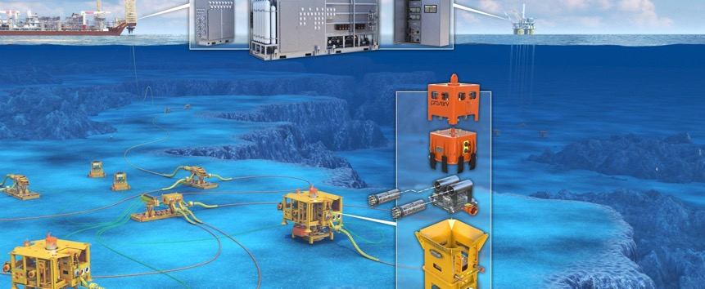
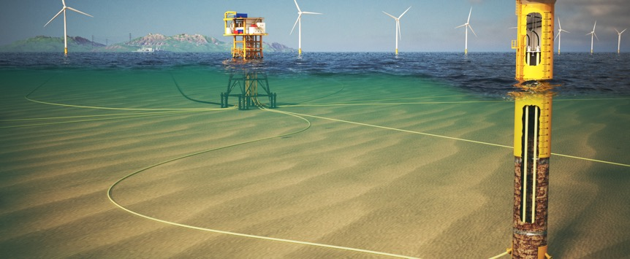


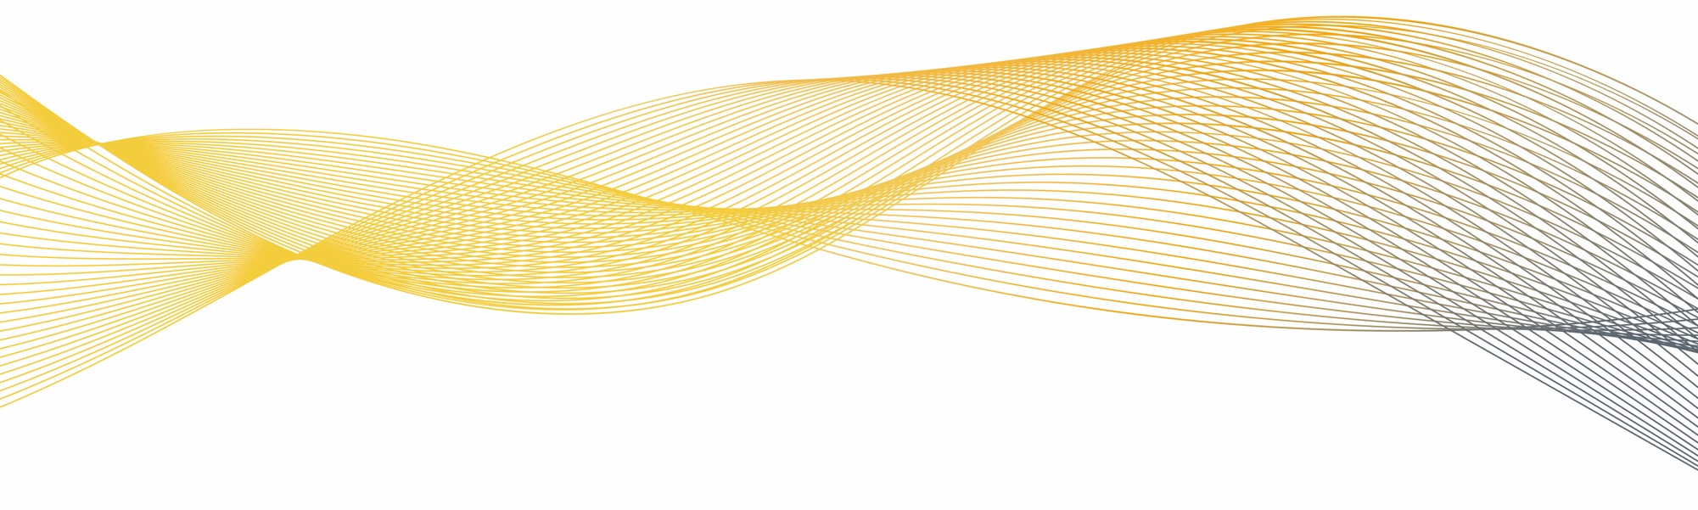
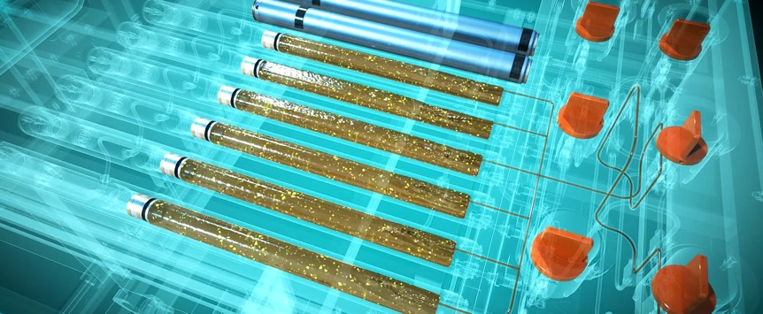
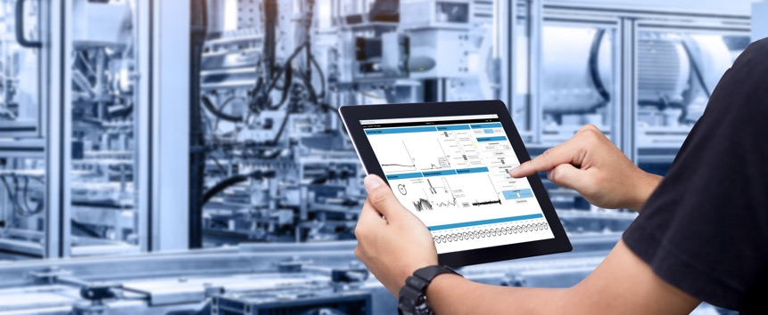
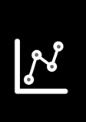

We improve the reliability, integrity, efficiency and productivity of critical infrastructure with industry leading controls technology
The Controls Technology Company
Control
Independent and reliable control systems for critical infrastructure.
Intuitive visualisation of asset integrity and performance.
Intelligence
Insights from advanced data analytics and machine learning to predict outcomes.
Optimisation
Improved performance and asset life extension through our expertise and technology.
Monitoring
ENERGY

Slide 5
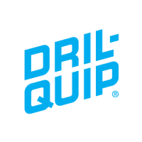




We have an open approach to collaboration
Partnerships
Empowering Choice
Empowering Innovation
HIPPS controls
Buoy controls
Tree controls
Advanced digital solutions
Alliances can bring a positive impact to operations as companies come together to offer integrated solutions, saving time, simplifying logistics and driving standardisation. We have an agnostic approach towards alliances and can accommodate client requests whether as part of a partnership or standalone.
Proserv partners with complimentary, emerging
technology companies to create compelling solutions for
customers. These relationships enable Proserv to be at the forefront of technology advancements as we continue to identify innovative ways to create value for our customers throughout the energy transition.

Slide 6

Never obsolete
For a control and monitoring systems to be labelled as obsolete, either a production critical component or an assembly is no longer physically produced and/or is no longer directly supported by the OEM.
Ensuring that a full system will never go obsolete requires the design and engineering of both component and assembly level systems. This ensures that new generation products are always backwards compatible.
When we say NO we mean
NEVER
OBSOLETE
Notes:
True control of our design
Ownership of critical component design and manufacture
Removes risk of obsolescence

Slide 7
ECG™ - Electro Cable Guard
Holistic Cable Monitoring System

Slide 8
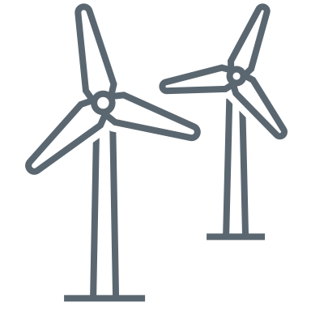
Key Stats
Cable Failures – The Challenge
Subsea cables faults are common
But they can take a lot of time and money to fix
£12.5m
cost to repair a single failed export cable
£8.4m
cost to repair a single failed inter array cable
£24m
Average generation
loss
38
ARRAY
62
EXPORT
75-80%
of insurance
claims by offshore wind industry
65%
of cable repair costs are for vessel charges
days downtime
on failed cable
ORE Catapult 2021
Notes:
10% CAPEX, 75-80% claims
Failure modes are not recognised for some time through operation
Export – 0.001 (1000km)
Array – 0.011 (91km)

Slide 9
Optimise, predict and protect
What should a cable monitoring enable?
Maximise power transmission and increase efficiencies
Reduce failures as a result of intelligent monitoring
Protect against serious events with warnings of developing faults
Save OPEX and vessel costs with planned intervention
Plan lower cost interventions around weather and resource availability
Peace of mind about the condition and integrity of your cable

Slide 10
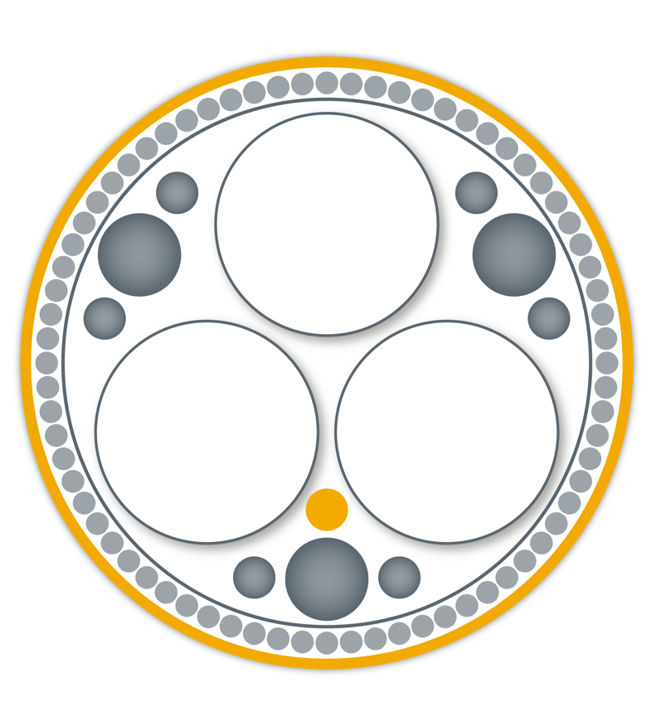



A technology partnership for predictive, holistic monitoring that cuts OPEX
ECG™ - Electro Cable Guard
SYNAPTEC
Development partner
Data analytics
Unique passive sensing technology
Power system and network experts
Commercialisation partners
PROSERV
System development lead
System integration
Technology owner
Project management
Commercialisation
BPP CABLE SOLUTIONS
Artificial intelligence/ Machine learning
Operational data
Data analytics
Data scientists
Proserv, BPP Cables and Synaptec have developed a solution that helps to mitigate cable failures across the life of wind farm.
Notes:
Intro to ECG™
Integration of multiple DxS monitoring parameters that are proven technologies applied to cable monitoring
We believe that DTS and DAS needs to be widely adopted when applying monitoring to IAC’s.
DTS and DAS is beginning to be adopted for monitoring, however ECG™ is a step change to holistic cable monitoring by applying Proserv control system experience and expertise with Synaptec’s unique passive sensor technology and BPP cable solutions cable design, analysis, real time monitoring, assessment of cable data and reporting.
The system is not a traditional ‘fit and forget’ data collection system which is called up after a failure occurs, but a real-time user-interactive technology for ongoing health monitoring.

Slide 11
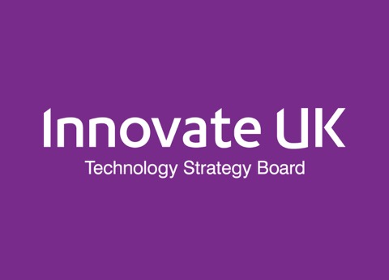


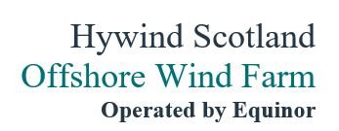

Proserv is not innovating for innovation’s sake – this is technology the industry wants and needs
Industry Backed Technology
Partially funded by
£1m of £1.5m covered by IUK Smart Grant
  IUK Project kicked off 1st May 2021
Equinor and ScottishPower Renewables industrial sponsors on the development project
  Development programme completing in Q4 2022
  18 months demonstration on Equinor’s Hywind Scotland Floating offshore wind farm
Industrial sponsors

Slide 12
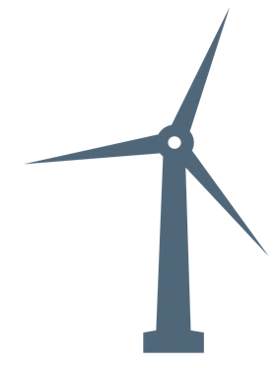

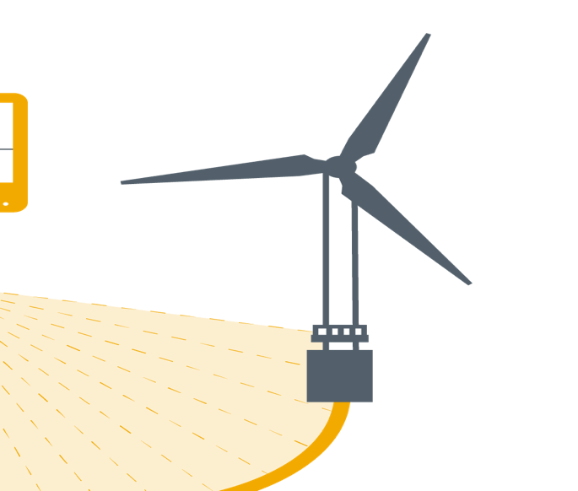





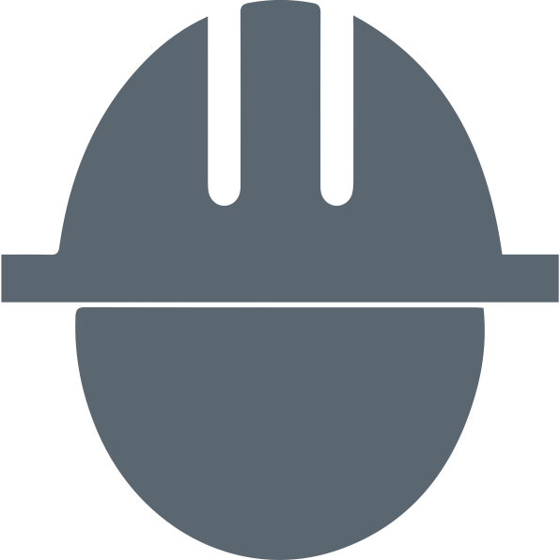


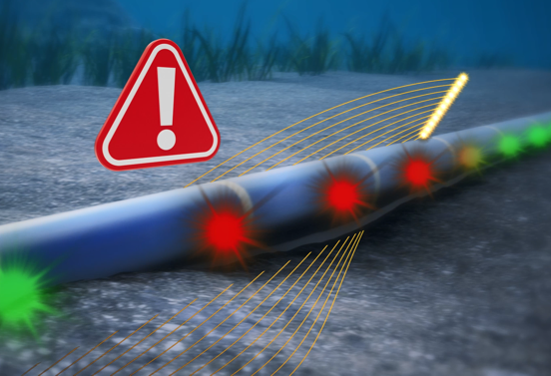
The problem with traditional monitoring methods
ECG™ - Electro Cable Guard
Reactive
Predictive
Isolated monitoring
Holistic monitoring
$
5:00
< CAPEX
-$
$
< OPEX
5:00
Notes:
Go through the overview of traditional systems today
Highlight predictive, holistic and reduced OPEX
Describe 3 companies coming together
Proserv global controls technology company with 60+ years of offshore energy systems experience and heritage
Tom: Synaptec are a leading photonic power systems monitoring technology company
Darren: BPP Cable Solutions are an independent subsea cables specialist
3 experienced companies in their fields coming together to develop and offer a unique methodology and alternative to cable monitoring.

Slide 13
The value of ECG™
ECG™ - Electro Cable Guard
ECG™: synchronous and permanent visibility of causal factors in key locations
Typical failure pathology
Monitoring techniques applied over time
Subjective, late warning
PD
Distributed sensors see causal factors earlier
Misses joints and terminations
DXS
COST
Unlikely to catch problems, expensive and risky
Inspections and ROV
Transients, PQ, load cycles, losses
Water ingress, floods, corrosion
Ohmic overheating, insulation failure
Normal operation TIME Thermal runaway

Slide 14
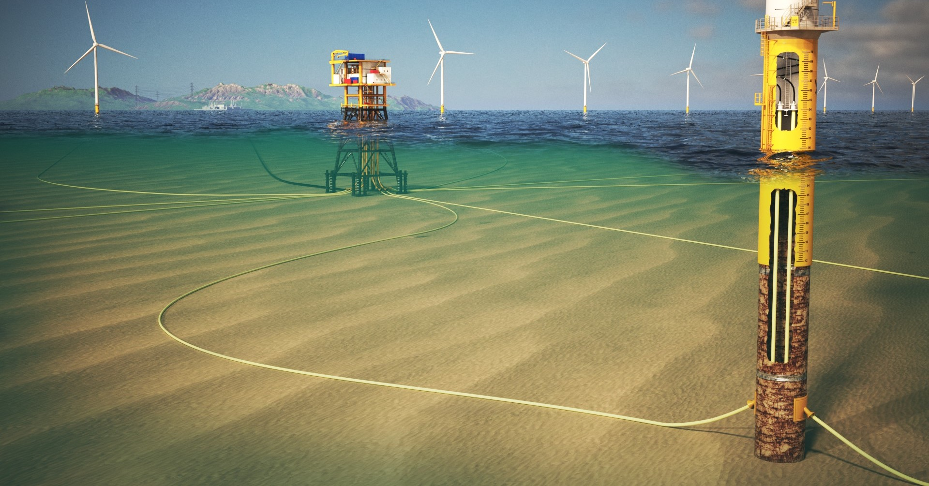

Scalable cable fault detection throughout the wind farm
ECG™ - Electro Cable Guard
Fault prediction
Automated reporting
Point temperature alarms
Power quality
Faulted section identification
Depth of burial
and free spanning
Fault location
TERMINATION MONITORING
Ongoing, gradual degradation
Cable entry stress and VIV
Events and impacts
Notes:
Highlight features
Ask question to Tom on how Synaptec technology can bring value to the customer.
Ask question to Darren on the how BPP will enable fault prediction and automated reporting and bring value.
Interrogation and ‘clean-up’ of raw data from Synaptec’s passive sensor technology;
Analysis of that data to determine out-of-control operating parameters, limits and fault conditions;
Apply machine learning algorithms to enable automated, real-time data monitoring and fault alarms based on an intuitive Red-Amber-Green traffic light system;
Use our knowledge and experience of cable design, analysis and operation to quantify potential future operational risks and estimate residual cable life.
Proserv is enabling this by integrating into a holistic solution

Slide 15
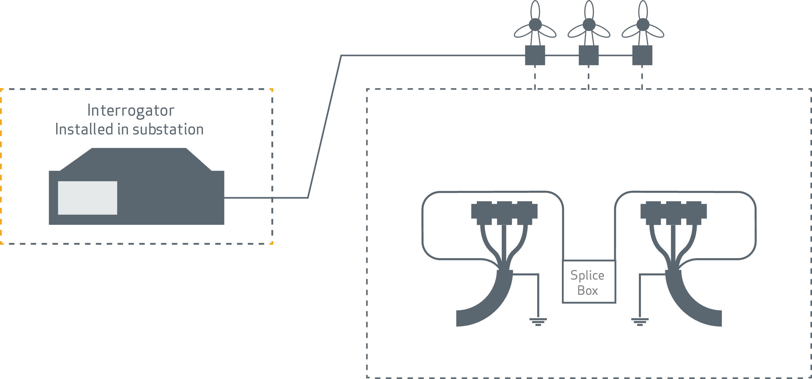
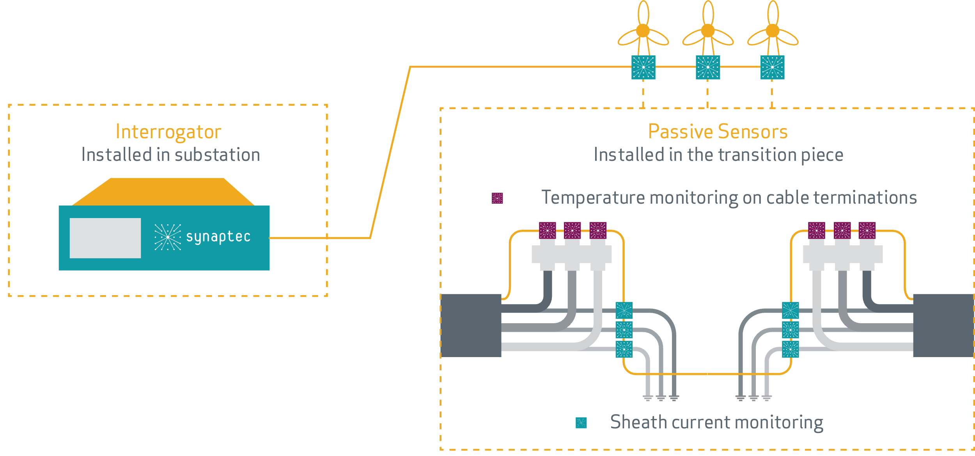
ECG™ Termination Sensors
ECG™ - Electro Cable Guard
Current state of play - Just DTS
Point monitoring with ECG™
Fibre optic cable for a DTS system is spliced through to the outgoing array cable, bypassing the phase terminations
DTS system does not monitor terminations themselves, a known problem area.
Precision monitoring of sheath current and/or temperature
Changes in cable termination resistance, e.g. corrosion in the joint or sheath tape becoming loose
Continuity of sheath
Immediate detection and location of earth faults

Slide 16
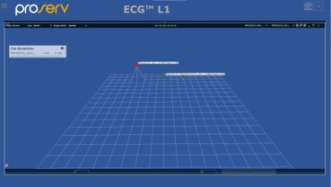
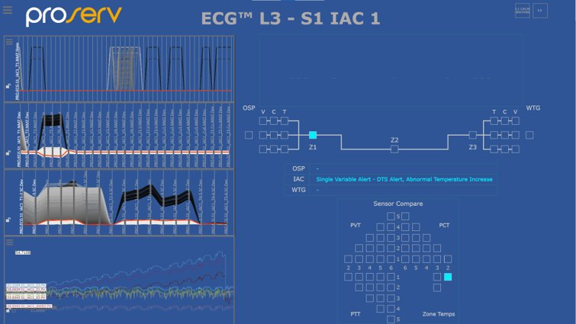
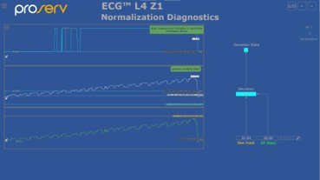
The visualisation employs human factors interface methodology for easy insights and action
Intuitive front-end dashboard​
Predictive events highlighted​
Wind farm level visualization​
Easy to identify warnings, events and impacts​
Holistic view​
Real-time data​

Slide 17
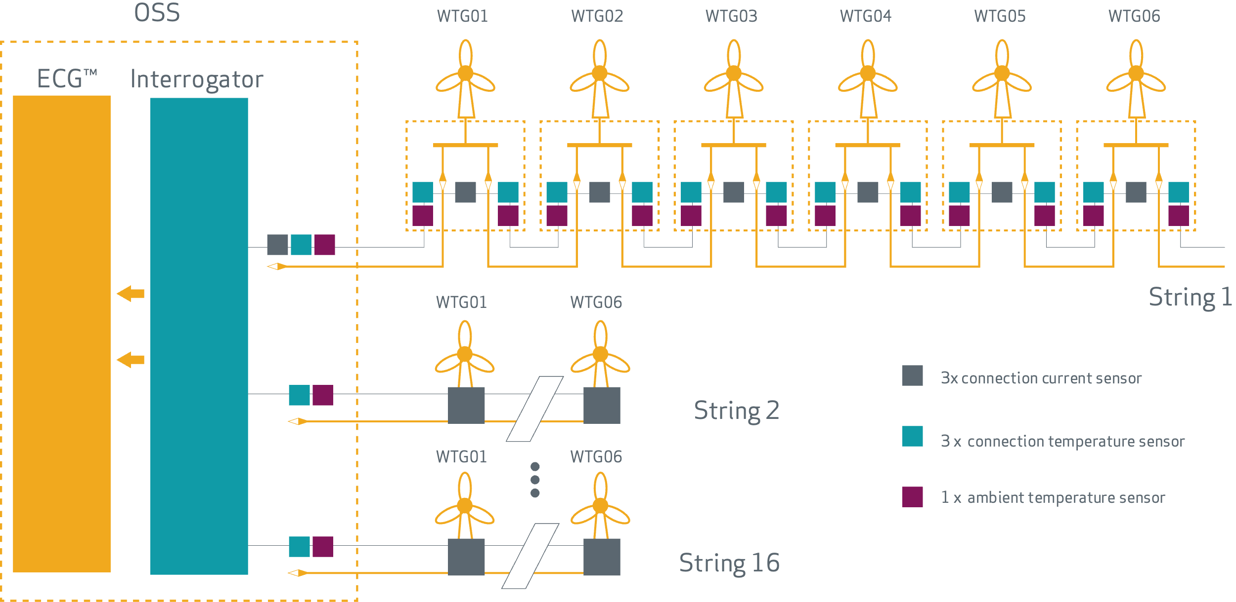
System Topology Example
Architecture

Slide 18
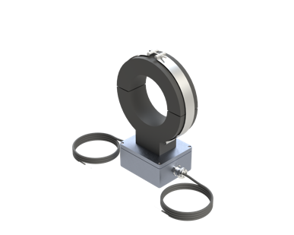
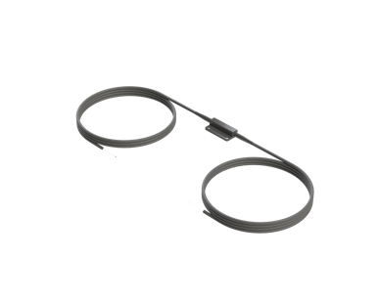
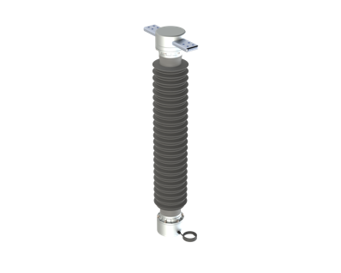
DES Termination Sensors
ECG™ - Electro Cable Guard
Measurands | Passive Sensors | Options | Insights | Benefits
Phase current at all cable sheath ends | PCT | Secondary connected or primary split core CT | Effect of all transients, load to compare temperature against | Determine where and how early factors contribute to failure
Sheath current at all cross-bonded grounding points | PCT | Secondary connected or primary split core CT | Conductor to screen, flashing, serial, wet faults | Fault location and characterisation
Temperature at all terminations | PTT | Directly applied to asset | Ohmic overheating as a function of load | Accurate RTTR measurements, earlier warning to avoid failure
Voltage at substation | PVT | Recommended secondary connected for cost | harmonics accelerating insulation failure | Locate and actively filter out source of harmful PQ
Moisture at all link boxes | PTT | Can be done with PTT | Water ingress, flooding | Locate and fix before failure
Photonic
current
transducer
(PCT)
Photonic
temperature
transducer
(PTT)
Photonic
voltage
transducer
(PVT)

Slide 19
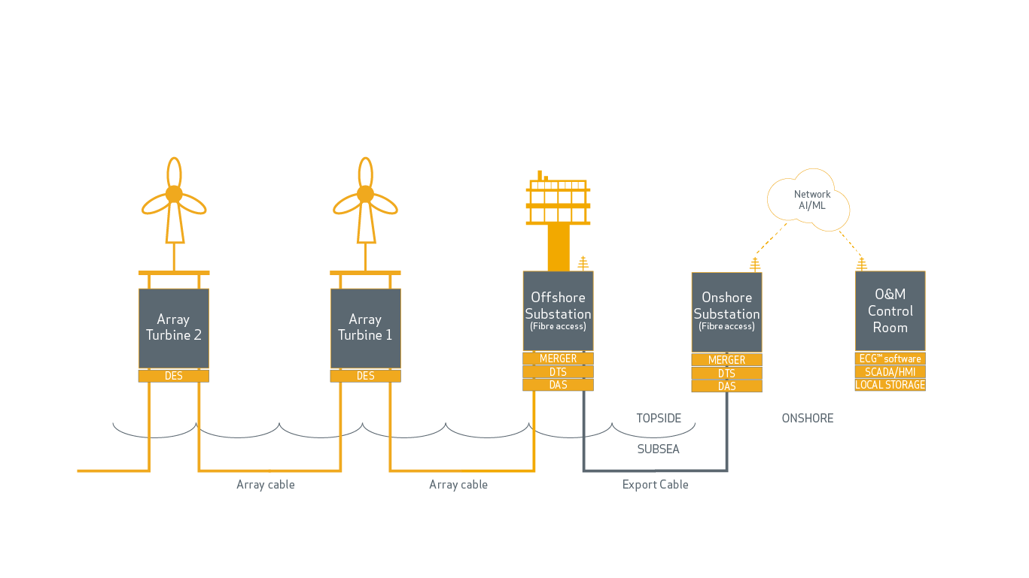
Example ECG™ System Topology – IAC and Export Cable Monitoring
ECG™ - Electro Cable Guard

Slide 20
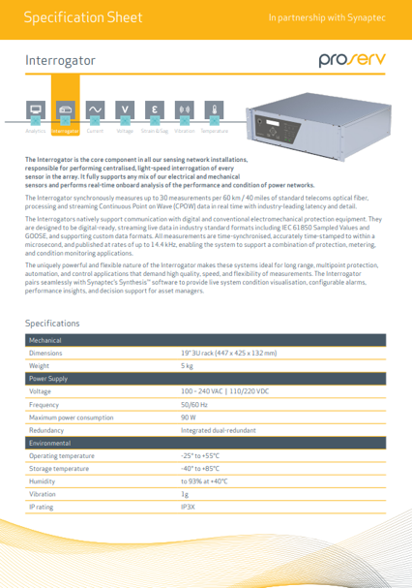
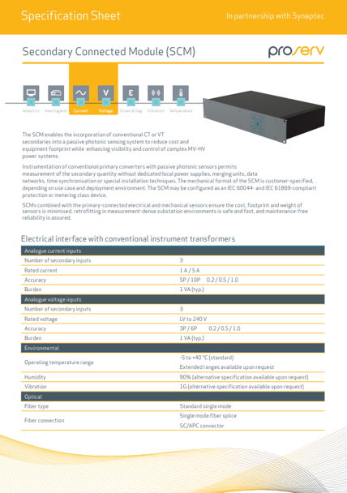

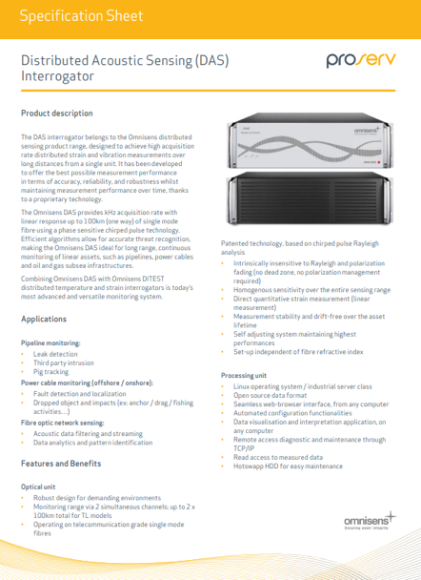
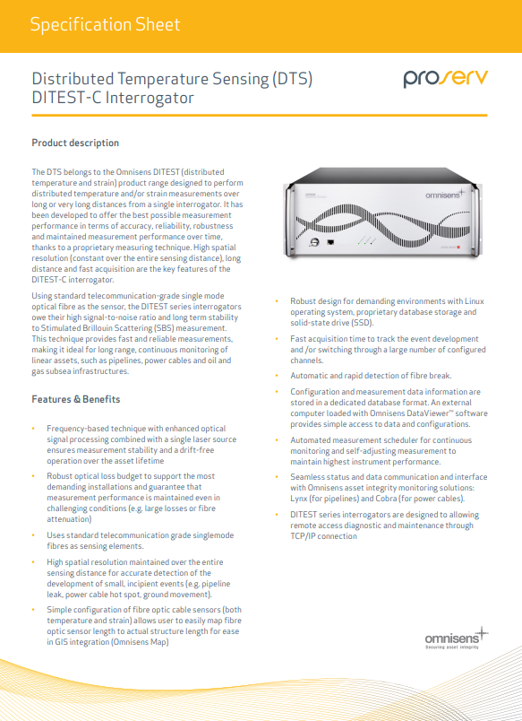





ECG™ can work with your preferred sensing vendor…
Distributed Sensing Systems
Sensing Agnostic…

Slide 21
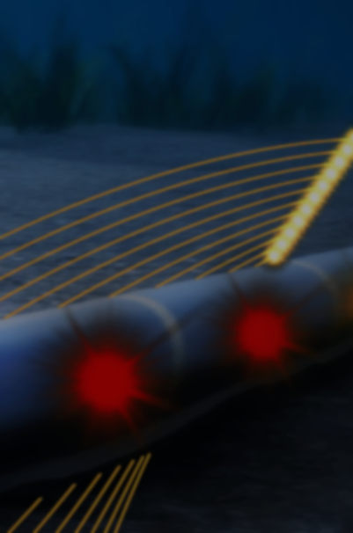
ECG™ delivers peace of mind about the condition and integrity of your cable
ECG™ value
 | IAC Cables | Export Cable
Average cable length within wind farm | 83km | 71km
Average operational life | 30 years | 30 years
Estimated failure rate Failures/km/year | 0.014​ | 0.001
Estimated failures per year | 34 IAC failures 1.162 per year​ | 2 failures​ per year
Average cost to repair | £8.4m | £12.5m
Total potential liability (not including lost power generation) | £292m £9.76m per year​ | £25m £800k per year​
Early fault identification
Failure prediction ​
Enables proactive maintenance campaigns
Minimises the risk and cost of unexpected downtime​

