Slide 1
Proserv
Metering and allocation

Slide 2






We are an independent, OEM agnostic solution provider
Metering allocation
Independent metering control systems integrator offering bespoke metering solutions tailored to client-led requirements.
Specialists in brownfield system refurbishment and life extension
Expert in live installations with no loss of flow
200
30
2,000
30
4,000
SUPPLIED SYSTEMS
Designed, manufactured, sold and serviced
YEARS SUPPORTING
Measurement control
systems
STREAMS MEASURED
Across all installed
systems
ANNUAL SUPPORT CONTRACTS
Systems supported globally
DAYS
LTI FREE
No lost time incidents for
11+ years

Slide 3
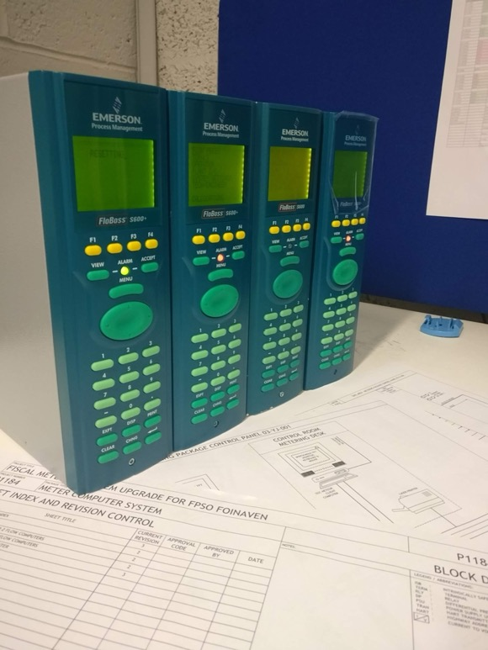

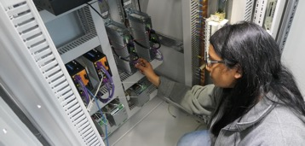
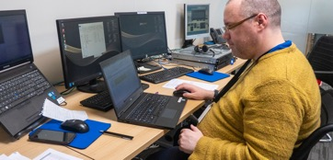
Proserv has considerable experience in the area of allocation metering and calculations.
Metering and allocation
FEED studies to into the metering in allocation systems
Flow computer system FDS
Meter selection and specification studies
Auditing of allocation metering
Production of allocation philosophy documentation
Consultancy on the upgrade and modification of allocation systems
Uncertainty analysis on allocation systems
Design and deployment of allocation software
Project management
Training in all aspects of allocation and metering

