Slide 1
Proserv ACT Solutions

Slide 2
Rejuvenate failing and unreliable subsea control system electronics
What is ACT
Augmented Control Technology (ACT)
Rejuvenate failing and unreliable subsea control system electronics
Alternative to the existing Original Equipment Manufacturer (OEM) for field extensions and upgrades
Greater reliability
Obsolescence solution
Extended well life
Upgraded monitoring and functionality
Cost savings
Better performance and operation
Improved environmental footprint
Replace Electronics
Refurbish SCMs
Co-exist with OEM
Upgraded SCS

Slide 3
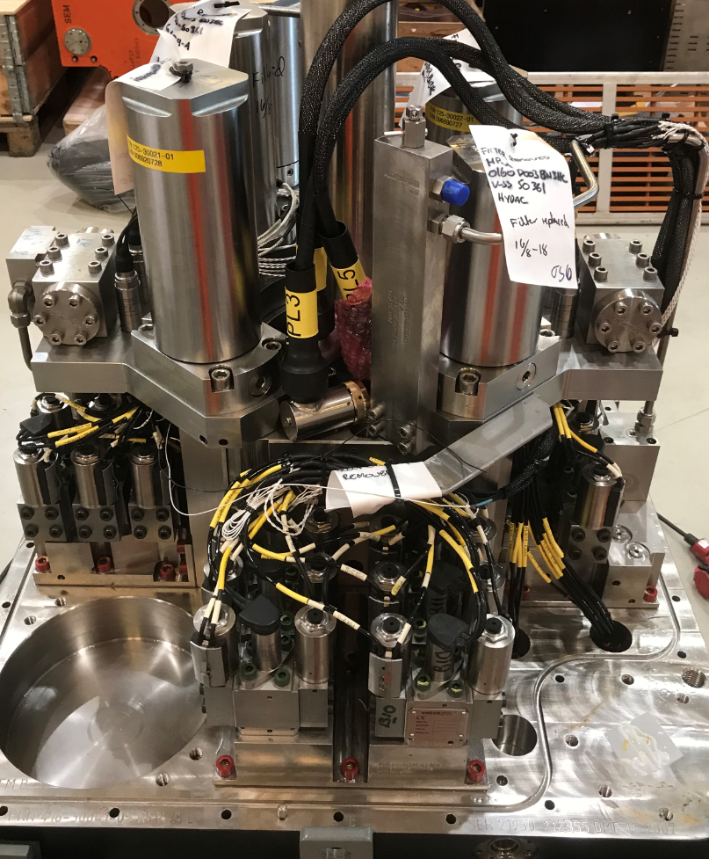
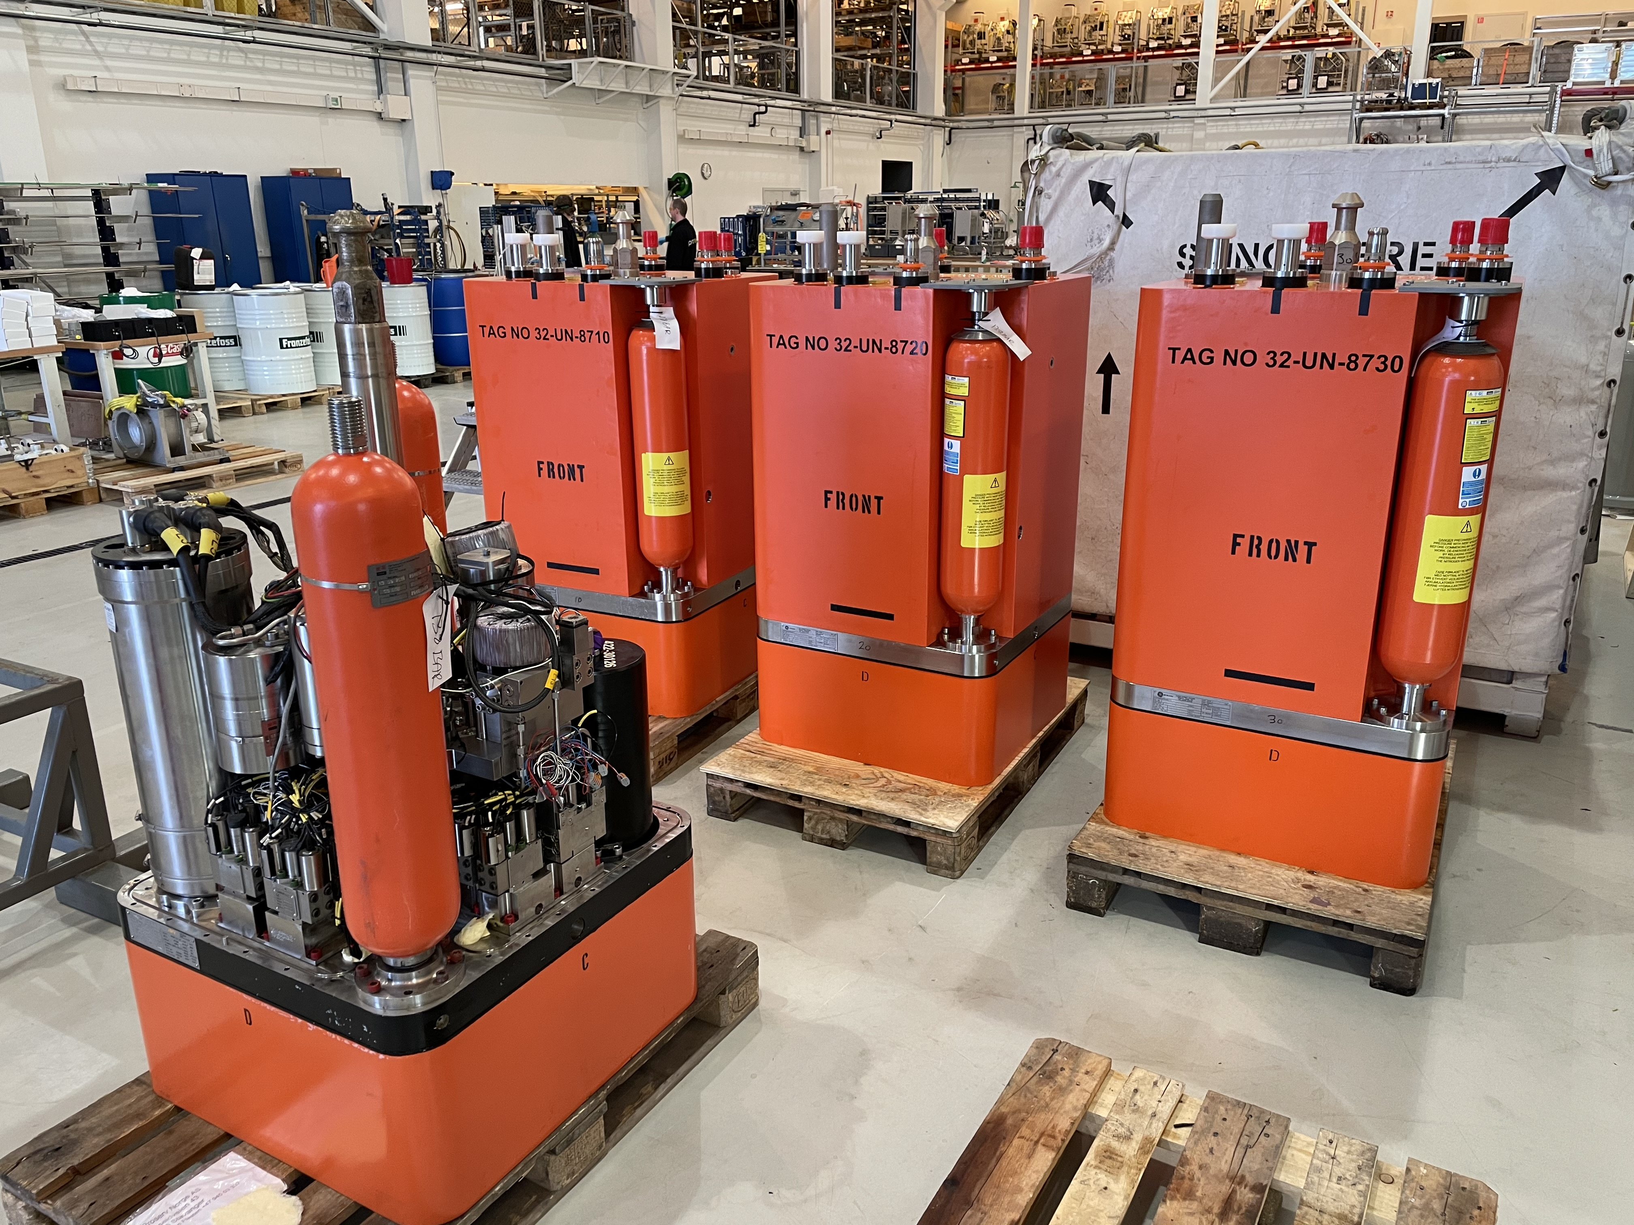
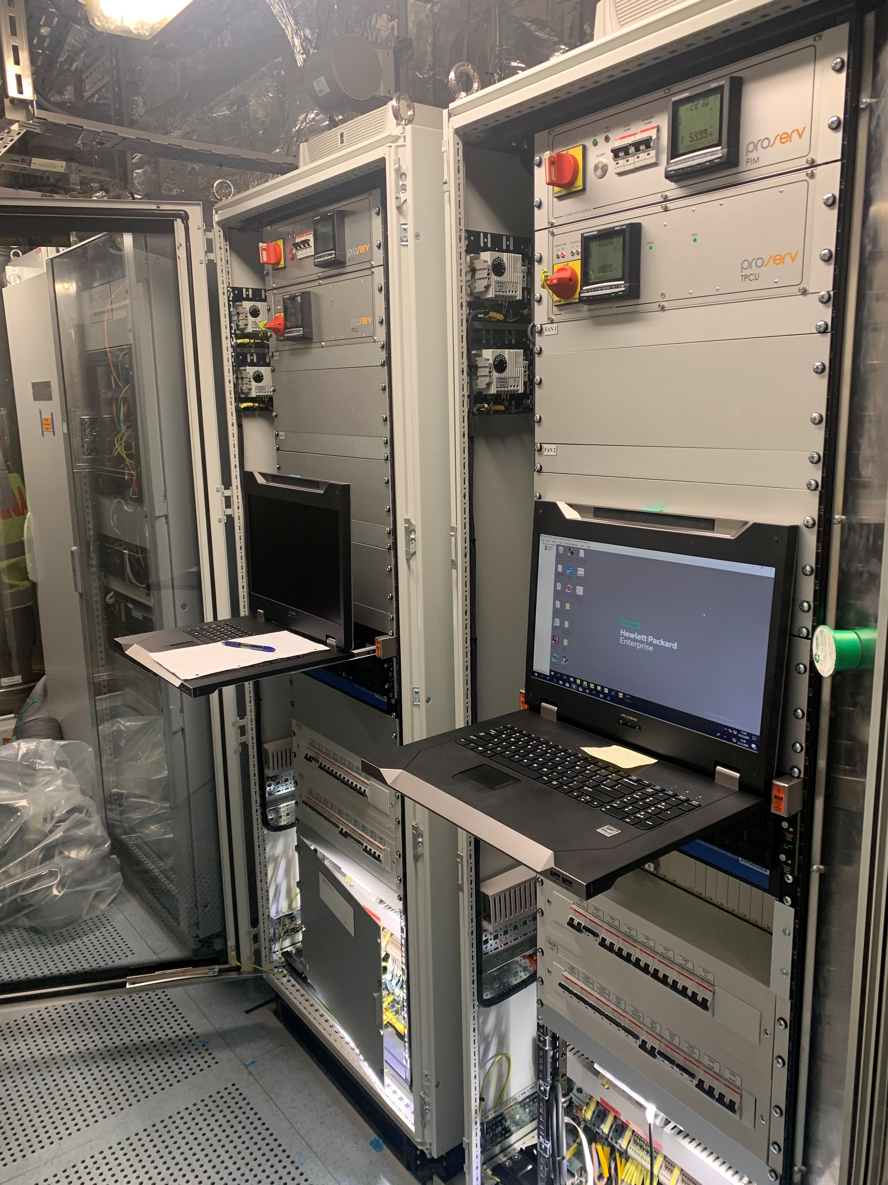
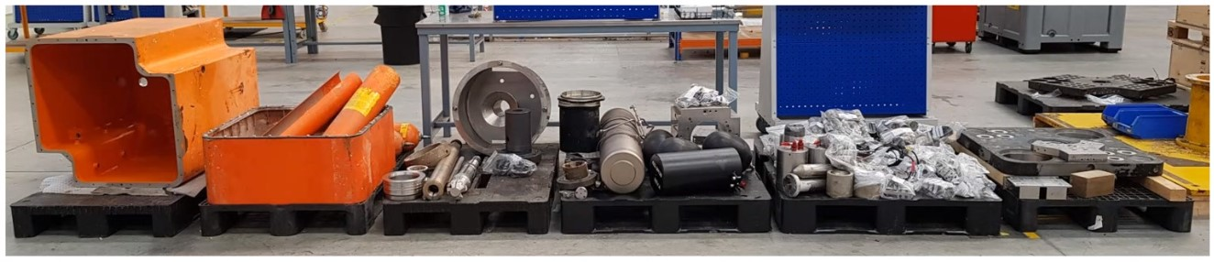
Upgrade, Replace, Co-exist, Refurbish
What is ACT
Upgraded SCS
Replace Electronics
Co-exist with OEM
Refurbish SCMs

Slide 4
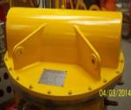
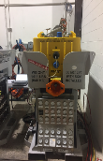
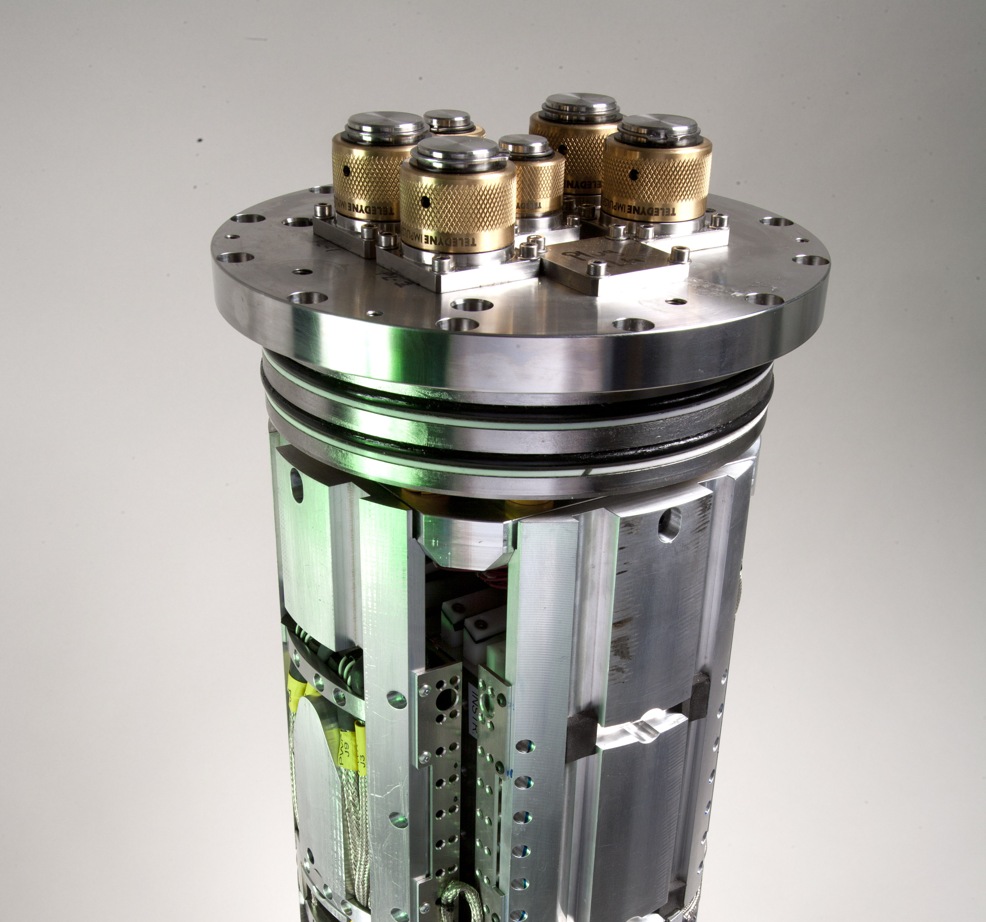
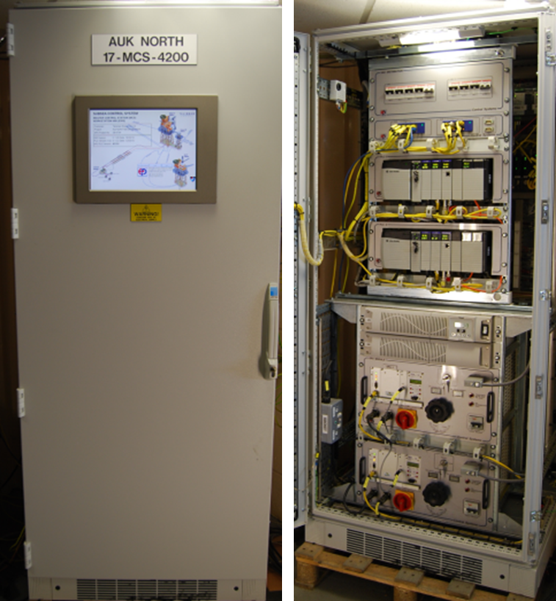
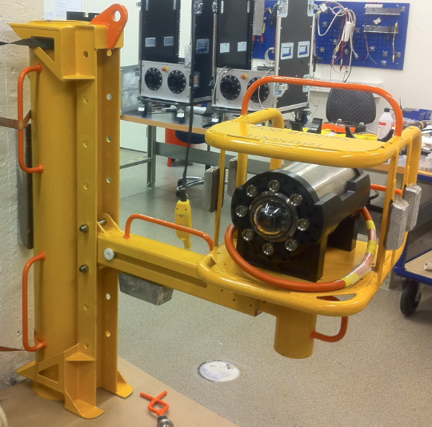
Brownfield upgrade options with Proserv means that you are no longer tied to the OEM
What is ACT
Operator Challenges
Obsolete equipment or OEM support
Risk of failure and poor reliability
Extend field for additional wells
Extend well life
Additional instrumentation for production optimisation
Proserv Solutions
Augmented Controls Technology
(ACT)
Retrofit A2G SEM Upgrade
SCM refurbishment
Co-exist
Topside upgrade
Adaptable solutions

Slide 5
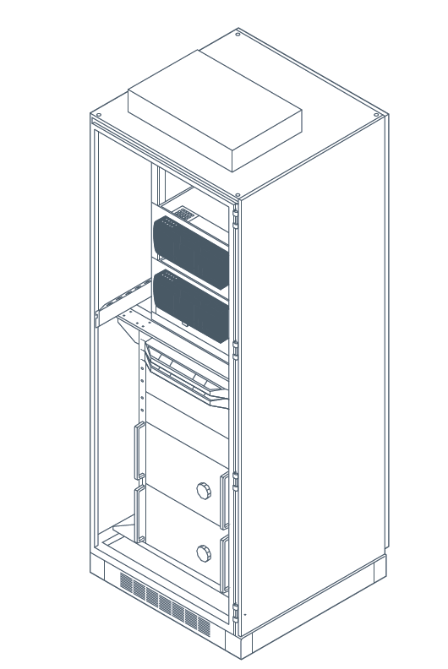
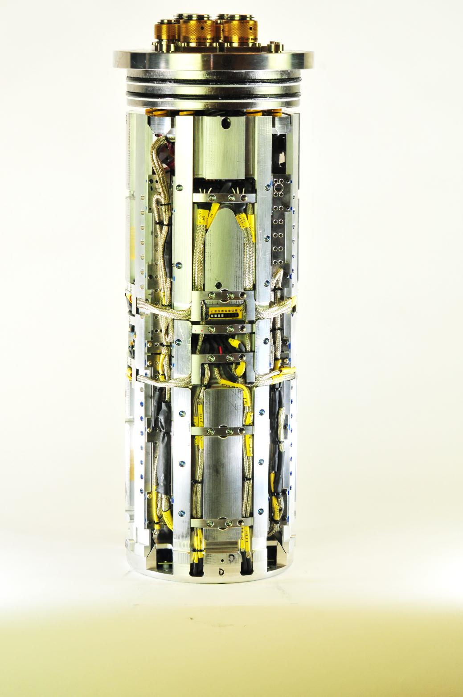
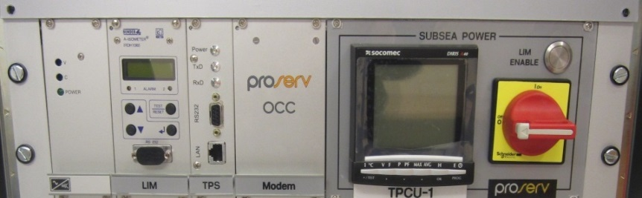
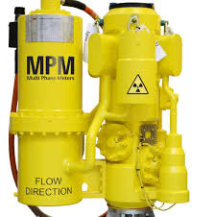
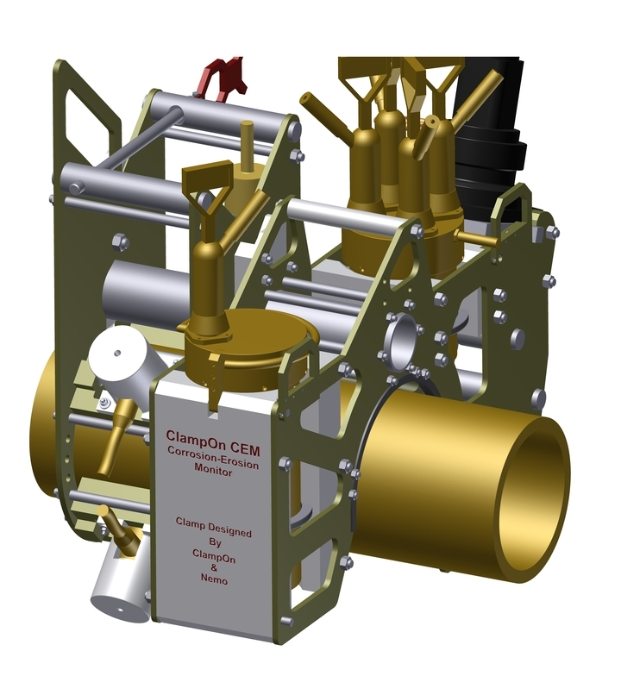
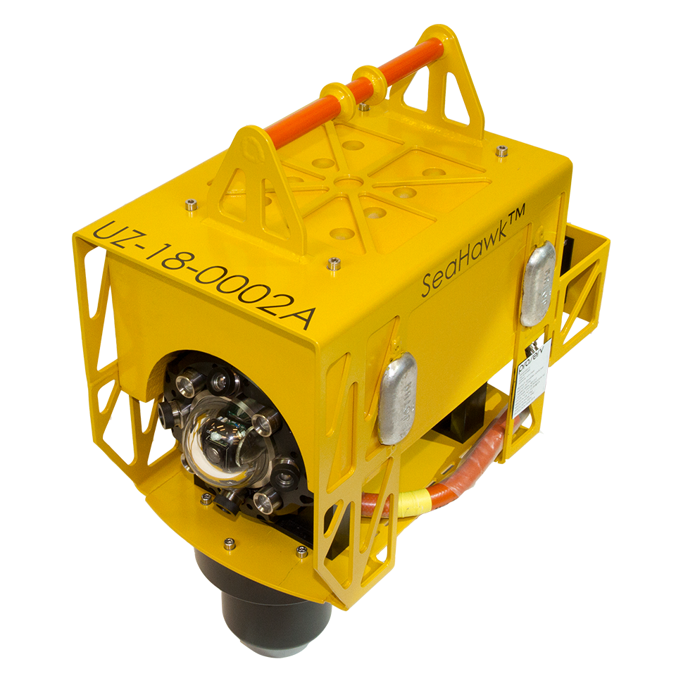
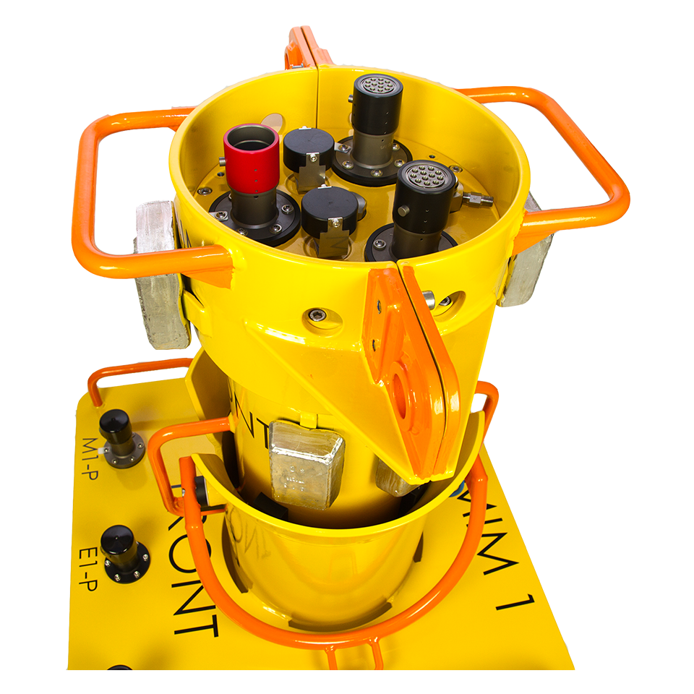
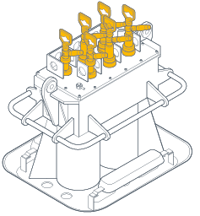
Extending life, extending fields, upgrading for new instrumentation and functions
What is ACT
Proserv SEM
Proserv SEM
Proserv SEM
Topside Power Control Unit
SCM
SCM
SCM
TUTU
SDU
Proserv SEM
Proserv TPCU
Existing Umbilical
Existing Umbilical
SCM
SDU
SDU
SeaHawk
SS Camera
Corrosion /
Erosion Monitor
Multi-Phase Flowmeter
Proserv SCM
Retrofit
DHPT
Existing subsea field
TPCU
Open Communication Hub (OCH) if required
Proserv co-exist equipment options

Slide 6
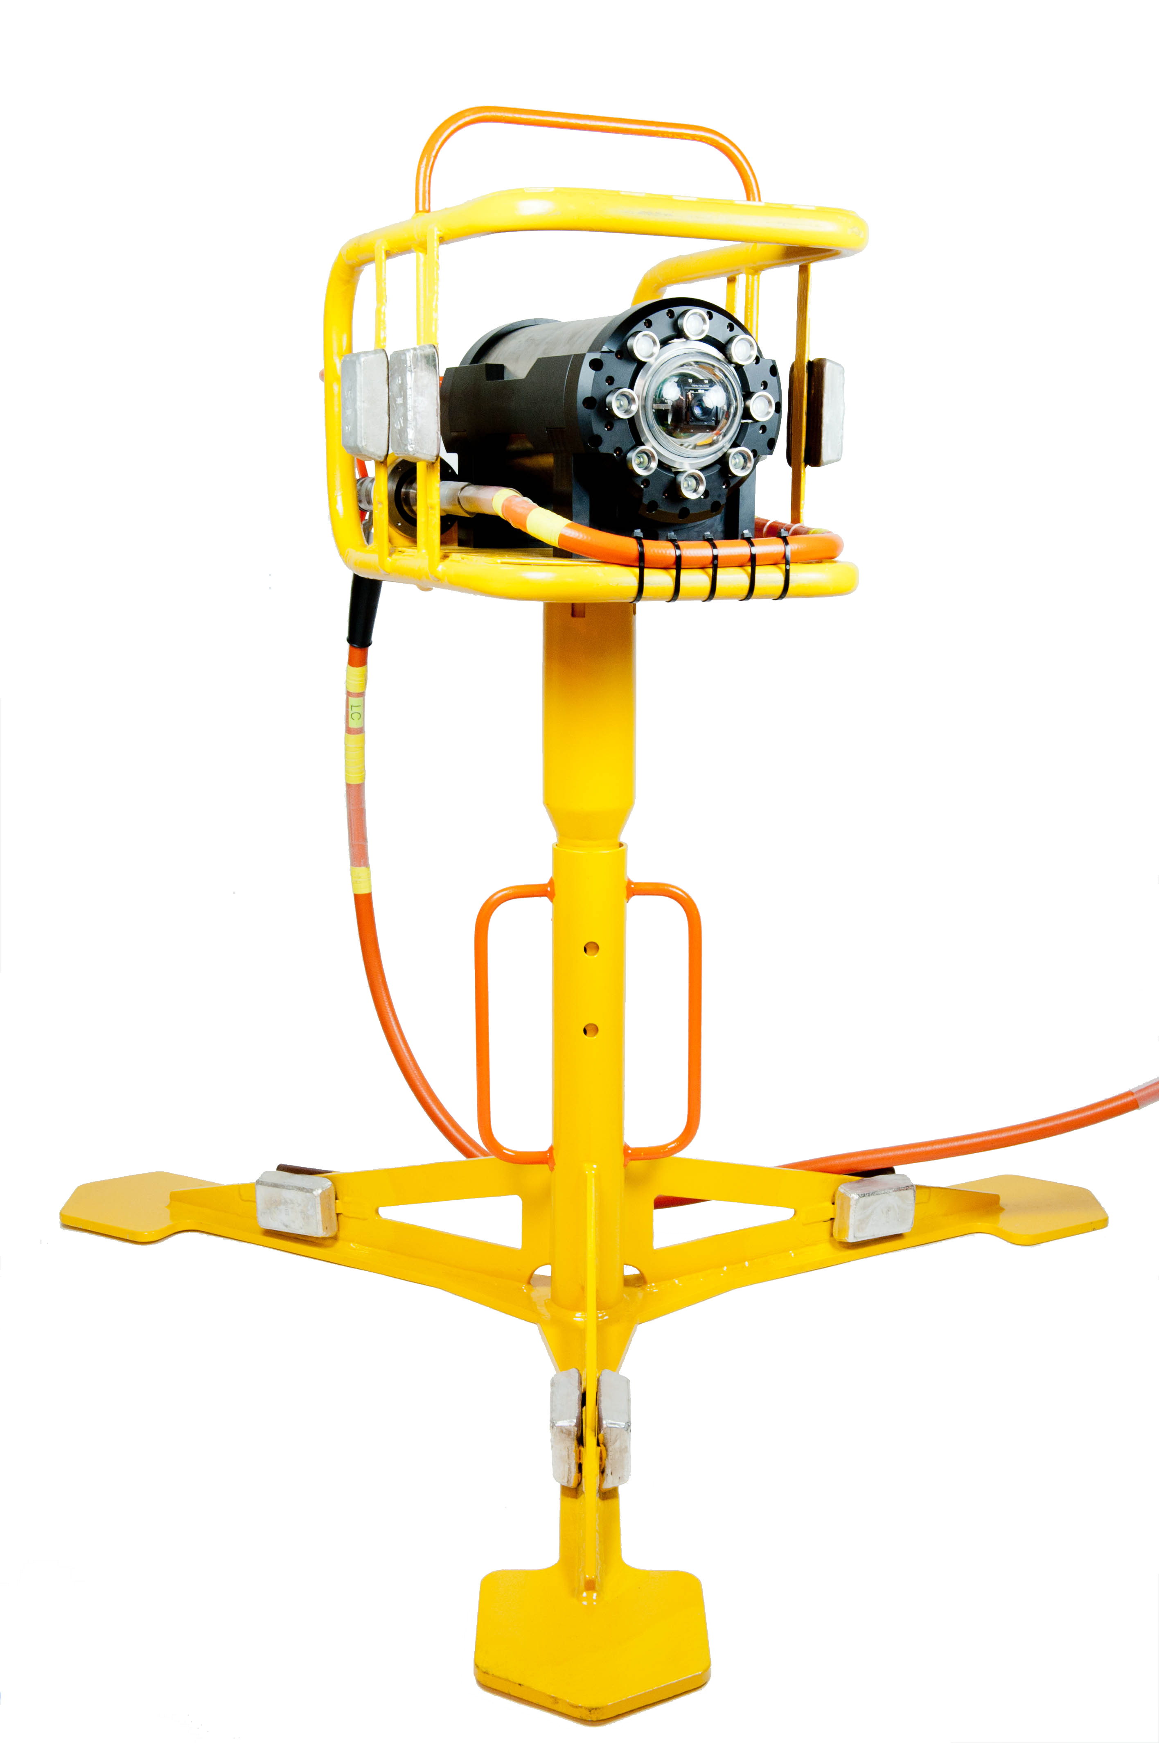
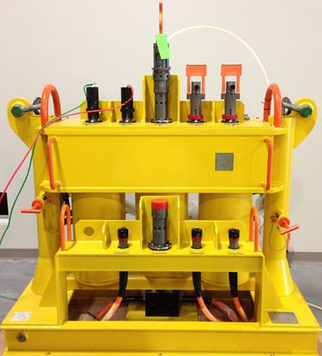
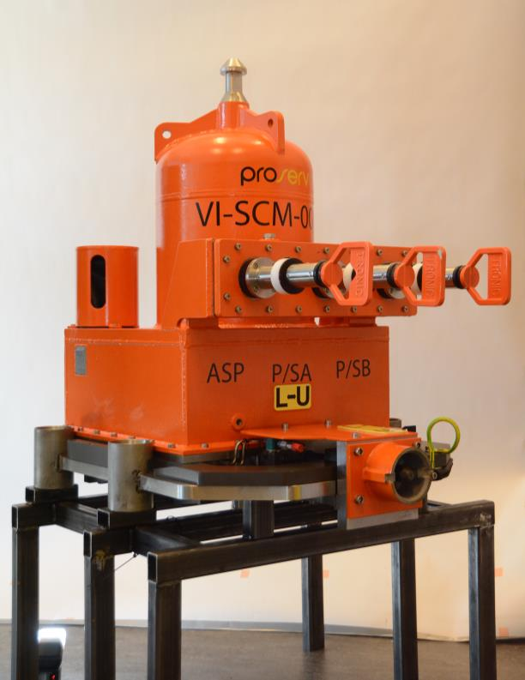
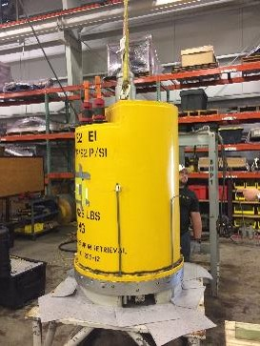
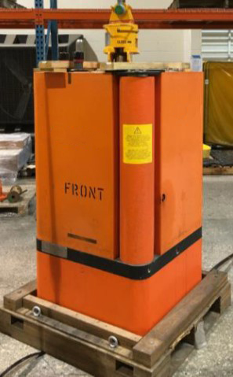
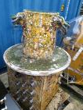
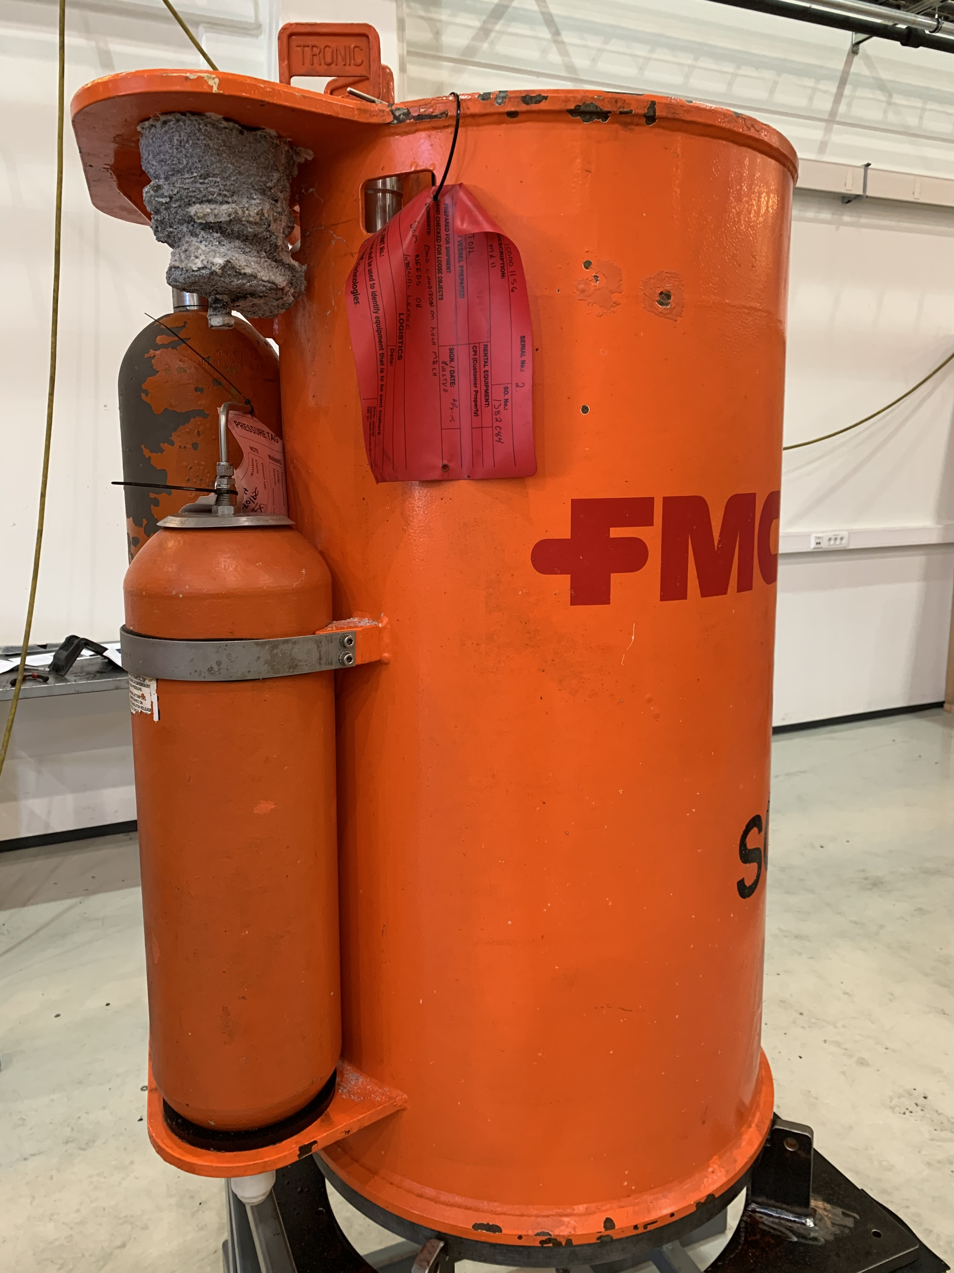
From co-exist for instruments to full data protocol solutions
History of ACT
2006
Co-exist for inclusion of SeaHawk leak detection camera on OEM control system
2011
Electronics replacement and co-exist on unsupported Aker SCM in North Sea
2012
Use of OCH for expanding 3rd party instrumentation on an existing subsea control system
2016
Full electronics replacement and SCM refurbishment as new. Topside interface was back compatible
2019
Full electronics replacement and co-exist solution for KOS150
2019
Full electronics replacement and co-exist solution for ICON
2019
Full electronics replacement and co-exist solution for Modpod
2023
Data protocol solution for KOS150, AKS and DQ

Slide 7
ACT solutions delivered and in development
ACT Solutions Available
FSSL 2nd Gen
(no current requirement)
3rd Gen
(successfully deployed)
4th Gen
(successfully deployed)
ICon
(successfully deployed)
Vectus
(identifying customers)
Aker
KOS100
(in progress)
KOS150
(delivered but not deployed)
200
(identifying customers)
200e
(identifying customers)
TFMC
GEC Marconi
(no current requirement)
ABB Seatec
(similar to modpod)
Modpod
(successfully deployed)
BHGE
Key
ACT Solution Available
Cameron Gen1
(successfully deployed)
2nd Gen
(solution available)
3rd Gen
(in progress)
OSS
ACT Solution In Development
No Current ACT Solution
Gen1 and Gen2
(solution available)
DQ

Slide 8
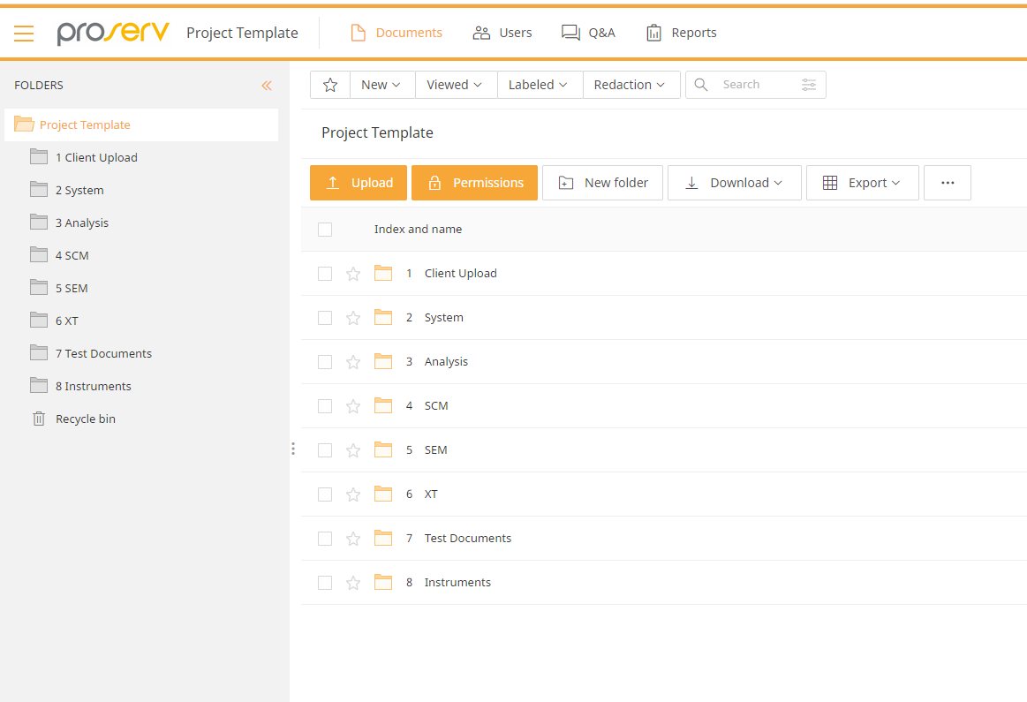
The ACT VDR protects both the client and Proserv employees from copyright infringement
ACT Virtual Data Room
The ACT projects often require study of customer and third-party information that may be subject to Intellectual Property (IP) rights that do not belong to Proserv, including information protected by Copyright.
Proserv respects valid third-party intellectual property rights and will not knowingly infringe such rights. Unauthorised use of third-party intellectual property rights may expose Proserv, Proserv Client and Proserv Personnel to potential legal claims, damages, and reputational loss.
The Proserv ACT VDR is a virtual data room where documents that contain copyright or otherwise sensitive information can be viewed in a robust manner without being inadvertently copied.
Data is held on a physical 3rd party server
encrypted in transfer and at rest,
is subject to an annual penetration test,
located within a SOC2 and ISO27001 certified datacentre,
compliant with GDPR, HIPPA and Privacy Shield Data Processing
All users only view documents in a view which uses a watermark feature
Users, other than the Proserv client, cannot download, save, print, copy or paste any information

Slide 9
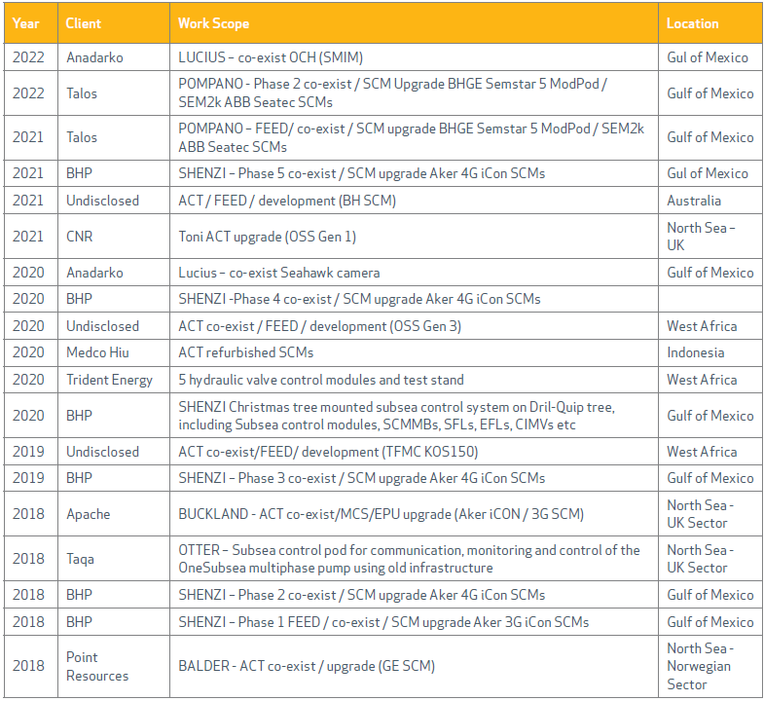
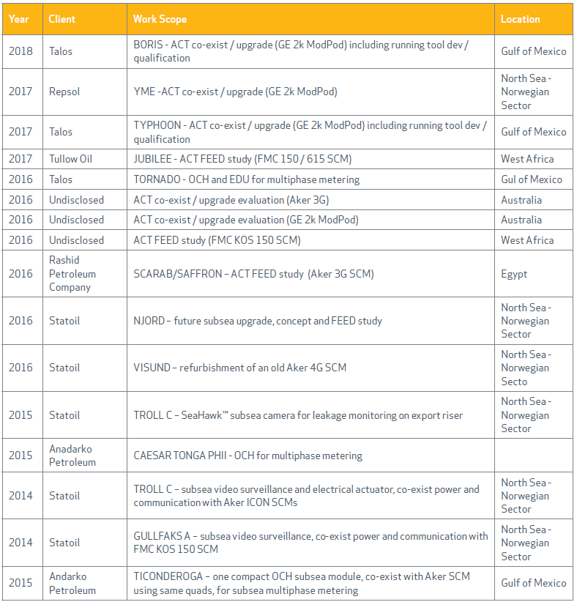
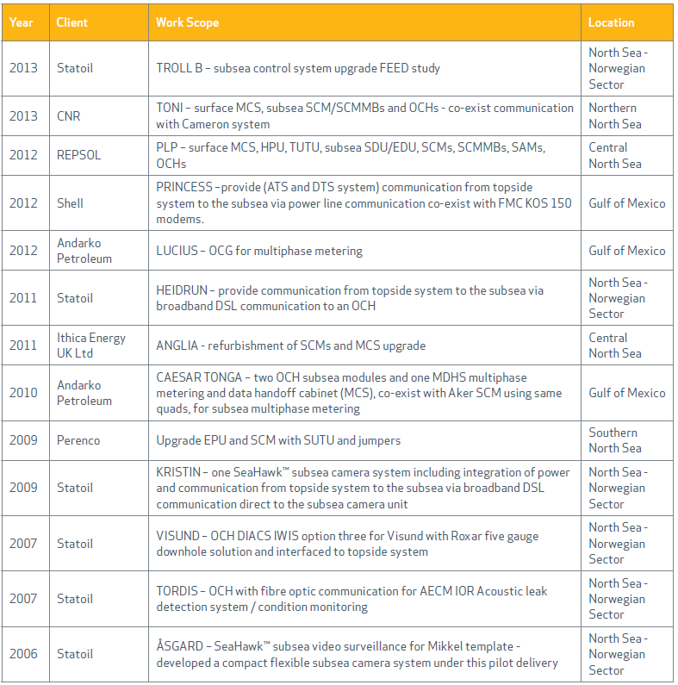
Track Record
ACT Projects
48 co-exist solutions delivered since 2006 to 16 different operators

Slide 10
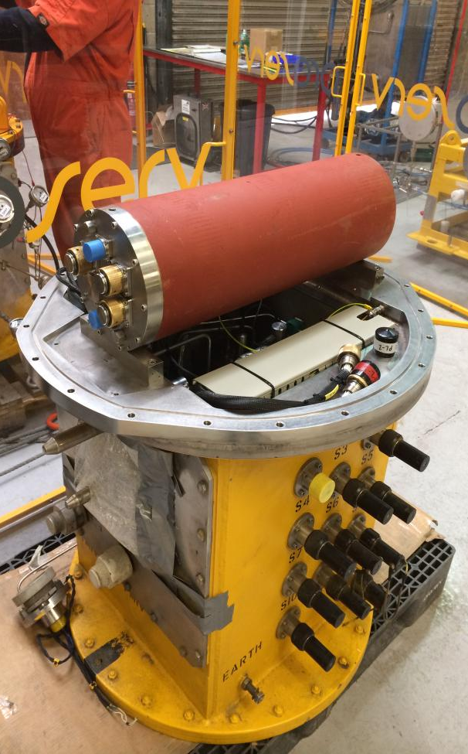

Obsolete SCM and technology upgrade - Ithaca Anglia
Case Study
The challenge
Upgrade and replace two obsolete Aker (FSSL) SCMs and upgrade topside facilities to include new MCS/EPUs
Why Proserv was chosen
New MCS required full integration into existing topside infrastructure without compromise to production
Existing SCMs are to be maintained for the subsea mechanical and electrical interfaces, which couldn’t be changed out
Inductive couplers and hydraulic couplers no longer available
The benefit to the customer
Extended field life at much reduced cost compared with total subsea change out and addressed obsolescence issues with electronics.
Provide continuing support for SCM, electronics and topside MCS
Ithaca Anglia upgrade 2014
North Sea
SEM upgrade and SCM refurbishment
Notes:
The Challenge
The client have been experiencing poor reliability with AK iCon SCMs on the Griffin field in the GOM. The field has three umbilicals approx. 12 km step out distances, each with up to 10 SCMs installed.
BHP approached Proserv who are currently in the FEED design of a major field upgrade which consists of the following Proserv SCM upgrade option.
Provide complete Life of Field services for AK Gen 4 SCMs.
Upgrade 6 Single SEM SCMs with Dual A2g SEM options providing greater availability and reliability.
Upgrade existing MCS with all new MCS using Rockwell PLCs
Provide a change out plan that allows co-exist with existing modules on each umbilical
Provide new Running tool
Proserv successfully completed co-exist testing with two AK SCMs onshore in Houma.
Later the subsea test module was deployed and this successfully co-existed with the production SCMs , finally proving that the Proserv system will operate without modifcations to existing OEM SCMs.

Slide 11

SCM retrofit due to obsolete OEM and technology upgrade
Case Study
The challenge
Client is experiencing poor reliability and future support for legacy SCMs
Consists of 3 umbilicals, each with up to ten SCMs, approx. 4-12 km step out
Why Proserv was chosen
Proserv’s A2G upgrades the SCMs to dual SEM architecture
Upgrade will co-exist with existing production SCMs in a phased change out
No additional modifications to existing OEM SCMs, except SEM upgrade
The benefit to the customer
Life of field extension (20 years extension)
Increased reliability and availability (Dual SEMs)
Lower cost to provide upgrade with local support
Still utilises existing inventory (spares)
Full MCS upgrade
Major operator, 2018/19
Gulf of Mexico
A2G SEM Upgrade and SCM refurbishment
Notes:
The Challenge
The client have been experiencing poor reliability with AK iCon SCMs on the Griffin field in the GOM. The field has three umbilicals approx. 12 km step out distances, each with up to 10 SCMs installed.
BHP approached Proserv who are currently in the FEED design of a major field upgrade which consists of the following Proserv SCM upgrade option.
Provide complete Life of Field services for AK Gen 4 SCMs.
Upgrade 6 Single SEM SCMs with Dual A2g SEM options providing greater availability and reliability.
Upgrade existing MCS with all new MCS using Rockwell PLCs
Provide a change out plan that allows co-exist with existing modules on each umbilical
Provide new Running tool
Proserv successfully completed co-exist testing with two AK SCMs onshore in Houma.
Later the subsea test module was deployed and this successfully co-existed with the production SCMs , finally proving that the Proserv system will operate without modifcations to existing OEM SCMs.

Slide 12
North Sea legacy subsea control module (SCM) – refurbishment
Case Study
The challenge
Refurbish a legacy SCM and upgrade with new Proserv A2G subsea electronics module (SEM)
Reuse all hydraulic parts and sensors, replacing only if necessary
Upgrade module to support redundant power/signal
Why Proserv was chosen
Market leading SEM reliability
Flexible system with an open, high bandwidth topside interface
The benefit to the customer
Cost effective, since most SCM parts are durable and will now be reused
Co-exist compatible with standard legacy OEM SCMs
Redundant supply and communication
New interfaces such SIIS level 1, 2, 3 available
Repsol, 2019
Norway, North Sea
MODPOD SCM
Notes:
Upgrade of 5 GE 2k SCM
Contract award : Jan 2018
EFAT: Feb 2019 - approx. 1 year after contract signed
Delivery: 2019
Scope of Work
Refurbish GE 2k MODPOD and upgrade with new A2G SEM
Reuse all hydraulic parts and sensors, replace only if necessary
Upgrade module to support redundant power/signal
Deliverables:
5 off refurbished SCMs, upgraded with new A2G SEMs
MCS inclusive integrated solution with ABB and 6 off Topside Power and Communication Unit (TPCU) prepared for 12 wells
HPU combined for topside and subsea wells
Benefits
Cost effective, since most SCM parts are durable and will now be reused
High bandwidth and open topside interface
Co-exist compatible with standard GE MODPOD SCM’s
Redundant supply and communication
Flexible system
Market-leading SEM reliability
New interfaces such SIIS level 1, 2, 3 a.o.
available if required
Open and flexible topside interface

